Slide 1
Week 5
Developing Marketing Strategy through Marketing Segmentation Targeting and Positioning

Slide 2
Week 4
Recap

Slide 3

Marketing Information and Customer Insights
Customer insights:
Fresh understandings of customers and the marketplace derived from marketing information that become the basis for creating customer value and relationships.
(To create value for customer, marketers must first gain fresh, deep insights into what customers need and want)
Notes:
consumers themselves usually can’t tell you exactly
what they need and why they buy. To gain good customer insights,
marketers must effectively manage marketing information from a
wide range of sources.

Slide 4
Marketing Information systems (MIS)
Marketing information system (MIS) refers to People, and procedures to gather, sort, analyse, evaluate and distribute needed and accurate information to marketing decision makers to generate customer insight
A marketing information system (MIS) provides information to the company’s marketing and other managers and external partners such as suppliers, resellers, and marketing service agencies.

Slide 5
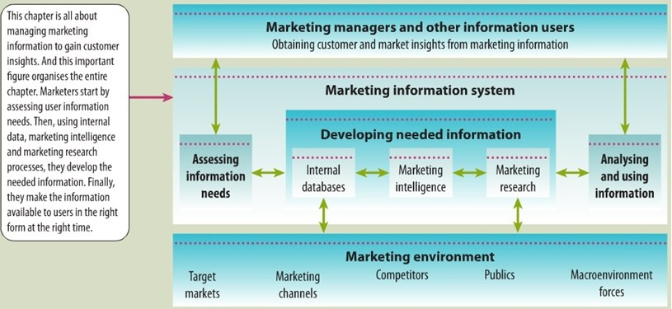
Marketing Information systems (MIS)

Slide 6
MIS
First, managers assess their information needs.
Next, developing the needed information from internal company records, marketing intelligence activities and the marketing research process.
Information analysis processes the information to make it more useful.
Finally, the MIS distributes information to managers in the right form at the right time to help them in marketing planning, implementation and control.

Slide 7
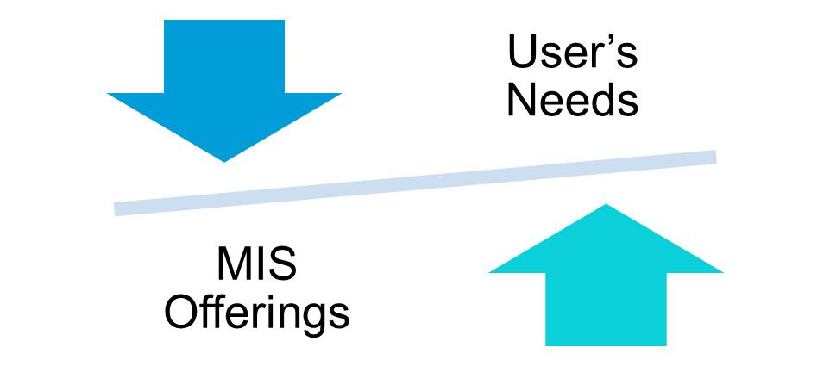
Assessing Marketing Information
Needs
A good MIS balances what the information users would like to have against what they really need and what is feasible to offer.

Slide 8
Developing Marketing Information
Marketers obtain information from
1 Internal data
2. Competitive Marketing intelligence
3. Marketing research
Notes:
The problem isn’t finding
information; the world is
bursting with information from a glut
of sources. The real challenge is to find
the right information—from inside and
outside sources—and turn it into
customer insights.

Slide 9

1. Internal data
Internal databases are electronic collections of consumer and market information obtained from data sources within the company network
(Marketing department, financial reports, customer service, company website , shipment)
Information from internal records
is usually quicker and cheaper
however has some problems because it
Collected for another purpose.

Slide 10
2. Competitive Marketing Intelligence
Competitive marketing intelligence: The systematic collection and analysis of publicly available information about consumers, competitors, and developments in the marketing environment.
(from social media, competitors, executives, engineers and scientists, purchasing agents, and the sales force, also supplier and resellers and customers)
Purpose:
to improve strategic decision
understanding the consumer environment,
assessing and tracking competitors’ actions,
providing early warnings of opportunities and threats.

Slide 11
3. Marketing research
Marketing research : The systematic design, collection, analysis, and reporting of data relevant to a specific marketing situation facing an organisation.
marketing research gives marketers insights into customer motivations, purchase behaviour, and satisfaction. It can help them to assess market potential and market share or measure the effectiveness of pricing, product, distribution, and promotion activities.
The marketing research process has four steps :
1. Defining the problem and research objectives,
2. Developing the research plan,
3. Implementing the research plan,
4. Interpreting and reporting the findings.

Slide 12

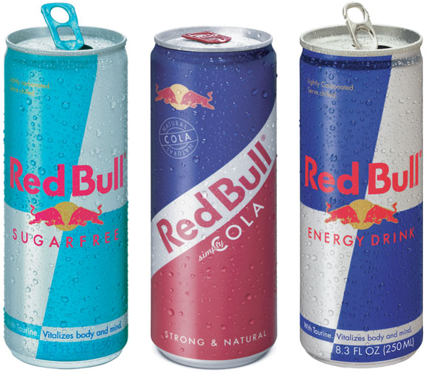
Marketing research process

Slide 13
Defining the Problem and Research Objectives
After the problem has been defined carefully, the manager and the researcher must set the research objectives.
Marketing research project might have one of three types of objectives.:
1. Exploratory research: gathering primary information that will help deﬁne the problem and suggest hypotheses.
2. Descriptive research: describing things such as the market potential for a product or the demographics and attitudes of consumers who buy the product.
3. Causal research: testing hypotheses about cause-and-effect relationships. (Through experiment)
Notes:
Exploratory research (focused group, open-ended questions
2. Descriptive research: closed ended questions

Slide 14
Developing the Research Plan
(Data collection)
To meet the manager’s information needs, the research plan can call for gathering secondary data, primary data, or both.
Secondary data consist of information that already exists somewhere, having been collected for another purpose
Companies can buy secondary data reports from outside suppliers or they can use Internet search engines
Primary data consist of information gathered for the special research plan
Companies need to design a plan for primary data collection calls for a number of decisions on research approaches, contact methods, the sampling plan, and research instruments.

Slide 15
Group Presentations Assesements 1 Batch 1
9th February 2022

Slide 16
Week 5 STPD

Slide 17
Customer-Driven Marketing Strategy:
Creating Value for Target Customers
Four major steps in designing a customer-driven marketing strategy: (STPD)
Market Segmentation
Market Targeting
Positioning
Differentiation

Slide 18
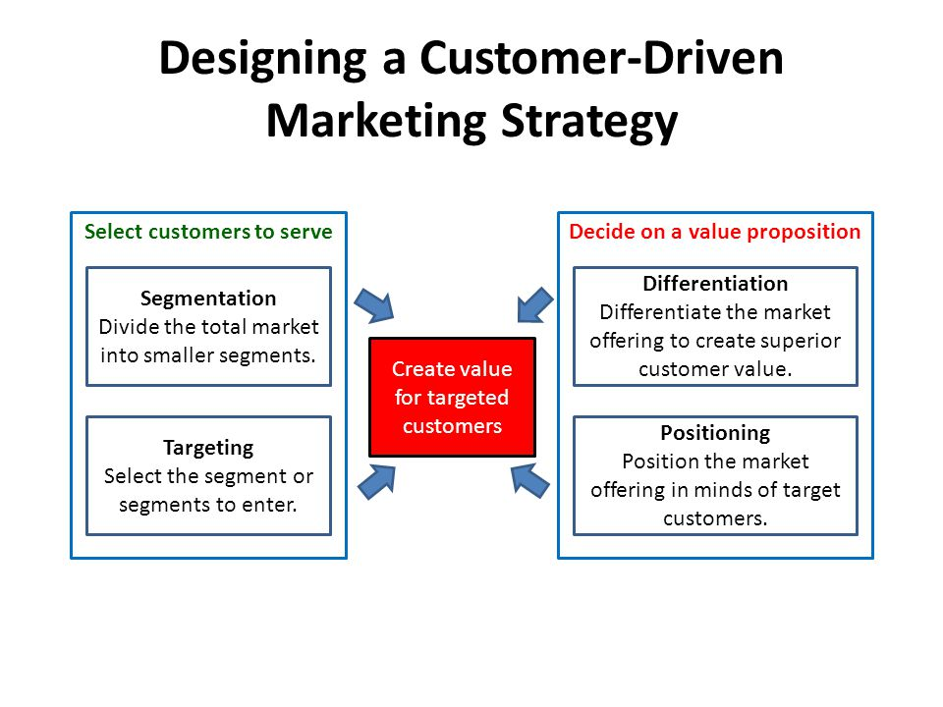

Slide 19
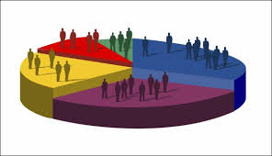
1. Segmentation
Market segmentation— Dividing a market into distinct groups of buyers with different needs, characteristics or behaviour, who might require separate products or marketing mixes.
Demographic segmentation
Psychographic segmentation
Behavioural segmentation
Intermarket/ Cross-market segmentation: consumers who have similar needs but they are in different countries

Slide 20
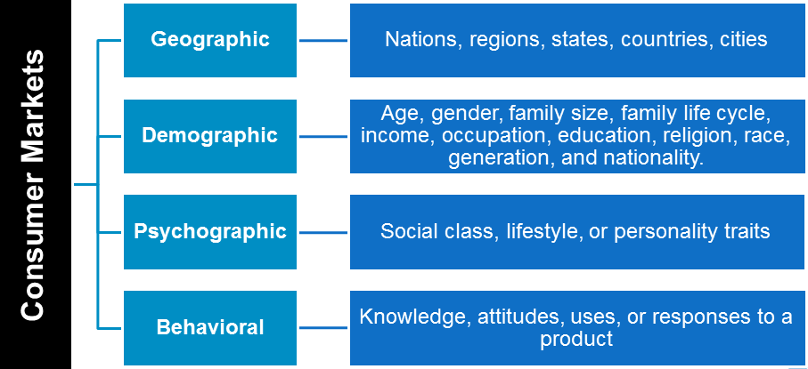
Market segmentation

Slide 21
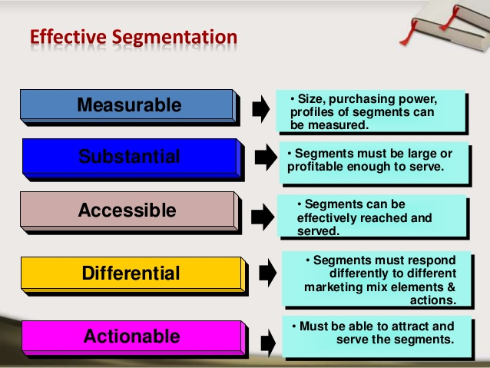
Requirements for Effective Segmentation

Slide 22
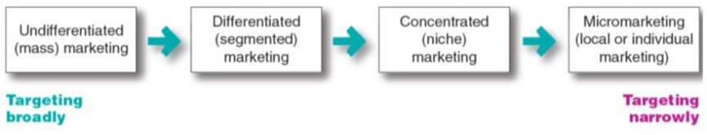
2. Market-targeting Strategy
A target market is a set of buyers who share common needs or characteristics that the company decides to serve.
Selecting a Target Market

Slide 23
Market-targeting strategies
1. Undifferentiated (mass) marketing targets the whole market with one offer.
  Mass marketing
  Focuses on common needs rather than what’s different
2. Differentiated marketing targets several different market segments and designs separate offers for each. (BMW produces several different brands of cars)
3. Concentrated (Niche)marketing targets a large share of a smaller market, Limited company resources . (Organic foods)
Knowledge of the market and customer’s need
More effective and efficient, few competitors

Slide 24
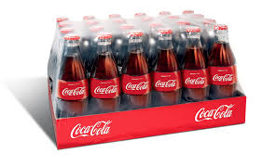

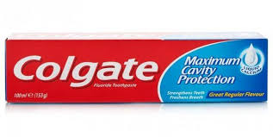
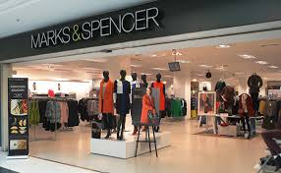


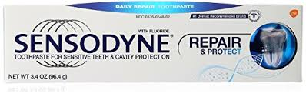

Slide 25


Market-targeting strategies
4. Micromarketing is the practice of tailoring products and marketing programs to suit the tastes of specific individuals and locations.
Local Marketing involves tailoring brands and promotion to the needs and wants of local customer segments.
(Cities. Neighborhoods, Stores)
2. Individual marketing involves tailoring products and marketing programs to the needs and preferences of individual customers.
Also known as: One-to-one marketing, customization
(Cabinet maker, tailoring a suit)

Slide 26


3. Positioning
Product position is the way the product is defined by consumers on important attributes—the place the product occupies in consumers’ minds relative to competing products. A product’s position is the complex set of:
Perceptions
Impressions
Feelings
Marketer must design marketing mix to
create theses planned position
Notes:
marketers do
not want to leave their products’ positions to chance. They must plan positions that will give
their products the greatest advantage in selected target markets, and they must design marketing mixes to create these planned positions.

Slide 27
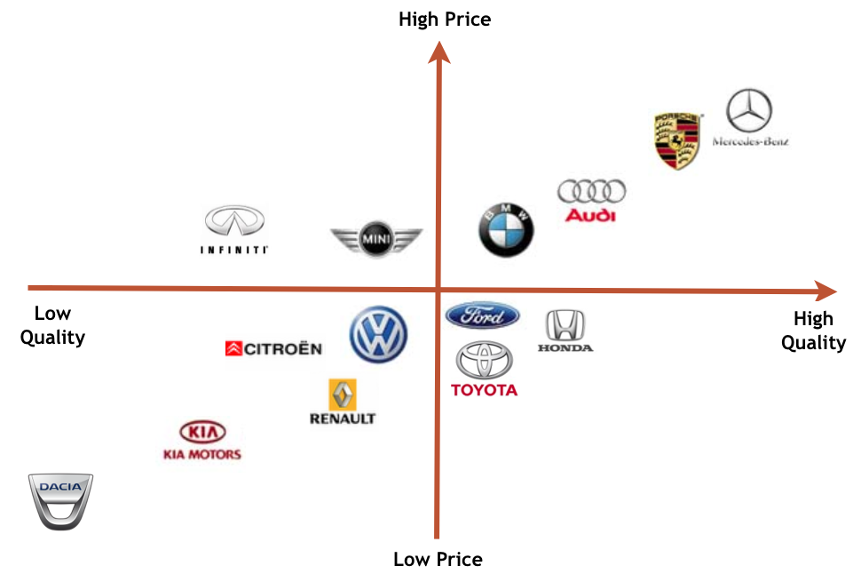
Positioning map
In planning their differentiation and positioning strategies, marketers often prepare perceptual positioning maps that show consumer perceptions of their brands versus competing products on important buying dimensions

Slide 28
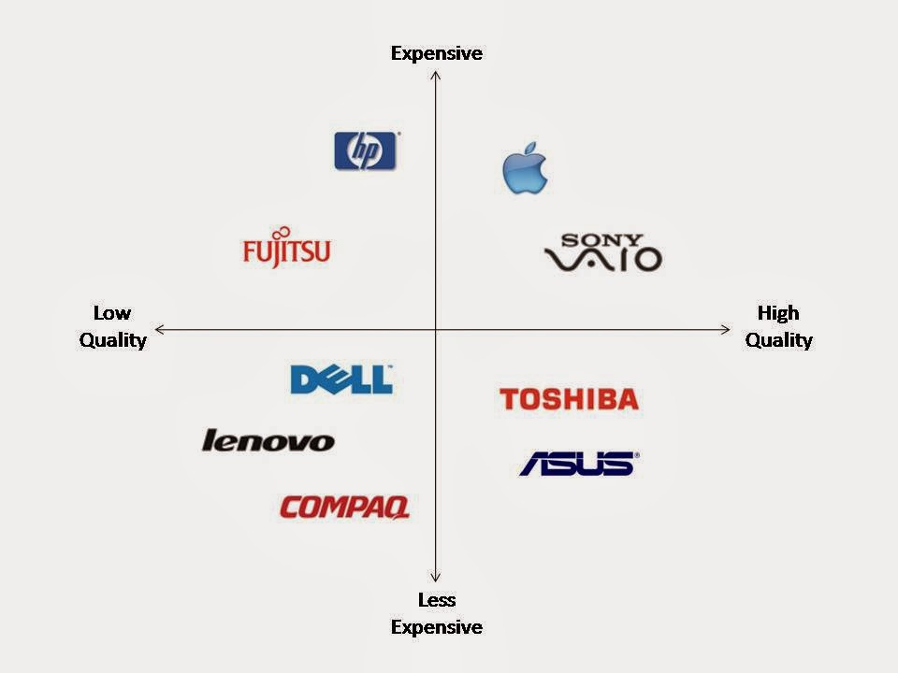

Slide 29
4. Differentiation & Positioning Strategy
A Brand’s positioning must serve the needs and preferences of well-defined target markets.
The differentiation and positioning task consists of three steps:
1. Identifying a set of possible competitive advantages to build a position.
2. Choosing the right competitive advantage to build a position.
3. choosing the right competitive advantages, and selecting an overall positioning strategy.
Competitive advantage: An advantage over competitors gained by offering greater customer value, either by having lower prices or providing more benefits that justify higher price.

Slide 30
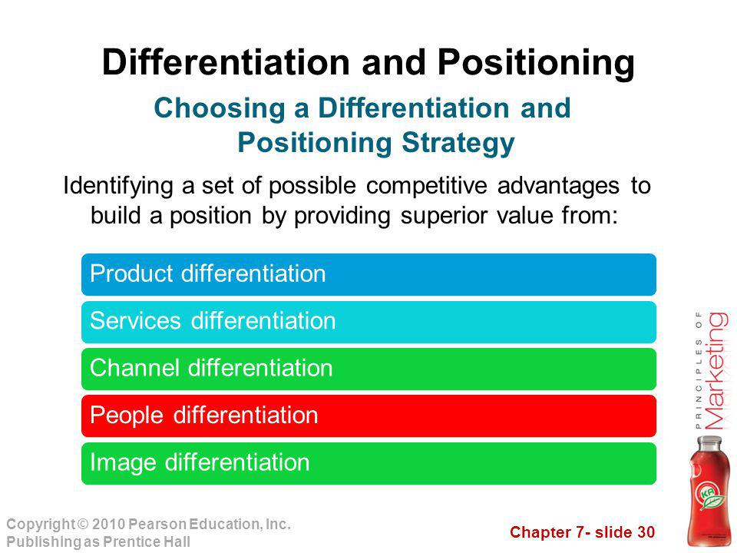

Slide 31
Differentiation and Positioning
Possible competitive advantages to build a position
Product differentiation : distinctive design, quality , package or performance (Subway differentiates itself as the healthy fast-food choice. )
Services differentiation : a firm can also differentiate the services that accompany the product. (Tesco open 24h)
People differentiation: strong competitive advantage through hiring and training better people than their competitors do (Singapore airline flight attendant )
Channel differentiation: gain competitive advantage through the way they design their channel’s coverage, expertise, and performance. ( Amazon)
Image differentiation : Companies design signs and logos that provide distinctive benefits and positioning. (IBM, Nike, Apple)

Slide 32

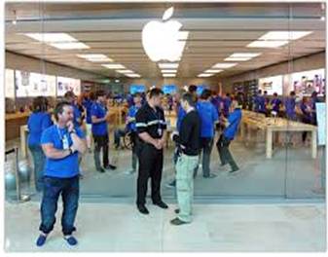

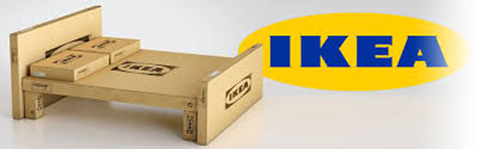






Slide 33
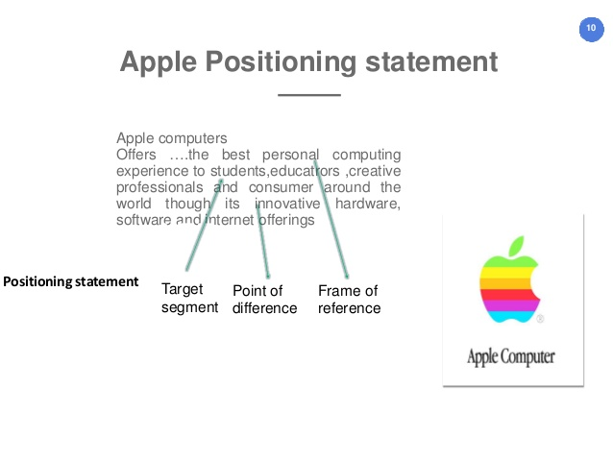

Slide 34
Quick Test 1
3. Explain how companies identify attractive market segments and choose a market targeting strategy:
four market-targeting strategies :
Undifferentiated (or mass) marketing.
Differentiated marketing
Niche marketing (concentrated marketing)
Micromarketing (Local marketing or Individual marketing )

Slide 35
Seminar Activity
Select an organisation of your choice in either the hospitality or transportation or the mobile telephony industry
With this company please undertake the following activities
Identify the segments that your selected business operate in?
What methods do your selected organisation use to target customers
What methods does your selected organisation use to create awareness by themselves(Positioning)
Your business Differentiation Strategy

Slide 36
Summary
Define the major steps in designing a customer-driven marketing strategy: market segmentation, targeting, differentiation, and positioning.
List and discuss the major bases for segmenting consumer and business markets: geographic, demographic, psychographic, and behavioural
demographic variables, including age, gender, family size, family life cycle, income, occupation, education, religion, race, generation, and nationality
psychographic : social class, lifestyle, or personality characteristics

