Slide 1
Week 4
Managing Marketing
Information to Gain Customer Insights
Marketing Research

Slide 2
Week 3 Recap
Environmental forces that affect the company’s ability to serve its customers.
Changes in the demographic and economic environments and marketing decisions
Major trends in the firm’s natural and technological environments.
Key changes in the political and cultural environments.
How companies react to the marketing environment.

Slide 3

The Marketing Environment
The marketing environment includes the actors and forces outside marketing that affect marketing management’s ability to build and maintain successful relationships with target customers
    The Microenvironment
    The Macro environment

Slide 4
The marketing environment
The marketing environment consists of the factors and forces that affect a company’s capability to operate effectively in providing products and services to its customers. We can identify three levels in the environment around the organisation:
Internal environment - This comprises internal factors that exist within an organisation.
The micro environment - This comprises those factors external to a business that directly affect the running of the business and over which it can exert some control.
The macro environment - This comprises a complex set of uncontrollable variables which collectively form a framework within which organisations conduct business.

Slide 5
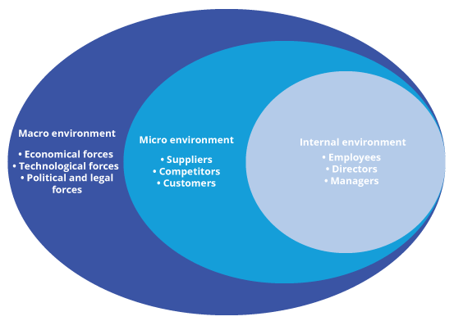
The marketing environment
The three levels in the environment are illustrated below:

Slide 6
VIDEO ON PESTLE
https://youtu.be/eGLFVjs1Zak

Slide 7
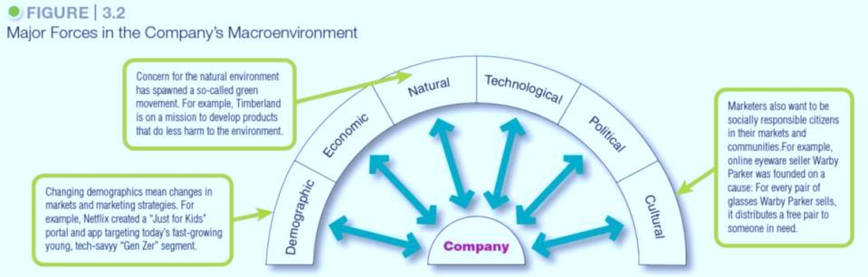
Macro-environment
Notes:
As shown in Figure 3.2, the company and all of the other actors operate in a larger macroenvironment of forces that shape opportunities and pose threats to the company.
Even the most dominant companies can be vulnerable to the often turbulent and changing forces in the marketing environment. Some of these forces are unforeseeable and uncontrollable. Others can be predicted and handled through skillful management.
Companies that understand and adapt well to their environments can thrive. Those that don’t can face difficult times.

Slide 8
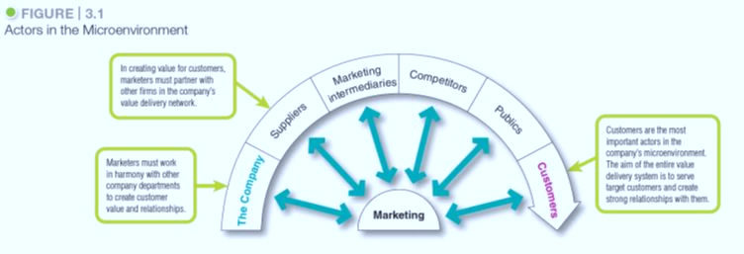
The Factors in the micro-environment

Slide 9
Assesements 1 ? Group Presentation Deadline 9th & 16th February 2022
Assessment criteria | Maximum Marks
Introduction and Background | 10%
Environmental Analysis (Internal and External Analysis) | 20%
SOWT Analysis and Summary of the issues based on the analysis | 15%
Market Research Primary/Secondary data collection (linked to the issues) is required | 15%
Conclusion and Recommendations– Recommendation should be based on issues being considered as weakness and threats identified in the SWOT analysis | 20%
Presentation style and format, Professionalism, and contribution to the group work | 20%

Slide 10
Environmental Analysis
Macro Factors
PESTLE
Micro
Porters 5 Forces
Companies Positioning map vs competitors
Internal
Organisational resources
Capabilities of the organisation

Slide 11
SWOT Analysis
Opportunities
Threats
Strengths
Weakness

Slide 12
Sources of collecting information
Where did you collect information for your presentation?
How legitimate were the sources ?
How does the sources help in collecting the information for the presentation?
Were the sources secondary or primary ?

Slide 13
Recommendations based on SWOT
..
..
..
..

Slide 14
Consumer Behaviour and Coca Cola
https://youtu.be/aGfdubLAtY8

Slide 15
Week 4
Managing Marketing
Information to Gain Customer Insights

Slide 16
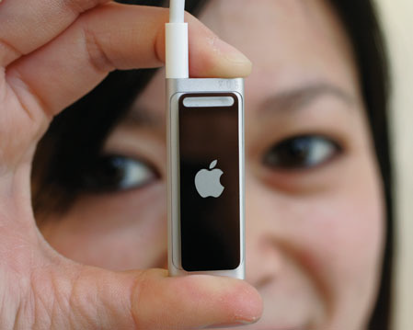
Marketing Information and Customer Insights
Customer insights:
Fresh understandings of customers and the marketplace derived from marketing information that become the basis for creating customer value and relationships.
(To create value for customer, marketers must first gain fresh, deep insights into what customers need and want)
Notes:
consumers themselves usually can’t tell you exactly
what they need and why they buy. To gain good customer insights,
marketers must effectively manage marketing information from a
wide range of sources.

Slide 17
Marketing Information systems (MIS)
Marketing information system (MIS) refers to People, and procedures to gather, sort, analyse, evaluate and distribute needed and accurate information to marketing decision makers to generate customer insight
A marketing information system (MIS) provides information to the company’s marketing and other managers and external partners such as suppliers, resellers, and marketing service agencies.

Slide 18
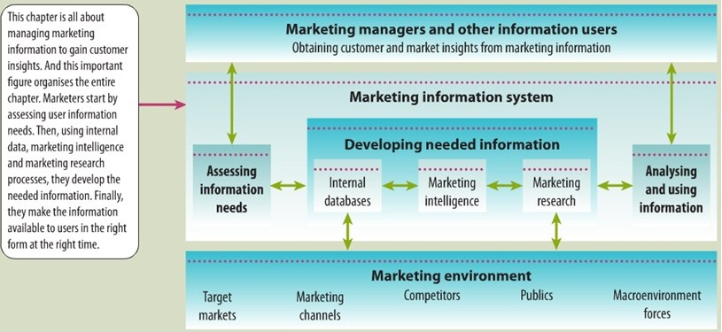
Marketing Information systems (MIS)

Slide 19
MIS
First, managers assess their information needs.
Next, developing the needed information from internal company records, marketing intelligence activities and the marketing research process.
Information analysis processes the information to make it more useful.
Finally, the MIS distributes information to managers in the right form at the right time to help them in marketing planning, implementation and control.

Slide 20
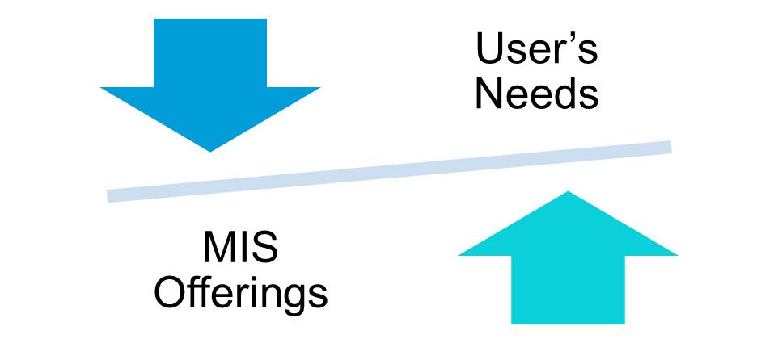
Assessing Marketing Information
Needs
A good MIS balances what the information users would like to have against what they really need and what is feasible to offer.

Slide 21
Developing Marketing Information
Marketers obtain information from
1 Internal data
2. Competitive Marketing intelligence
3. Marketing research
Notes:
The problem isn’t finding
information; the world is
bursting with information from a glut
of sources. The real challenge is to find
the right information—from inside and
outside sources—and turn it into
customer insights.

Slide 22

1. Internal data
Internal databases are electronic collections of consumer and market information obtained from data sources within the company network
(Marketing department, financial reports, customer service, company website , shipment)
Information from internal records
is usually quicker and cheaper
however has some problems because it
Collected for another purpose.

Slide 23
2. Competitive Marketing Intelligence
Competitive marketing intelligence: The systematic collection and analysis of publicly available information about consumers, competitors, and developments in the marketing environment.
(from social media, competitors, executives, engineers and scientists, purchasing agents, and the sales force, also supplier and resellers and customers)
Purpose:
to improve strategic decision
understanding the consumer environment,
assessing and tracking competitors’ actions,
providing early warnings of opportunities and threats.

Slide 24
3. Marketing research
Marketing research : The systematic design, collection, analysis, and reporting of data relevant to a specific marketing situation facing an organisation.
marketing research gives marketers insights into customer motivations, purchase behaviour, and satisfaction. It can help them to assess market potential and market share or measure the effectiveness of pricing, product, distribution, and promotion activities.
The marketing research process has four steps :
1. Defining the problem and research objectives,
2. Developing the research plan,
3. Implementing the research plan,
4. Interpreting and reporting the findings.

Slide 25

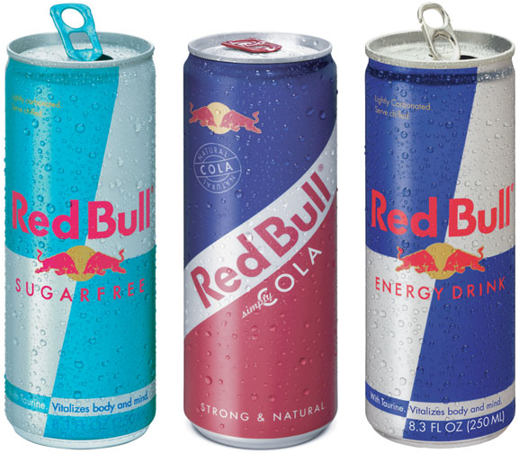
Marketing research process

Slide 26
Defining the Problem and Research Objectives
After the problem has been defined carefully, the manager and the researcher must set the research objectives.
Marketing research project might have one of three types of objectives.:
1. Exploratory research: gathering primary information that will help deﬁne the problem and suggest hypotheses.
2. Descriptive research: describing things such as the market potential for a product or the demographics and attitudes of consumers who buy the product.
3. Causal research: testing hypotheses about cause-and-effect relationships. (Through experiment)
Notes:
Exploratory research (focused group, open-ended questions
2. Descriptive research: closed ended questions

Slide 27
Developing the Research Plan
(Data collection)
To meet the manager’s information needs, the research plan can call for gathering secondary data, primary data, or both.
Secondary data consist of information that already exists somewhere, having been collected for another purpose
Companies can buy secondary data reports from outside suppliers or they can use Internet search engines
Primary data consist of information gathered for the special research plan
Companies need to design a plan for primary data collection calls for a number of decisions on research approaches, contact methods, the sampling plan, and research instruments.

Slide 28
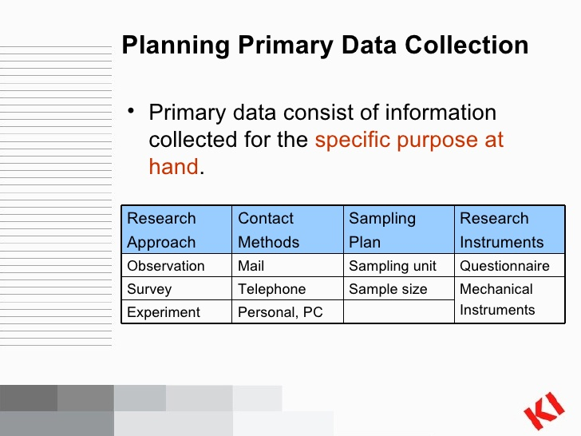
Research Approaches

Slide 29
Research approaches
(Primary data collection)
Observational approach : gathering primary data by observing relevant people, actions and situations. (ethnographic research).
Observation is best suited for exploratory research
Survey approach: Gathering primary data by asking people directly questions about their knowledge, attitudes, preferences, and buying behaviour.
Surveys are best suited for descriptive research
Experimental approach :gathering primary data by selecting matched groups of subjects, giving them different treatments, controlling unrelated factors and checking for differences in group responses. (cause and effect relationship)
Experimental approach is best suited for causal research

Slide 30
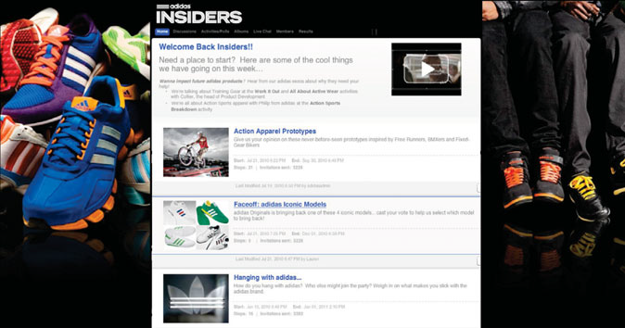
Contact methods
Mail, Telephone, and Personal Interviewing
Focus group interviewing
Online marketing research : Internet surveys, online focus groups, Web-based experiments, or tracking consumers’ online behaviour
Online focus groups: gain qualitative insights about consumer attitudes and behaviour.

Slide 31
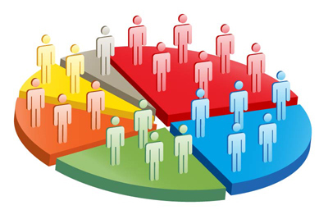
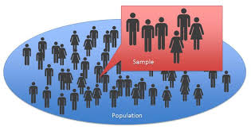
Sampling Plan
Sample: A segment of the population selected for marketing research to represent the population as a whole.
Who is to be surveyed?
How many people should be surveyed?
How should the people be chosen?(Randomly or Cluster)

Slide 32
Research Instruments
Questionnaires :
Open-end questions (interview ) include all possible answers, and subjects make choices among them
Closed-end questions allow respondents to answer in their own words. Useful in exploratory research
Mechanical Instruments:
Eye-tracking,
Neuro-marketing: measuring brain activity to
learn how consumers feel and respond
Checkout scanners
Mechanical devices (to track eye movement,
monitor heart rates, and measure
other physical responses)

Slide 33
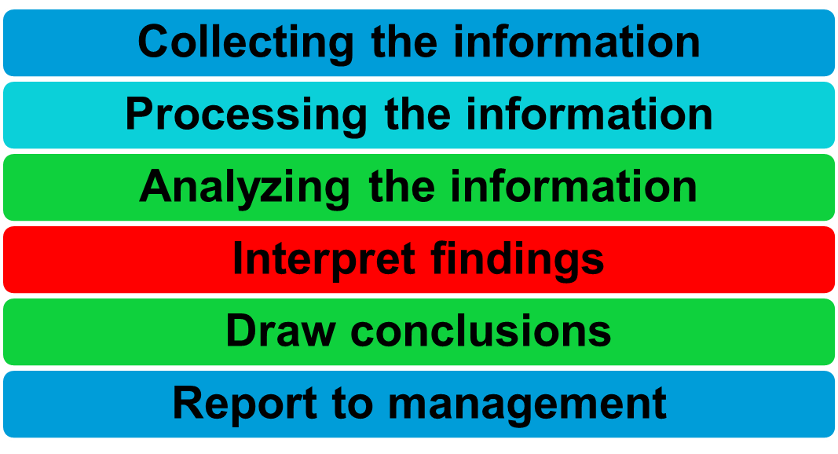
Implementing & Interpreting the Research Plan

Slide 34
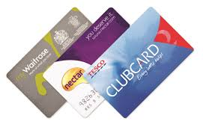

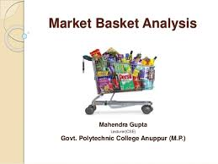
Analysing and Using Marketing
Information
Customer relationship management (CRM):
Managing detailed information about individual customers and carefully managing customer touch points to maximize customer loyalty.
CRM consists of sophisticated software and analytical tools that integrate customer information from all sources, analyse it in depth, and apply the results to build stronger customer relationships.

Slide 35
Review
Customer insights:
Fresh understandings of customers and the marketplace derived from marketing information that become the basis for creating customer value and relationships.
Marketing information system (MIS) refers to People, and procedures to gather, sort, analyse, evaluate and distribute needed and accurate information to marketing decision makers to generate customer insight.
Developing Marketing Information:
Internal data, Marketing intelligence, Marketing research
Type of research objectives : Exploratory , descriptive, causal
Research approaches: observation, survey, experiment

Slide 36
Class Activities
https://study.com/academy/practice/quiz-worksheet-market-research-methodology.html

