Slide 1
Consumer Behaviour
Week 3
Notes:
I have been given only a limited time speak with you today
So I don’t have much time to say all that I want to say TODAY.
However, I will be meeting you several times during your course.
Today, I want to focus on the important things that need to be said,
To students on their first day.

Slide 2
Chapter Outline
Model of Consumer Behavior
Characteristics Affecting Consumer Behavior
Types of Buying Decision Behaviour
The Buyer Decision Process
Consumer Behavior Across International Borders

Slide 3
You the consumer!
Discuss with a partner:
  One product or service that you bought recently?
  Why did you buy it?
  What particular personal factor/s influenced your purchase decision?
  Did any marketing messages or activities influence
  your decision?
  Do you think that the purchase may have been different for someone else? If so, how?
Notes:
Use this activity as an icebreaker to start the session, focusing on the individual’s perspective as a consumer.
Did they have a strong need to buy something?
Did they put a lot of thought into it?
Had they used it before?
Did they buy it for someone else?
Was the purchase decision actually theirs?
Did they consider other people’s responses to the purchase?
Did they make the purchase for an organisation?
Were emotional factors important?
Was the consumer’s financial position important?
Was advertising influential?
Conclude the discussion saying that this is what the topic of the course/text is about: trying to understand why consumers behave as they do and how marketers try to respond to consumer behaviour with marketing strategies in order to achieve marketing objectives. These marketing strategies may include advertising, price reductions or high prices for ‘prestige’ products, the scent of perfume as consumer walks through the store or coffee at an open house, friendly well trained staff influencing the consumer’s decision to make a purchase etc.
The final point:
Do you think that the purchase may have been different for someone else?
This is to illustrate that not all individuals are the same and that, in their marketing efforts, marketers must understand both the similarities and the differences between individuals.

Slide 4
Assesements 1 ? Group Presentation Deadline 9th & 16th February 2022
Assessment criteria | Maximum Marks
Introduction and Background | 10%
Environmental Analysis (Internal and External Analysis) | 20%
SOWT Analysis and Summary of the issues based on the analysis | 15%
Market Research Primary/Secondary data collection (linked to the issues) is required | 15%
Conclusion and Recommendations– Recommendation should be based on issues being considered as weakness and threats identified in the SWOT analysis | 20%
Presentation style and format, Professionalism, and contribution to the group work | 20%

Slide 5
Environmental Analysis
Macro Factors
PESTLE
Micro
Porters 5 Forces
Companies Positioning map vs competitors
Internal
Organisational resources
Capabilities of the organisation

Slide 6
SWOT Analysis
Opportunities
Threats
Strengths
Weakness

Slide 7
Sources of collecting information
Where did you collect information for your presentation?
How legitimate were the sources ?
How does the sources help in collecting the information for the presentation?
Were the sources secondary or primary ?

Slide 8
Recommendations based on SWOT
..
..
..
..

Slide 9
Consumer Behaviour and Coca Cola
https://youtu.be/aGfdubLAtY8

Slide 10
Model of Consumer Behavior
Consumer buyer behavior refers to the buying behavior of final consumers—individuals and households who buy goods and services for personal consumption.
Consumer market refers to all of the personal consumption of final consumers.

Slide 11


Model of Consumer Behavior
Marketing stimuli consists of the 4 Ps
Product
Price
Place
Promotion
Other stimuli include:
Economic forces
Technological forces
Political forces
Cultural forces

Slide 12
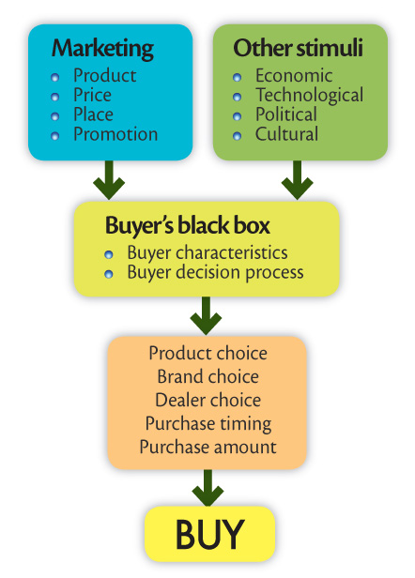
Model of
Consumer Behavior

Slide 13
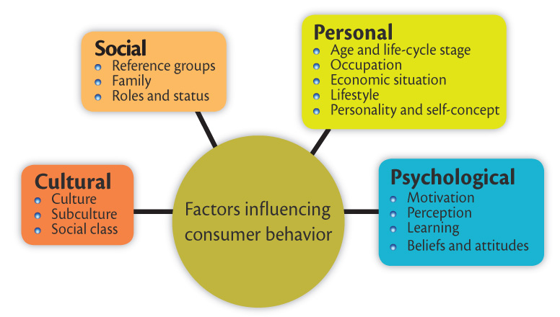
Factors influencing Consumer Behavior

Slide 14

Characteristics Affecting Consumer Behavior
Cultural Factors
  Buyer’s culture
  Buyer’s subculture
  Buyer’s social class
Social Factors
  Reference groups
  Family
  Roles and status

Slide 15
Characteristics Affecting Consumer Behavior
Personal Factors
  Age and life-cycle stage
  Occupation
  Economic situation
  Lifestyle
  Personality and self-concept
Psychological Factors
  Motivation
  Perception
  Learning
  Beliefs and attitudes

Slide 16
Characteristics Affecting Consumer Behavior
Culture is the learned values, perceptions, wants, and behavior from family and other important institutions.

Slide 17
Characteristics Affecting Consumer Behavior
Subcultures are groups of people within a culture with shared value systems based on common life experiences and situations.
  Chinese
  Indians
  Malays
  Eurasians
Notes:
Slide may be changed according to country where it is used.

Slide 18

Characteristics Affecting Consumer Behavior
Social classes are society’s relatively permanent and ordered divisions whose members share similar values, interests, and behaviors.
  Measured by a combination of occupation, income, education, wealth, and other variables

Slide 19
Characteristics Affecting Consumer Behavior
The major social classes:
Upper class
Middle class
Working class
Lower class

Slide 20
Characteristics Affecting Consumer Behavior
Social Factors
Groups
Membership groups have a direct influence and to which a person belongs.
Aspirational groups are groups to which an individual wishes to belong.
Reference groups are groups that form a comparison or reference in forming attitudes or behavior.

Slide 21
Characteristics Affecting Consumer Behavior
Social Factors
Groups
Opinion leaders are people within a reference group with special skills, knowledge, personality, or other characteristics that can exert social influence on others.
  Buzz marketing enlists opinion leaders to spread the word.
  Social networking is a new form of buzz marketing
    MySpace.com
    Facebook.com

Slide 22
Characteristics Affecting Consumer Behavior
Social Factors
Family is the most important consumer-buying organization in society.
Social roles and status are the groups, family, clubs, and organizations to which a person belongs that can define role and social status.

Slide 23
Characteristics Affecting Consumer Behavior
Personal Factors
Personal characteristics
Age and life-cycle stage
Occupation
Economic situation
Lifestyle
Personality and self-concept

Slide 24
Characteristics Affecting Consumer Behavior
Personal Factors
Age and life-cycle stage
RBC (Royal Bank of Canada) Royal Bank has identified five life-stage segments:
  Youth—younger than 18 years
  Getting started—18-35 years
  Builders—35-50 years
  Accumulators—50-60 years
  Preservers—over 60 years

Slide 25
Characteristics Affecting Consumer Behavior
Personal Factors
Occupation affects the goods and services bought by consumers.
Economic situation includes trends in:
  Personal income
  Savings
  Interest rates

Slide 26
Characteristics Affecting Consumer Behavior
Personal Factors
Lifestyle is a person’s pattern of living as expressed in his or her psychographics.
  Measures a consumer’s AIOs (activities, interests, and opinions) to capture information about a person’s pattern of acting and interacting in the environment.

Slide 27
Characteristics Affecting Consumer Behavior
Personal Factors
SRI Consulting’s Values and Lifestyle (VALS) typology:
Classifies people according to how they spend money and time:
  Primary motivations
  Resources

Slide 28
Characteristics Affecting Consumer Behavior
Personal Factors
Primary motivations
Ideals
Achievement
Self-expression

Slide 29
Characteristics Affecting Consumer Behavior
Personal Factors
Resources
High resources
  Innovators exhibit all primary motivations.
Low resources
  Survivors do not exhibit strong primary motivation.

Slide 30
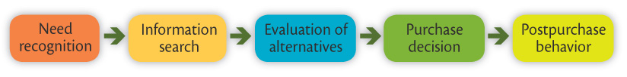
The Buyer Decision Process
Five stages in the buyer decision process
Need recognition
Information search
Evaluation of alternatives
Purchase decision
Post-purchase behavior

Slide 31
Seminar Activity 1
Describe the Buying Decision Process for a mobile/smartphone. Fit your description around the five stages that follow:
Recognition of a need.
Choice of level of involvement
Identification of alternatives
Purchase Decision
Post Purchase Evaluation
.

Slide 32
Characteristics Affecting Consumer Behavior
Personal Factors
Personality and Self-Concept
Personality refers to the unique psychological characteristics that lead to consistent and lasting responses to the consumer’s environment.

Slide 33



Characteristics Affecting Consumer Behavior
Personal Factors
Personality and Self-Concept
Brand personality refers to the specific mix of human traits that may be attributed to a particular brand:
  Sincerity
  Excitement
  Competence
  Sophistication
  Ruggedness

Slide 34

Characteristics Affecting Consumer Behavior
Personal Factors
Personality and Self-Concept
Self-concept refers to people’s possessions that contribute to and reflect their identities.

Slide 35
Characteristics Affecting Consumer Behavior
Psychological Factors
Motivation
Perception
Learning
Beliefs and attitudes

Slide 36
Characteristics Affecting Consumer Behavior
Psychological Factors
Motivation
A motive is a need that is sufficiently pressing to direct the person to seek satisfaction.
Motivation research refers to qualitative research designed to probe consumers’ hidden, subconscious motivations.

Slide 37
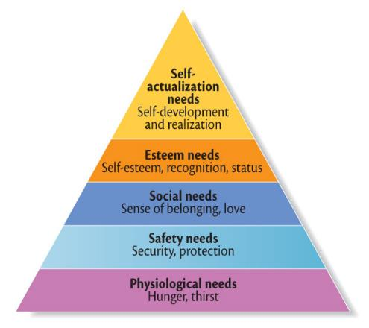
Characteristics Affecting Consumer Behavior
Psychological Factors
Abraham Maslow’s Hierarchy of Needs
People are driven by particular needs at particular times.
Human needs are arranged in a hierarchy from most
pressing to least pressing.

Slide 38
Characteristics Affecting Consumer Behavior
Psychological Factors
Perception is the process by which people select, organize, and interpret information to form a meaningful picture of the world from three perceptual processes:
  Selective attention
  Selective distortion
  Selective retention

Slide 39
Characteristics Affecting Consumer Behavior
Psychological Factors
Selective attention is the tendency for people to screen out most of the information to which they are exposed.
Selective distortion is the tendency for people to interpret information in a way that will support what they already believe.
Selective retention is the tendency to remember good points made about a brand they favor and to forget good points about competing brands.

Slide 40
Characteristics Affecting Consumer Behavior
Psychological Factors
Learning is the changes in an individual’s behavior arising from experience and occurs through interplay of:
  Drives
  Stimuli
  Cues
  Responses
  Reinforcement

Slide 41
Characteristics Affecting Consumer Behavior
Psychological Factors
Beliefs and Attitudes
Belief is a descriptive thought that a person has about something based on:
  Knowledge
  Opinion
  Faith

Slide 42
Characteristics Affecting Consumer Behavior
Psychological Factors
Beliefs and Attitudes
Attitudes describe a person’s relatively consistent evaluations, feelings, and tendencies toward an object or idea.

Slide 43
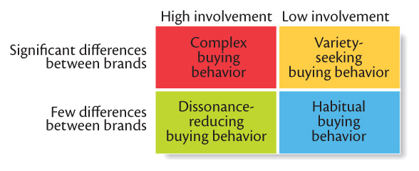
Four Types of Buying Decision Behavior
Complex buying behavior
Dissonance-reducing buying behavior
Habitual buying behavior
Variety-seeking buying behavior

Slide 44
Types of Buying Decision Behavior
Complex Buying Behavior
Occurs when consumers are highly motivated in a purchase and perceive significant differences among brands.
Purchasers are highly motivated when:
  Product is expensive
  Product is risky
  Product is purchased infrequently
  Product is highly self-expressive

Slide 45
Types of Buying Decision Behavior
Dissonance-reducing buying behavior occurs when consumers are highly involved with an expensive, infrequent, or risky purchase, but see little difference among brands.
  Post-purchase dissonance occurs when the consumer notices certain disadvantages of the product purchased or hears favorable things about a product not purchased.

Slide 46
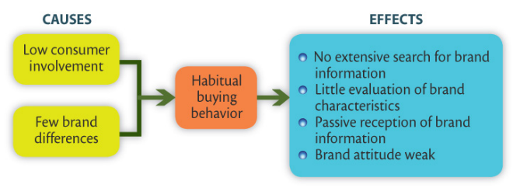
Types of Buying Decision Behavior
Habitual buying behavior occurs when consumers have low involvement and there is little significant brand difference.
Variety-seeking buying behavior occurs when consumers have low involvement and there are significant brand differences.

Slide 47
The Buyer Decision Process
Five stages in the buyer decision process
Need recognition
Information search
Evaluation of alternatives
Purchase decision
Post-purchase behavior

Slide 48
The Buyer Decision Process
Need Recognition
Need recognition occurs when the buyer recognizes a problem or need triggered by:
  Internal stimuli
  External stimuli

Slide 49
The Buyer Decision Process
Information Search
Information search is the amount of information needed in the buying process and depends on:
The strength of the drive,
The amount of information you start with,
The ease of obtaining the information,
The value placed on the additional information, and
The satisfaction from searching.

Slide 50
The Buyer Decision Process
Information Search
Sources of information:
Personal sources—family and friends
Commercial sources—advertising, Internet
Public sources—mass media, consumer organizations
Experiential sources—handling, examining, using the product

Slide 51
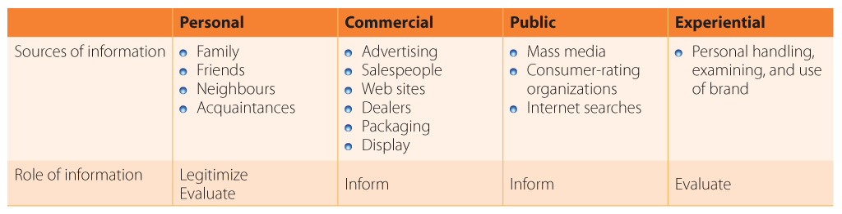
Sources and Role of Information

Slide 52
The Buyer Decision Process
Evaluation of Alternatives
Evaluation of alternatives is how the consumer processes information to arrive at brand choices.

Slide 53
The Buyer Decision Process
Purchase Decision
The purchase decision is the act by the consumer to buy the most preferred brand.
The purchase decision can be affected by:
  Attitudes of others
  Unexpected situational factors

Slide 54
The Buyer Decision Process
Post-Purchase Decision
The post-purchase decision is the satisfaction or dissatisfaction the consumer feels about the purchase.
Relationship between:
  Consumer’s expectations
  Product’s perceived performance

Slide 55
The Buyer Decision Process
Post-Purchase Decision
The larger the gap between expectation and performance, the greater the consumer’s dissatisfaction.
Cognitive dissonance is the discomfort caused by a post-purchase conflict

Slide 56
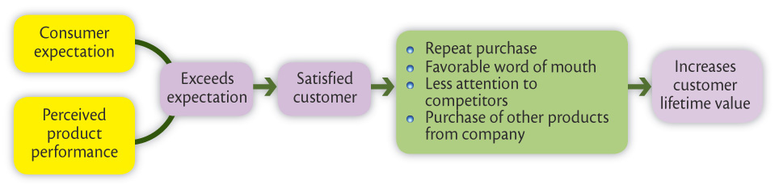
The Buyer Decision Process
Post-Purchase Decision
Customer satisfaction is a key to building profitable relationships with consumers—to keeping and growing consumers and reaping their customer lifetime value.

Slide 57
The Buyer Decision Process for
New Products
Stages in the Adoption Process
Awareness
Interest
Evaluation
Trial
Adoption

Slide 58
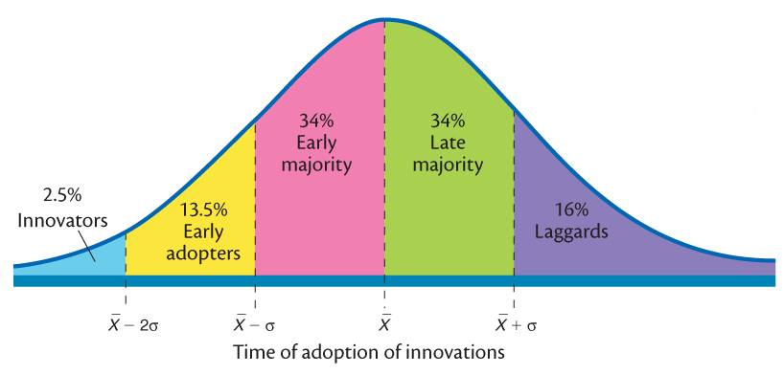
The Buyer Decision Process for
New Products
Individual Differences in Innovation

Slide 59
Consumer Behavior Across International Borders
Differences can include:
  Values
  Attitudes
  Behaviors
The question for marketers is whether to adapt or standardize the marketing.

Slide 60
Any Questions So far?

