Slide 1
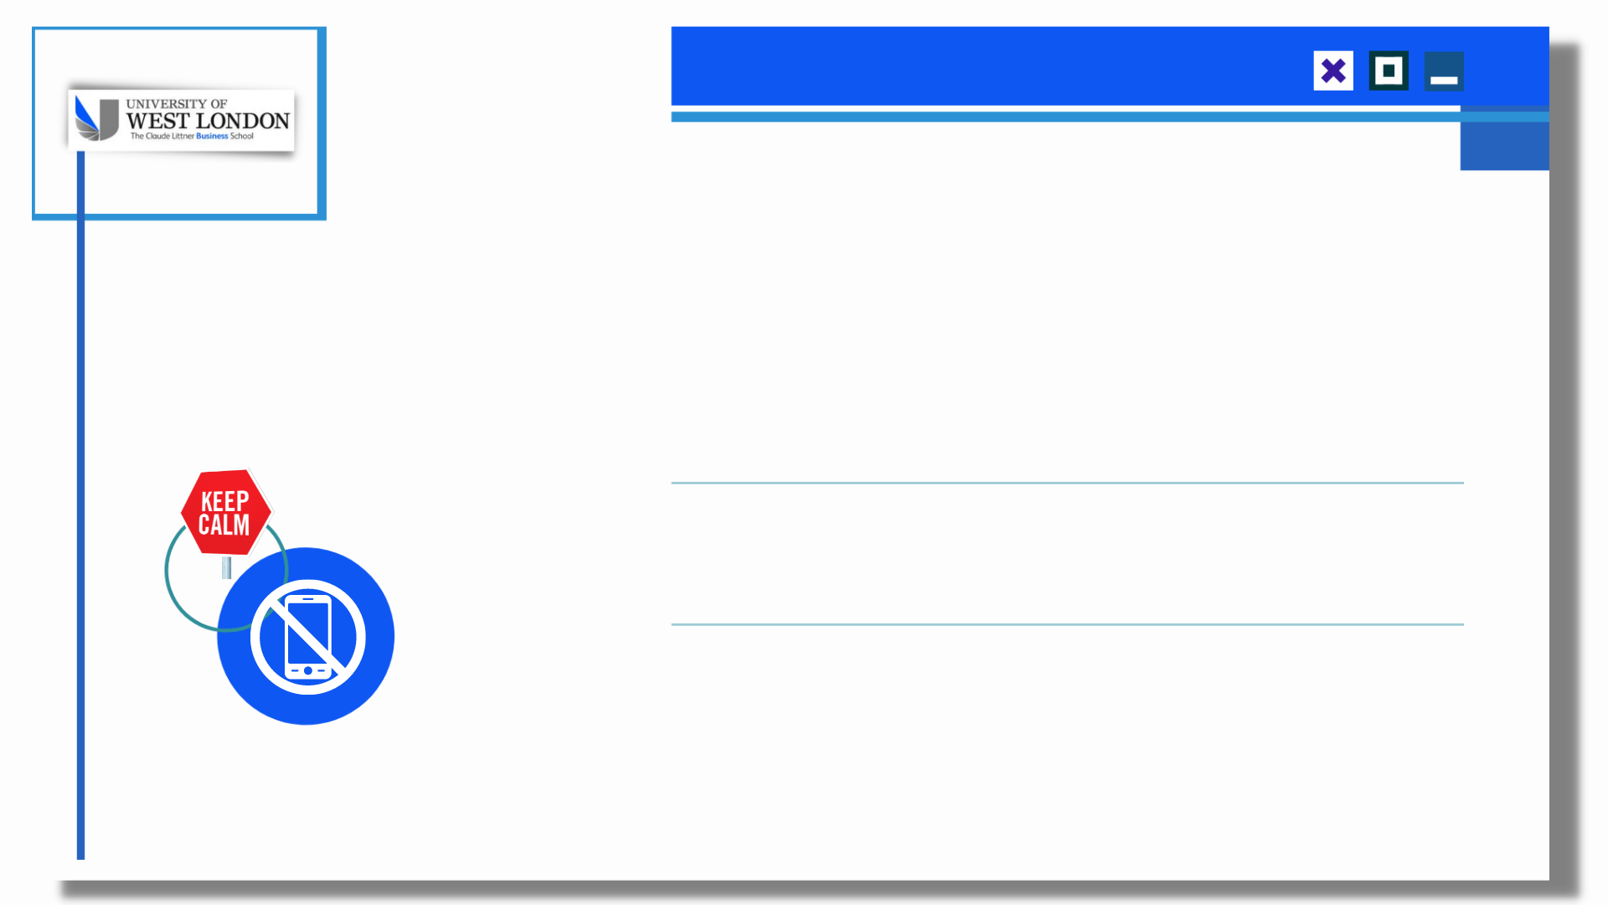
BA30030E
Personalised Learning
Week 1: Module Introduction
Francisca Umeh

Slide 3
Outline session 1
Introductions & expectations
Module introduction – MSG
Assessment – 3 stages
Blackboard

Slide 5
What is Academic Success for PL?
Academic Success is the ability to ‘Practicalise’ the conceptual, theoretical and subject knowledge with a specific goal.
Francisca C Umeh

Slide 6
Module Study Guide

Slide 7
What is personalised learning?
Provide opportunities for academic/personal development to help you progress to level 4
Develop skills to be a reflective and successful learner
Provide support for level 3 assignments (other modules)

Slide 8
Teaching team
Module Leader & Course Leader
Dr Francisca Umeh
Francisca.umeh@uwl.ac.uk
Paragon 11th floor
Ext 0208 209 4189
For all inquiries, always here to help☺
Tutors:

Slide 9
Total Guided Learning Hours | 200
Consisting of:
Teaching Contact Hours | 48
Independent Study Hours | 152

Slide 10
Learning Outcomes – Personalised Learning
By the end of the module students will be able:
LO1 To take account of your strengths and weaknesses as a foundation level learner and address your learning needs
LO2 To take appropriate action to become an effective learner, appropriate to foundation level
LO3 To implement a relevant study plan, agreed by your tutor
LO4 To prepare a personalised learning plan for level 4

Slide 11
Your Study Guide.
Essential Reading
Weerawardene, D & Byrne, P (2021) Academic development and Employability. Hampshire: Pearson.
Recommended Reading
Aish, F., Tomlinson, J. (2013). Lectures: Learn listening and note-taking skills 1st Ed. London: Collins EAP
Byrne, P (2021) Business Skills for the 21st Century. UK Pearson.
Cameron, S. (2016) The Business Students Handbook 6th Ed; Pearson
Cottrell, S. (2013) The Study Skills Handbook. 4th ed. Basingstoke: Palgrave Macmillan
Dowson, P. (2015) Personal & Professional Development for Business Students 1st Ed; Sage
Gallagher, K. (2012) Skills Development for Business and Management Students. 2nd ed. Oxford: OUP
Lumley, M., Wilkinson, J. (2013) Developing Employability for Business. Oxford: OUP
McMillan, K. and Weyers, J. (2011) How to write Essays and Assignments 2nd Ed; Pearson
McMillan, K. and Weyers, J. (2013) How to Cite, Reference & avoid plagiarism at University, 1st Ed; Pearson
McMillan, K. and Weyers, J. (2014) How to write for University: Academic Writing for Success 1st Ed Pearson

Slide 12
A variety of on-line electronic resources is available to UWL students including access to the following Databases:
PROQUEST DIRECT
EBSCOHOST
EMERALD
These can all be accessed through the site below. You must have activated your account as a UWL student and have your sign-in details to access them remotely.
http://lrs.UWL.ac.uk/eresources/index.html

Slide 13
Extended Induction material
Introduction to Blackboard
Introduction to Vteam
Introduction to student handbook

Slide 15
Human Bingo
This ice-breaker is an extremely quick way to get to know one another, you will probably have spoken to everyone else in the room by the time you finish it. The idea of the exercise is to put a different person’s name in each of the boxes in the grid below. You must put a different person’s name in each box. For the boxes marked with an * the person must demonstrate that they can. Therefore, make sure that if someone says they can roll their tongue, you see actually see them doing it.
Is left handed | Can say hello in 5 languages * | Has met royalty | Can sing a Cardi B song (chorus) *
Has children | Can quote 3 lines from Star Wars * | Has NOT seen a Harry Potter film | Has ever hitch-hiked
Is wearing contact lenses * | Is a teetotaller | Can repeat ‘Toy Boat’ 5 times fast * | Has been in a prison cell
Has a tattoo | Has gone bungee jumping or parachuting | Can recite 6 lines from Shakespeare * | Has the same favourite colour as yourself
Has drunk a pint in less than 10 seconds | Can roll their tongue * | Has been abroad this year | Has been mistaken for a Youtube/Insta/TV personality

Slide 17
Module contents
Introduction to Plagiarism and Referencing
Reading skills
Reflective thinking
Speaking skills
Note-taking
Library use
Writing Skills
Business field trip
Personal Development Planning
Goal-setting

Slide 18
Students’ Expectations
Expectations Specific expectations students can have of tutors:
Helpfulness
Professionalism
Timely responses to queries and timely marking
Knowledge of the subject area and how to apply knowledge to the business environment
Good timekeeping
Help with assessment preparation
To make learning enjoyable and relevant

Slide 19
Tutors’ Expectations
Specific expectations tutors will have of students:
Full attendance at classes
Effective contribution to practical exercises and all activities
If you cannot attend to let the tutor know in good time
Engagement in all course activities
152 hours of independent study
Timely work submission
Professional behaviour in and out of class
Good communication with tutors/Course Leader should difficulties occur
Constructive feedback where possible

Slide 20
Over to you…
What are you most worried about?
What are you most looking forward to?
Tell the person sitting next to you

Slide 22
Weekly Sessions
Weekly activities
Communicative/interactive lessons
Tutor based
Student led
Learning from feedback

Slide 23
Assessments

Slide 24
Assessment
One assessment divided into three parts:
Part A – Weekly Reflective Journal
Part B – Personal Learning & Development Plan
Part C - Personal Learning & Development Interview

Slide 25
Assessment Part A
Reflective Journal
Approx 1200 words
Starts from week 1
Use the template provided on BB
Record what you learn from weekly sessions and how you can improve your skills
Formative submission of weekly reflective journal in week 8

Slide 26
Marking Grid
Assessment criteria:

Slide 27
Blackboard
Blackboard = Learning materials, assessments, module information + more
Web login: portal.uwl.ac.uk and App: www.uwl.ac.uk/mobilelearn
Complete the introductory activity this week: www.uwl.ac.uk/blackboardhelp
Need help?
Problems logging in: contact IT Services
Help using Blackboard: www.uwl.ac.uk/blackboardhelp
Questions about the course materials & assessments: ask me!
Notes:
Notes for staff
Blackboard should be introduced in week 1 or 2
The main aim of showing this slide is to make the students aware of Blackboard and direct to the online activity they should complete at www.uwl.ac.uk/blackboardhelp
The slide is purposely plain so that you can incorporate it with your own slides.

Slide 28
Blackboard

Slide 30
Assessment Part B
Personal Development and Learning Plan
What is a PDP/Why is it a useful tool?
Show template on BB
Go through detailed brief from MSG
Formative and summative submission

Slide 31
Assessment Part C
PDP Interview
PDP Interviews to be held over weeks 12 and 13 with Francisca or Paul OR Francisca and Paul. Interviews will be audio recorded for grading purposes.
You will need to bring your completed reflective journal and personal learning and development plan with a cover page; you will also need to prepare a 3-5 minute presentation based on these to a pre-arranged interview (no slides are required). The tutor(s) will listen to the presentation and ask questions about the reflective journal and plan. This interview will be audio recorded. There will be opportunities to discuss the interview process and obtain feedback in class. (From MSG)

Slide 32
Assessment
All assessments will have many opportunities for in-class practice and formative feedback so please attend / communicate and take advantage of these opportunities as you will be the WINNER if you do.

Slide 33
Marking Grid
Assessment criteria:

Slide 34
Activity 2
Seven Approaches to Learning

Slide 35
By the end of the Module, you will have amazing skills in:
Reflective writing

Slide 37
How can I help you?
Any question concerning the module study guide?
Any question concerning the assessment?

