Slide 1
New Product Development & Product Life Cycle Strategy
Week 8

Slide 2
Recap
The core customer value consists of the core problem-solving benefits that consumers seek when they buy a product.
The actual product exists around the core and includes the quality level, features, design, brand name, and packaging.
The augmented product is the actual product plus the various services and benefits offered with it, such as a warranty, free delivery,
Consumer products : those bought by final consumers—are usually classified according to consumer shopping habits (convenience products, shopping products, specialty products, and unsought products).
Industrial products: purchased for further processing or for use in conducting a business—include materials and parts, capital items, and supplies and services
Notes:
2

Slide 3
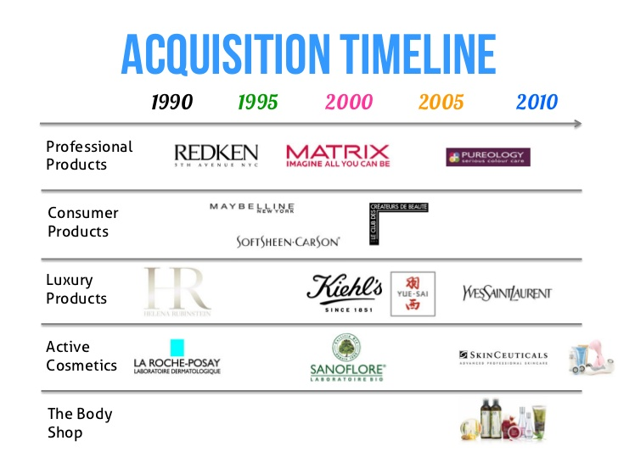
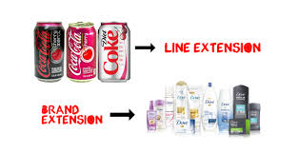
Recap
Service characteristics: intangible, inseparable, variable, and perishable
Brand development :
line extension
brand extension
multibrands,
new brands

Slide 4
Week 7 New Product Development Process and the Product Life cycle

Slide 5
Class Group Activities
Describe TWO internal and TWO external influences on the setting of organisational objectives for a supplier of office furniture to businesses
Your employer is a major chain of fast-food restaurants. Use examples from this industry to illustrate how external factors will influence objective setting.
Evaluate the importance of the marketing planning process for an organisation of your choice . how will this help them to achieve the company’s objectives

Slide 6
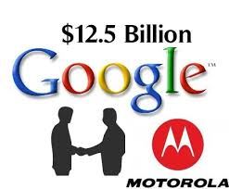



New-Product Development Strategy
Ways to obtain new products
Acquisition refers to the buying of a whole company, a patent, or a license to produce someone else’s product.
New product development: development of original products, product improvements, product modifications, and new brands developed from the firm’s own research and development.
NPD is expensive, time consuming and risky
Notes:
6

Slide 7
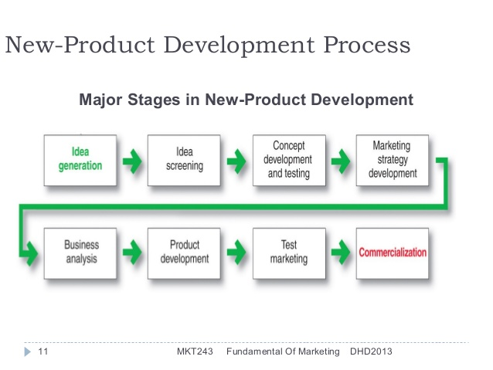

Slide 8

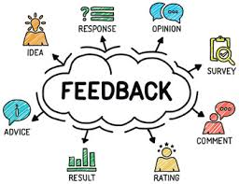

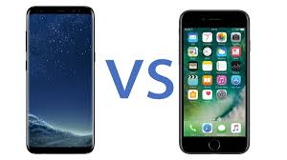
Idea Generation
1.dea generation is the systematic search for new product ideas.
Sources of new product ideas: Internal & External
Internal: The company can ﬁnd new ideas through its own formal research and development efforts. It can pick the brains of its executives, scientists, engineers, designers, manufacturing and salespeople
External sources refer to sources outside the company such as customers, competitors, distributors, suppliers, and outside design firms
Notes:
It was anticipating needs before they exist that brought about Nokia’s revolutionary 9000 Communicator, which was the world’s ﬁrst all-in-one mobile communications device – a fax, phone, digital diary, calculator and palm-top computer all rolled into one
8

Slide 9
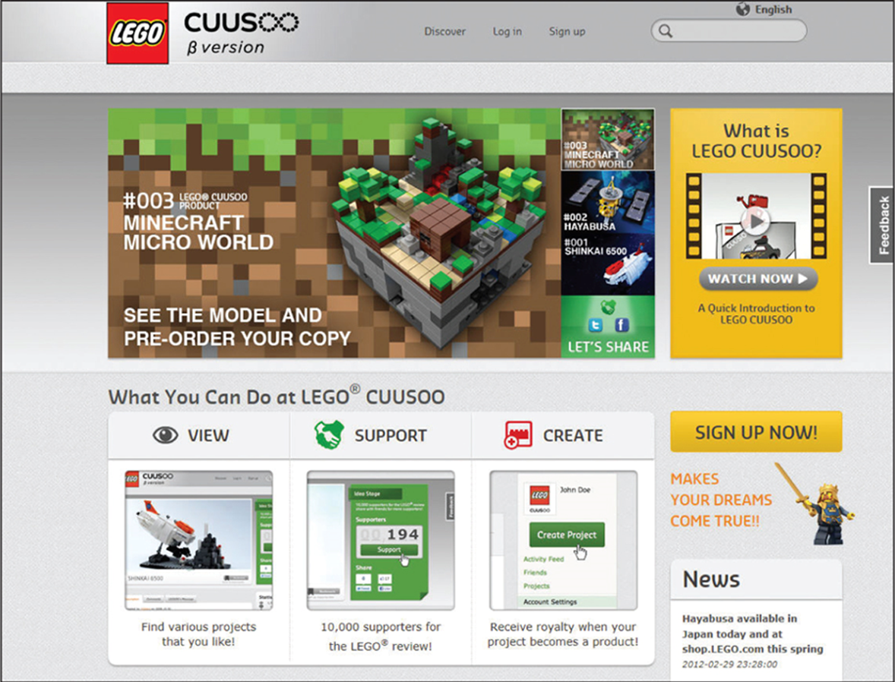

Internal and external sources

Slide 10


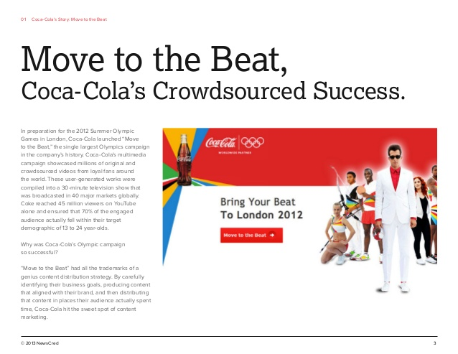
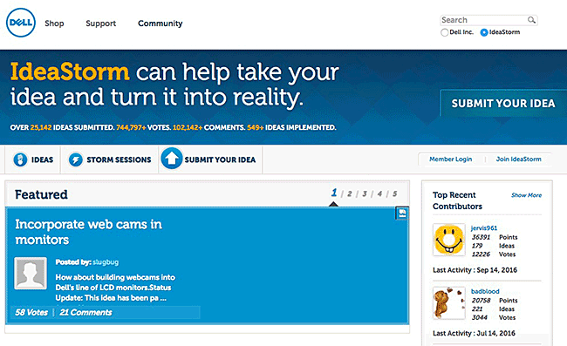
Crowdsourcing
Crowdsourcing : Inviting broad communities of people, customers, employees, independent scientists and researchers, and even the public at large—into the new-product innovation process.
Advantages of using crowdsourcing may include improved costs, speed, quality, flexibility, scalability, or diversity

Slide 11
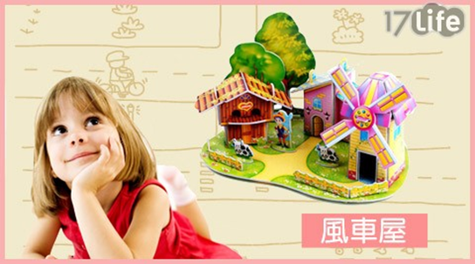
Idea Screening
2.idea Screening: Screening new-product ideas in order to spot good ideas and drop poor ones as soon as possible.
RWW: 1. Is it Real? 2. Can we Win? 3. Is it Worth doing?
1. Is there a real need and desire for the product and will customers buy it? Is there a clear product concept and will such a product satisfy the market?
2. Does the product offer a sustainable competitive advantage? Does the company have the resources to make such a product a success?
3. Does the product fit the company’s overall growth strategy? Does it offer sufficient profit potential?
Notes:
Typically, the committee asks questions such as these: Is the product truly useful to consumers and society? Is this product good for our particular company? Does it mesh well with the company’s objectives and strategies? Do we have the people, skills and resources to make it succeed? Does it deliver more value to customers than competing products? Is it easy to advertise and distribute? Many companies have well-designed systems for rating and screening new-product ideas.
11

Slide 12
Concept Development & Testing
3. Concept development : An attractive idea must then be developed into a product concept. It is important to distinguish between a product idea, a product concept, and a product image.
Product idea is an idea for a possible product that the company can see itself offering to the market.
Product concept is a detailed version of the idea stated in meaningful consumer terms.
Product image is the way consumers perceive an actual or potential product.

Slide 13
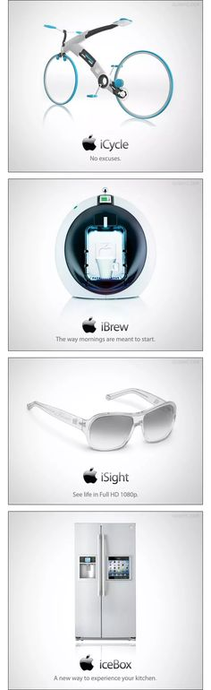




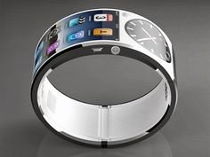




Slide 14
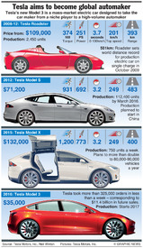
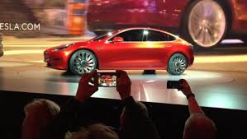
Concept Testing
Concept testing refers to testing new product concepts with groups of target consumers to find out if the concepts have strong consumer appeal.
For some concept tests, a word or picture description might be sufficient.
However, Physical presentation of the concept will increase the reliability
of the concept test.
Concept 1: An affordably priced midsize car designed as a second
family car to be used around town for running errands and visiting friends.
Concept 2: A mid-priced sporty compact appealing to young singles and couples.
Concept 3: A “green” car appealing to
environmentally conscious people who want
practical, low-polluting transportation

Slide 15
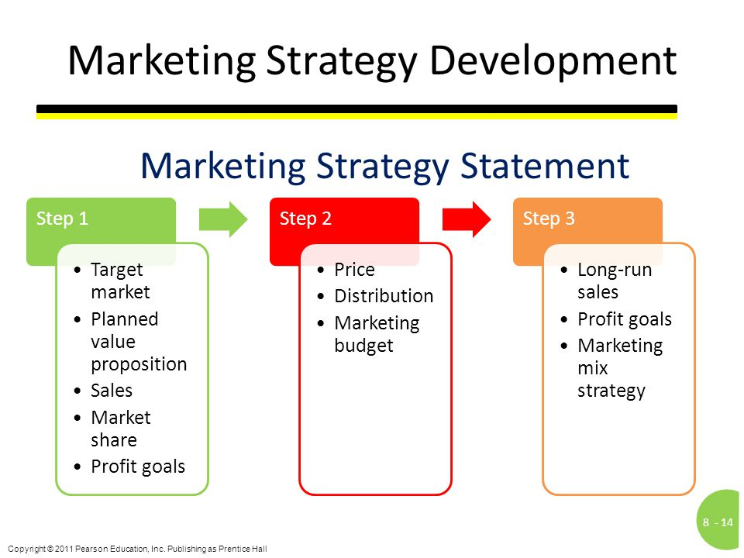
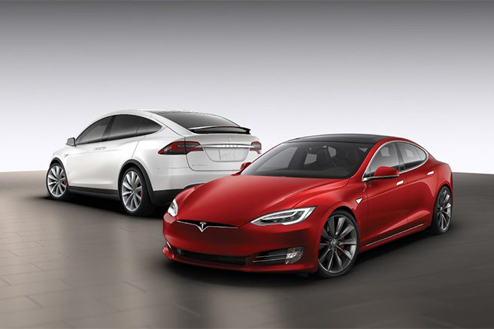
Marketing Strategy Development
Marketing strategy development is designing an initial marketing strategy for a new product based on the product concept.
Marketing strategy statement consists of:
Target market description
Value proposition planned
Sales, market-share, and marketing mix

Slide 16

Business Analysis
Business analysis is a review of the sales, costs, and profit projections for a new product to find out whether these factors satisfy the company’s objectives. If the business analysis satisfies the company’s objectives, the product can move to the product development stage.
Estimate sale: sales history – assess the risk estimate – estimate cost (R&D, marketing, operation)- The company then uses the sales and costs figures to analyse the new product’s financial attractiveness.
To estimate sales, the company might look at the
sales history of similar products and conduct market surveys

Slide 17

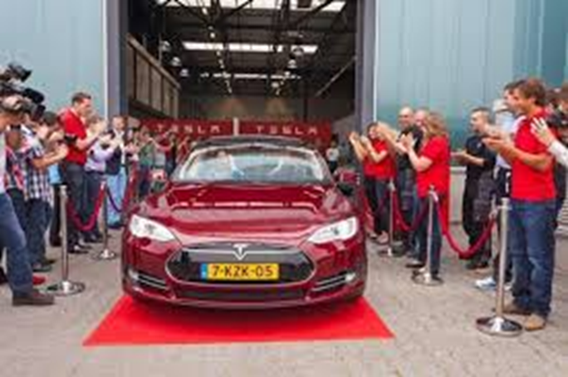
Product Development(testing)
Product development is developing the product concept into a physical product to ensure that the product idea can be turned into a workable market offering. Marketers often involve actual customers in product testing
When the prototypes are ready, they undergo rigorous functional tests under laboratory and ﬁeld conditions to make sure that the product performs safely and effectively.

Slide 18
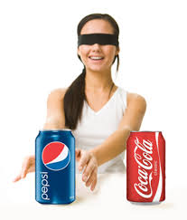

Test Marketing
Test marketing: test product in more realistic market settings.
A good test market can provide a wealth of information about the potential success of the product and marketing programme.
When test marketing is likely : New product with large investment, Uncertainty about product or marketing program
When test marketing is unlikely: Simple line extension, Copy of competitor product, Low costs, Management confidence
Notes:
Test marketing gives the marketer experience with marketing the product before going to the great expense of full introduction. It lets the company test the product and its entire marketing programme – positioning strategy, advertising, distribution, pricing, branding and packaging and budget levels.
18

Slide 19
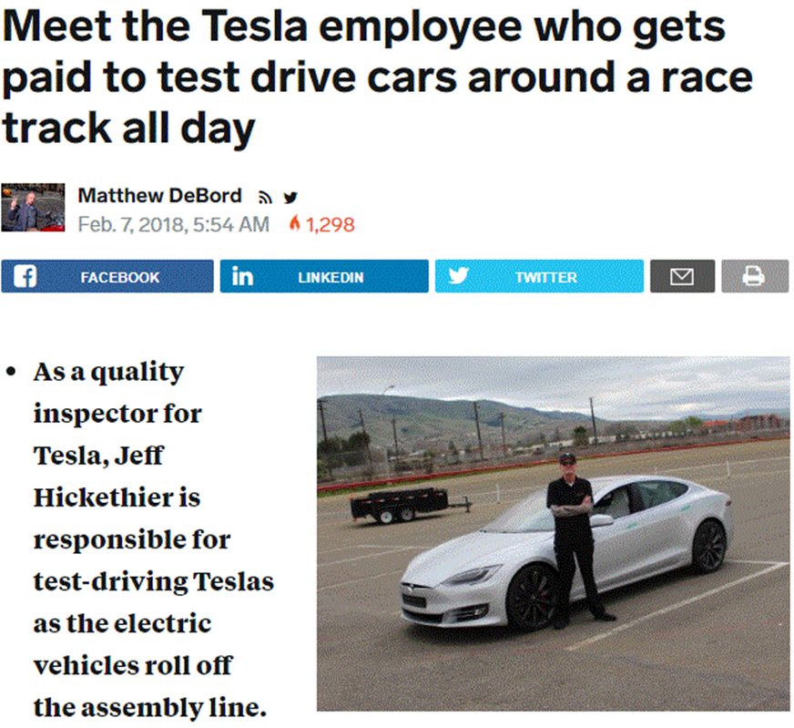
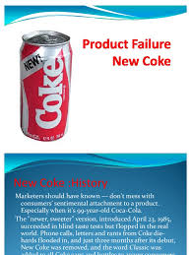


Slide 20
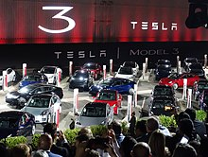
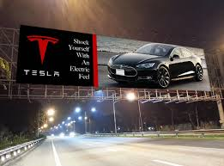
Commercialization
Commercialization involves introducing a new product into the market.
When to launch? whether the time is right to introduce the new product, If it can be improved further,
Where to launch? Should it be in a single location, or region, several regions, the national market or the international market?
How to launch? The company also must develop an action plan for introducing the new product into the selected markets
To whom? Within the rollout markets, the company must target its distribution and promotion to customer groups who represent the best prospects.
Notes:
. For how to launch company must spend the marketing budget on the marketing mix and various other activities.
20

Slide 21
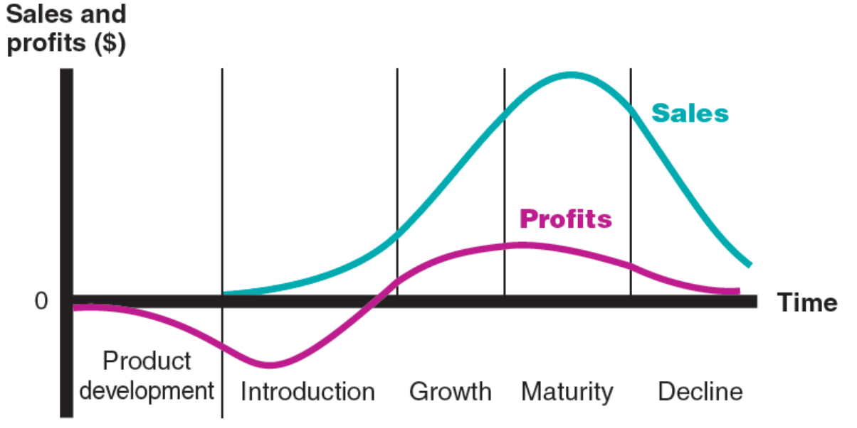
Product Life Cycle Strategies
The product life cycle (PLC) is the course of a product’s sales and profits over its lifetime. It involves five distinct stages: product development, introduction, growth, maturity, and decline.

Slide 22
Product Life Cycle Strategies
Product development : begins when the company ﬁnds and develops a new-product idea sales are zero and the company’s investment costs mount,
Introduction is a period of slow sales growth as the product is being introduced in the market. Proﬁts are non-existent in this stage because of the heavy expenses of product introduction.
Growth: Rapid market acceptance and increasing profits

Slide 23
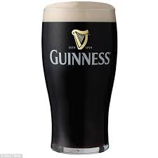
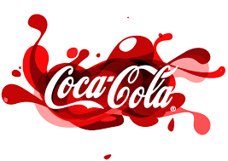
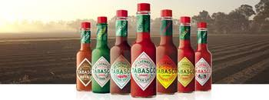
Product Life Cycle Strategies
Maturity : is a period of slowdown in sales growth because the product has achieved acceptance by most potential buyers. Proﬁts level off or decline because of increased marketing outlays to defend the product against competition
Decline: Sales fall off and profits drop.

Slide 24
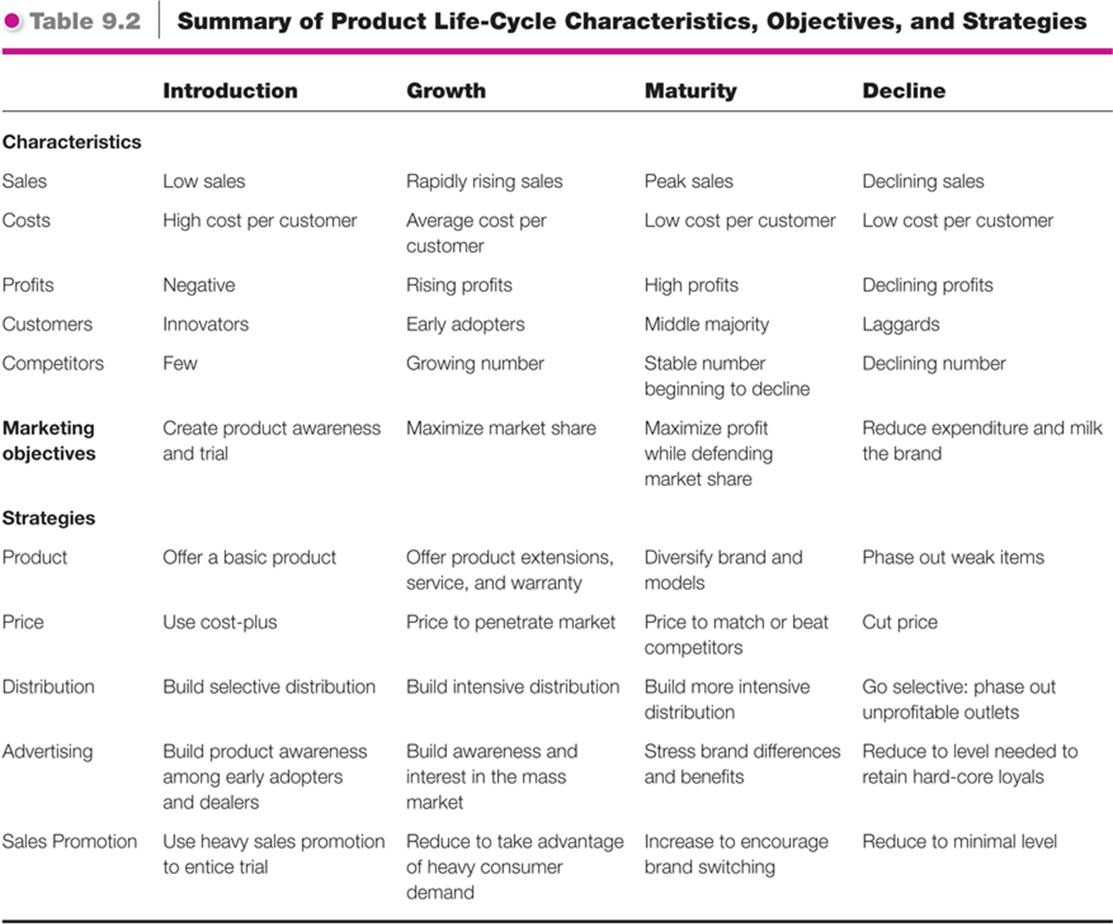

Slide 25
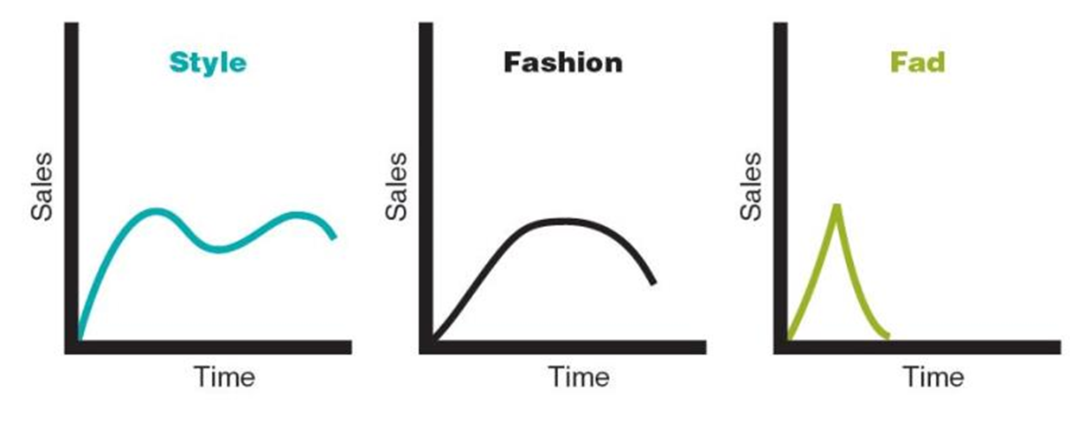
Product Life Cycle concept
Style: A basic and distinctive mode of expression: art (realist, surrealist, abstract), clothing (formal, casual)
Fashion: A currently accepted or popular style in a given ﬁeld.
Fads: A temporary period of unusually high sales driven by consumer enthusiasm and immediate product or brand popularity
Notes:
Product classes have the longest life-cycles
Fashion: For example, the more formal ‘business attire’ look of corporate dress of the 1980s and early 1990s has now given way to the ‘business casual look’ of today.
25

Slide 26



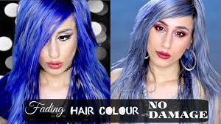


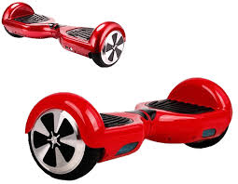



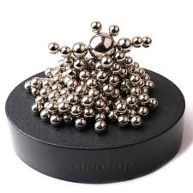
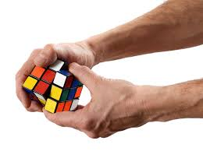
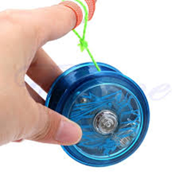

Slide 27
PLC Introduction Stage
Introduction stage : The product life-cycle stage when the new product is ﬁrst distributed and made available for purchase.
Well-known products such as instant coffee, personal computers and mobile telephones lingered for many years before they entered a stage of rapid growth.
Low sales, high distribution, heavy promotion spending (a rapid penetration strategy
Higher income group: business or professional users were the earliest targets.

Slide 28
PLC Growth Stage
Growth stage: The product life-cycle stage at which a product’s sales start climbing quickly.
The ﬁrm uses several strategies to sustain rapid market growth as long as possible
improving product quality
Adding new product features and models
Entering new market segments and new distribution channels
Shifting some advertising from awareness to building product conviction and purchase
Lowering prices at the right time to attract more buyers
Notes:
In the growth stage, the firm faces a trade-off between high market share and high current profit. By spending a lot of money on product improvement, promotion, and distribution, the company can capture a dominant position. In doing so, however, it gives up maximum current profit, which it hopes to make up in the next stage
28

Slide 29
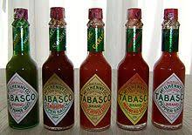
PLC Maturity Stage
Maturity stage: The stage in the product life-cycle where sales growth slows or levels off.
Slowdown in sales results in many producers with many products to sell . this overcapacity leads to greater competition,
Competitors begin to cut prices, increase their advertising and sales promotions, and raise their R&D budgets to ﬁnd better versions of the product. These steps lead to a drop in proﬁt
Substitute products,
Increased promotion and R&D to support sales
Modifying the market & marketing mix,
Notes:
The maturity stage normally lasts longer than the previous stages, and it poses strong challenges to marketing management. Most products are in the maturity stage of the life cycle, and therefore most of marketing management deals with the mature product
29

Slide 30
PLC Decline Stage
Decline stage: The product life-cycle stage at which a product’s sales decline, Sales decline for many reasons, including technological advances, shifts in consumer tastes, and increased competition.
Finally, management may decide:
Maintain the product Without change , competitors will leave the industry
Harvest the product: Reducing various costs such as R&D, ads,
Drop the product : Drop from the line or sell it
Notes:
Management may decide to maintain its brand, repositioning or reinvigorating it in hopes of moving it back into the growth stage of the product life cycle. Management may decide to harvest the product, which means reducing various costs (plant and equipment, maintenance, R&D, advertising, sales force), hoping that sales hold up. Finally, management may decide to drop the product from its line. The company can sell the product to another firm or simply liquidate it at salvage value. If the company plans to find a buyer, it will not want to run down the product through harvesting.
30

Slide 31
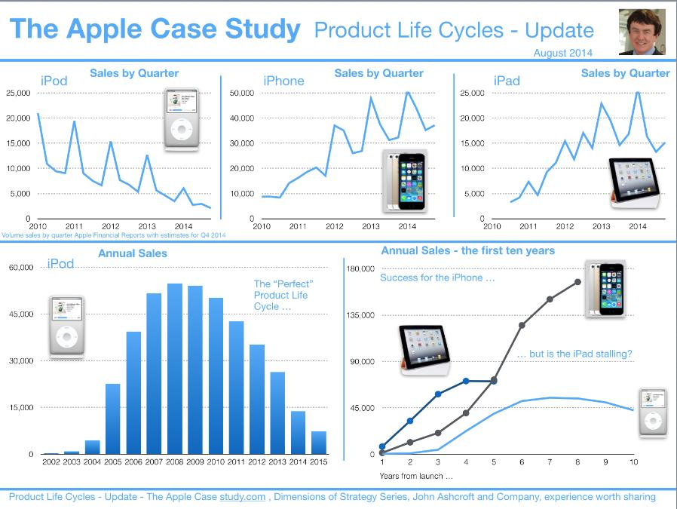

Slide 32
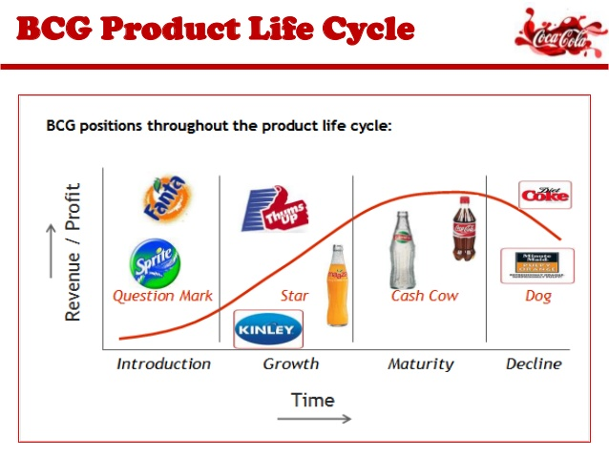

Slide 33
Seminar Activities

Slide 34
Group Activity: When products go wrong!
Example | Possible impact | What could the company have done to alleviate this
1.A new potato chip product, had side effects including extreme abdominal cramps. It was withdrawn due to public safety.
2.A new yogurt flavoured shampoo led to reports of people eating the product and becoming very ill. It was withdrawn shortly after the launch.
3.A smokeless cigarette product was launched, but it had a flavour or rotten garbage. It was dropped soon after its launch, which cost $300 million.

Slide 35
Group Activity: When products go wrong!
4.Apple maps launched in 2012, hoping to rival Google maps. However it was riddled with errors including missing out towns and cities and misspelt capital cities. After its launch, even the CEO at Apple advised customers to use other maps.
5.McDonalds launched a new product, along with a promotional campaign costing $100 million, but it contained 79% of an adults recommended daily allowance of salt and a huge amount of fat. It was withdrawn by the Public Health body.
6.In 1985 Coca Cola changed their recipe for Coke and released the new version. They received 400,000 complaints and reverted back to the old recipe after 79 days.
7.In 1980, a Lawn Darts game was launched whereby giant darts were thrown into the ground. It was recalled in 1988 by the consumer product safety commission, after 3 people were killed.

