Slide 1
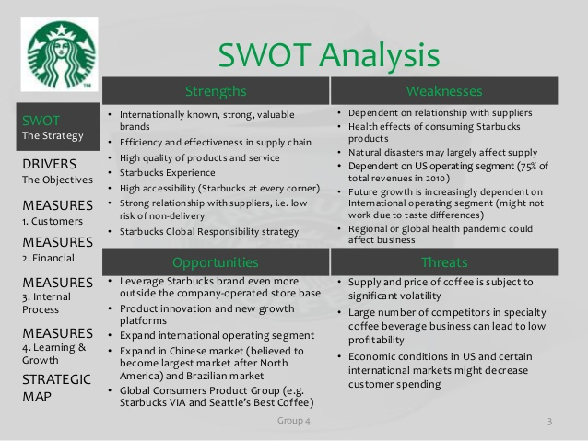

Slide 2
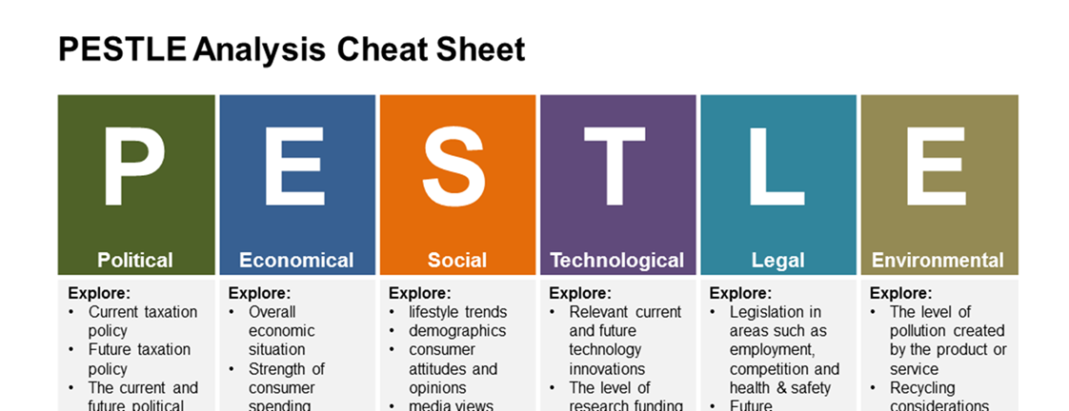
Recap
The Marketing Environment
    The Microenvironment: Consists of the actors close to the company that affect its ability to serve its
    Customers, the company, suppliers, marketing intermediaries, competitors, and publics (bank, media)
The Macroenvironment: Comprises a complex set of uncontrollable variables which collectively form a framework within which organization's conduct business.

Slide 3
Week 4
Chapter 4
Managing Marketing
Information to Gain Customer Insights
Maryam.Feyzi-Zad@uwl.ac.uk

Slide 4
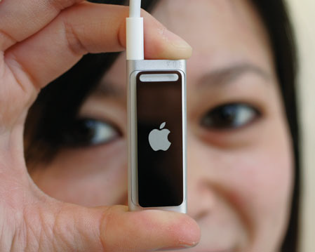
Marketing Information and Customer Insights
(To create value for customer, marketers must first gain fresh, deep insights into what customers need and want)
Customer Insights:
Fresh understandings of customers and the marketplace derived from marketing information that become the basis for creating customer value and relationships.
Notes:
consumers themselves usually can’t tell you exactly what they need and why they buy. To gain good customer insights,
marketers must effectively manage marketing information from a wide range of sources.

Slide 5
Marketing Information systems (MIS)
Marketing information system (MIS) refers to People, and procedures to gather, sort, analyse, evaluate and distribute needed and accurate information to marketing decision makers to generate customer insight
A marketing information system (MIS) provides information to the company’s marketing and other managers and external partners such as suppliers, resellers, and marketing service agencies.

Slide 6
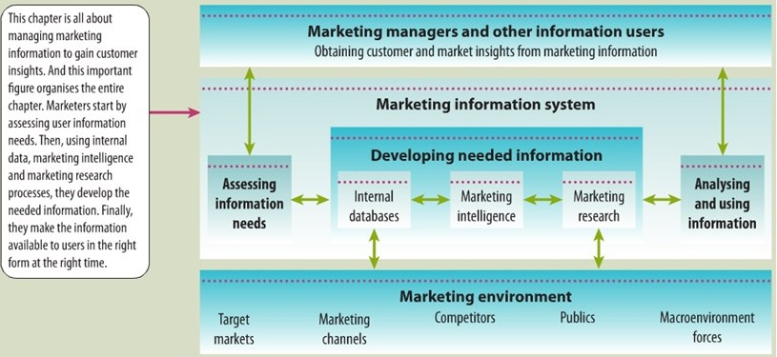
Marketing Information systems (MIS)

Slide 7
MIS
First, managers assess their information needs.
Next, developing the needed information from internal company records, marketing intelligence activities and the marketing research process.
Information analysis processes the information to make it more useful.
Finally, the MIS distributes information to managers in the right form at the right time to help them in marketing planning, implementation and control.

Slide 8
Developing Marketing Information
Marketers obtain information from
1 Internal data
2. Competitive Marketing intelligence
3. Marketing research
Notes:
The problem isn’t finding information; the world is bursting with information. The real challenge is to find the right information—from inside and outside sources—and turn it into
customer insights.

Slide 9

1. Internal data
Internal databases are electronic collections of consumer and market information obtained from data sources within the company network
(Marketing department, financial reports, customer service, company website , shipment)
Secondary
Information from internal records
is usually quicker and cheaper
however has some problems because it
Collected for another purpose.
Notes:
Internal databases usually can be accessed more quickly and cheaply than other information sources, but they also present some problems.
Because internal information is often collected for other purposes, it may be incomplete or in the wrong form for making marketing decisions

Slide 10
2. Competitive Marketing Intelligence
Competitive marketing intelligence: The systematic collection and analysis of openly available information about consumers, competitors, and developments in the marketing environment.
(From social media, competitors, executives, engineers and scientists, purchasing agents, and the sales force, also supplier and resellers and customers) Secondary
Purpose:
Improving strategic decision
Understanding the consumer environment
Assessing and tracking competitors’ actions
Providing early warnings of opportunities and threats.
Notes:
Good marketing intelligence can help marketers gain insights into how consumers talk about and connect with their brands.

Slide 11
3. Marketing research
Marketing research : The systematic design, collection, analysis, and reporting of data relevant to a specific marketing situation facing an organisation.
Marketing research gives marketers insights into customer motivations, purchase behaviour, and satisfaction. It can help them to assess market potential and market share or measure the effectiveness of pricing, product, distribution, and promotion activities.
Primary data collection
The marketing research process has four steps :
1. Defining the problem and research objectives
2. Developing the research plan
3. Implementing (Applying) the research plan
4. Interpreting and reporting the findings
Notes:
For example,
Google wants to know how Web searchers will react to a proposed redesign of its site.
Or Samsung wants to know how many and what kinds of people will buy its next-generation, televisions.

Slide 12


Marketing research process

Slide 13
Defining the Problem and Research Objectives
After the problem has been defined carefully, the researcher must set the research objectives.
Marketing research project might have one of three types of objectives.:
1. Exploratory research: Gathering primary information that will help deﬁne the problem and suggest hypotheses.
2. Descriptive research: Describing marketing problems or situations, such as the market potential for a product or the demographics and attitudes of consumers who buy the product.
3. Causal research: Testing hypotheses about cause-and-effect relationships. (Through experiment)
Notes:
Exploratory research (focused group, open-ended questions
Descriptive research: closed ended questions

Slide 14
Developing the Research Plan
(Data collection)
To meet the manager’s information needs, the research plan can call for gathering secondary data, primary data, or both.
Secondary data consist of information that already exists somewhere, having been collected for another purpose
Companies can buy secondary data reports from outside suppliers or they can use Internet search engines
Primary data consist of information gathered for the special research plan
Companies need to design a plan for primary data collection calls for a number of decisions on research approaches, contact methods, the sampling plan, and research instruments.
Notes:
Once the research problem and objectives have been defined, researchers must determine the exact information needed, develop a plan for gathering it efficiently, and present the plan to management.
Researchers usually start by gathering secondary data. The company’s internal database provides a good starting point.

Slide 15
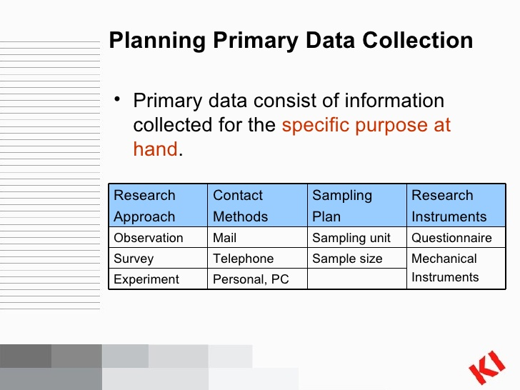
Research Approaches
Notes:
Secondary data can usually be obtained more quickly and at a lower cost than primary data, Internet search engines can be a big help in locating secondary information sources. However, they can also be very frustrating and inefficient. In most cases, the company must also collect primary data.

Slide 16
Research Approaches
(Primary Data Collection)
Observational approach : Gathering primary data by observing relevant people, actions and situations. (ethnographic research).
Observation is best suited for Exploratory Research
Survey approach: Gathering primary data by asking people directly questions about their knowledge, attitudes, preferences, and buying behaviour.
Surveys are best suited for Descriptive Research
Experimental approach:Gathering primary data by selecting matched groups of subjects, giving them different treatments, controlling unrelated factors and checking for differences in group responses. (cause and effect relationship)
Experimental approach is best suited for Causal Research
Notes:
Ethnographic: relating to the scientific description of peoples and cultures with their customs, habits, and mutual differences.

Slide 17
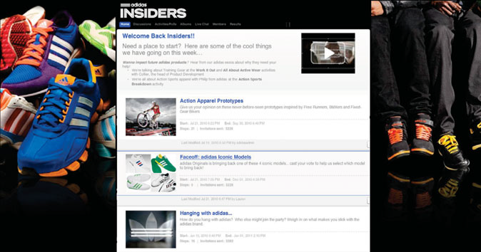
Contact methods
Mail, Telephone, and Personal Interviewing
Focus group interviewing
Online marketing research : Internet surveys, online focus groups, Web-based experiments, or tracking consumers’ online behaviour
Online focus groups: Gain qualitative insights about consumer attitudes and behaviour.

Slide 18
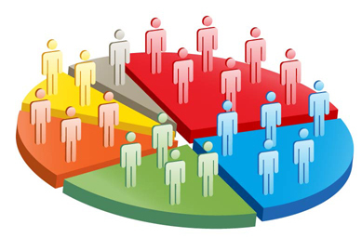
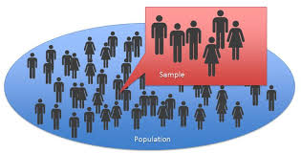
Sampling Plan
Sample: A segment of the population selected for marketing research to represent the population as a whole.
Who is to be surveyed?
How many people should be surveyed?
How should the people be chosen?(Randomly or Cluster)
Notes:
Randomly or Cluster; Group

Slide 19
Research Instruments
Questionnaires :
Open-end questions (interview) include all possible answers, and subjects make choices among them
Closed-end questions allow respondents to answer in their own words such as “yes/no” or among a set multiple choice questions.
Mechanical Instruments:
Eye-tracking,
Neuro-marketing: measuring brain activity to
learn how consumers feel and respond
Checkout scanners
Mechanical devices (to track eye movement,
monitor heart rates, and measure
other physical responses)

Slide 20
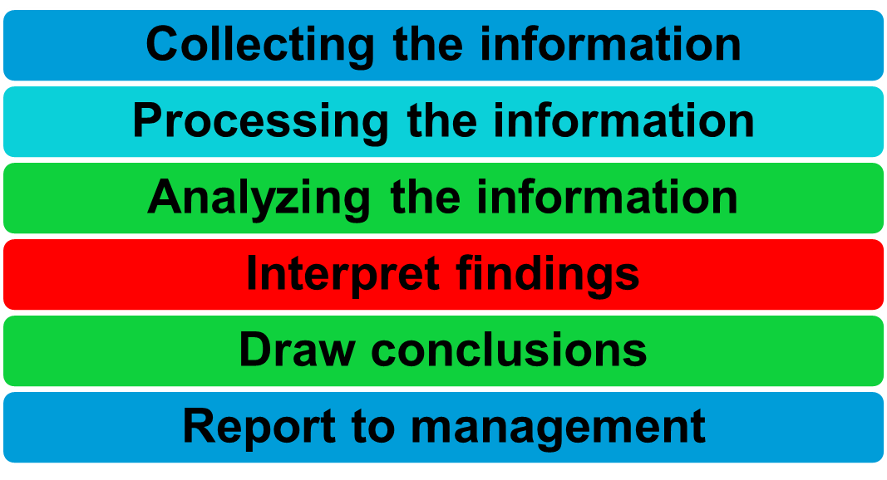
Implementing & Interpreting the Research Plan
Notes:
3. Researchers should make sure that the plan is applied correctly and process and analyse the collected data to isolate important information.
4. Researchers should interpret the findings, draw conclusions, and make a report of them, present important findings that are useful in the major decisions faced by management.

Slide 21
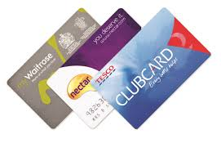

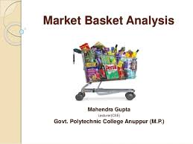
Analysing and Using Marketing
Information
Customer relationship management (CRM): is the overall process of building and maintaining profitable customer relationships by delivering superior customer value and satisfaction.
It is Managing detailed information about individual customers and carefully managing customer touch points to maximize customer loyalty.
By using CRM to understand customers better, companies can provide higher levels of customer service and apply the results to build stronger customer relationships.

Slide 22
Review
Customer Insights:
Fresh understandings of customers and the marketplace derived from marketing information that become the basis for creating customer value and relationships.
Marketing Information System (MIS) refers to People, and procedures to gather, sort, analyse, evaluate and distribute needed and accurate information to marketing decision makers to generate customer insight.
Developing Marketing Information:
Internal data, Marketing intelligence, Marketing research
Type of Research Objectives : Exploratory , descriptive, causal
Research approaches: Observation, survey, experiment

Slide 23
Group activity : Market Research
You are working in the marketing department for Asda supermarket
Director of your selected branch would like you to conduct a research to solve one of the branch problem therefore :
1. Conduct exploratory research, (recognise some issues)
2. Research instrument : interview, open- end questions
3. Analysis and interpret the data,
4 . Present the recommendation for the managers.

