Slide 1
Week 6 Products & Branding

Slide 2
Recap
Explain how companies identify attractive market segments and choose a market targeting strategy:
four market-targeting strategies :
Undifferentiated (or mass) marketing.
Differentiated marketing
Niche marketing (concentrated marketing)
Micromarketing (Local marketing or Individual marketing )

Slide 3
Recap
Define the major steps in designing a customer-driven marketing strategy: market segmentation, targeting, differentiation, and positioning.
List and discuss the major bases for segmenting consumer and business markets: geographic, demographic, psychographic, and behavioural
demographic variables, including age, gender, family size, family life cycle, income, occupation, education, religion, race, generation, and nationality
psychographic : social class, lifestyle, or personality characteristics (opinion, interest, activities)

Slide 4
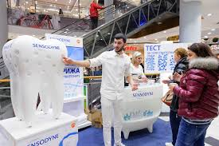
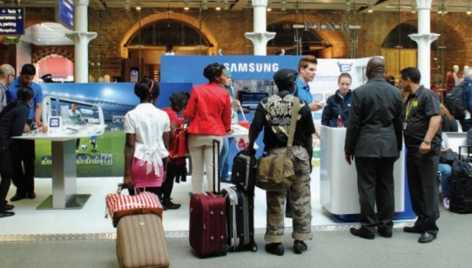
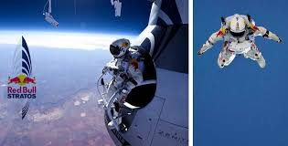
Products, Services, and Experiences
Product is anything that can be offered in a market for attention, acquisition, use, or consumption that might satisfy a need or want.
Service is a product that consists of activities, benefits, or satisfactions and that is essentially intangible and does not result in the ownership of anything.
Experiences have always been an important part of marketing for some companies. (differentiation) Disney , Samsung , Apple
(Samsung: As part of its sponsorship of the 2012 Olympics, Samsung created brand experiences at various destinations around London, including St Pancras International, Stratford International, Westfield Stratford, ..,)

Slide 5
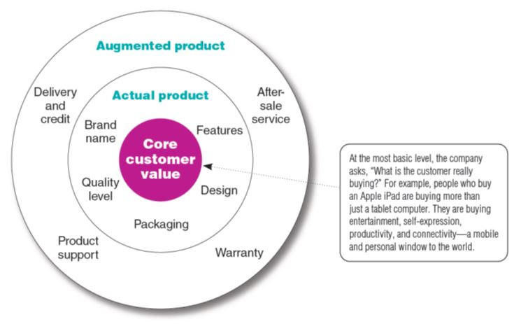
Level of Product & Service

Slide 6
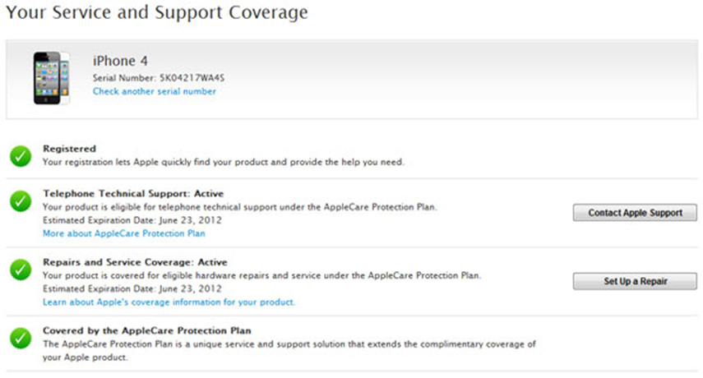
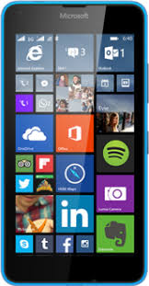
Level of Product & Service
Core customer value: The most basic level is the core customer value, which addresses the question What is the buyer really buying?
Marketers first define the core, problem-solving benefits or services that consumers seek.
Actual product: They need to develop product and service features, design, a quality level, a brand name, and packaging
Augmented product : offering additional consumer services and benefits based on actual product.

Slide 7
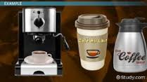
Product Classification according to durability
Non-durable product—A consumer product that is normally consumed in one or a few uses. such as beer, soap and food products
Durable product—A consumer product that is usually used over an extended period of time and that normally survives many uses. Examples are refrigerators, cars and furniture.

Slide 8
Product Classification according to type of customer
1. Consumer products are products and services bought by final consumers for personal consumption.

Slide 9
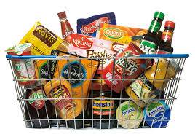
Customer product
1. Convenience products (Non durable products)are consumer products and services that the customer usually buys frequently, immediately, and with a minimum comparison and buying effort. (magazine, toothpaste, milk)

Slide 10
Customer product
2. Shopping products (durable products) are less frequently purchased and consumers spend considerable time and effort gathering information and comparing alternative brands carefully on suitability, quality, price and style. Examples of shopping products are :
Major appliances,
televisions, furniture,
and clothing.
(Selective distribution in
fewer outlets)

Slide 11
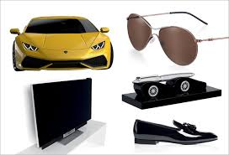
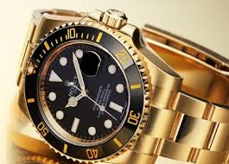
Customer product
3. Specialty products are consumer products and services with unique characteristics or brand identification for which a significant group of buyers is willing to make a special purchase effort. (Luxury goods: Rolex watches or fine crystal)
Exclusive distribution in only one or a few
outlets per market area

Slide 12
Customer product
4. Unsought products are consumer products that the consumer does not know about or knows about but does not normally think of buying.
Require a lot of advertising,
personal selling, and
other marketing efforts.

Slide 13
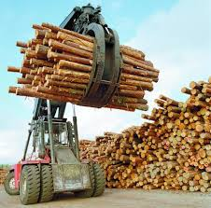
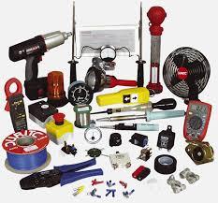
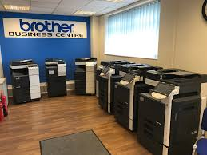
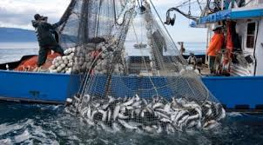
Product Classification
2. Industrial products are those products purchased for further processing or for use in conducting a business.
The distinction between a consumer product and an industrial product is based on the purpose for which the product is purchased.
Materials and parts (Raw , Manufactured, Natural & Farm materials )
Capital items (production & operation) construction and equipment
Supplies and services (convenience products of the industrial field & repair and advisory service

Slide 14
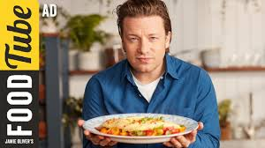
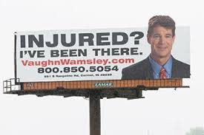
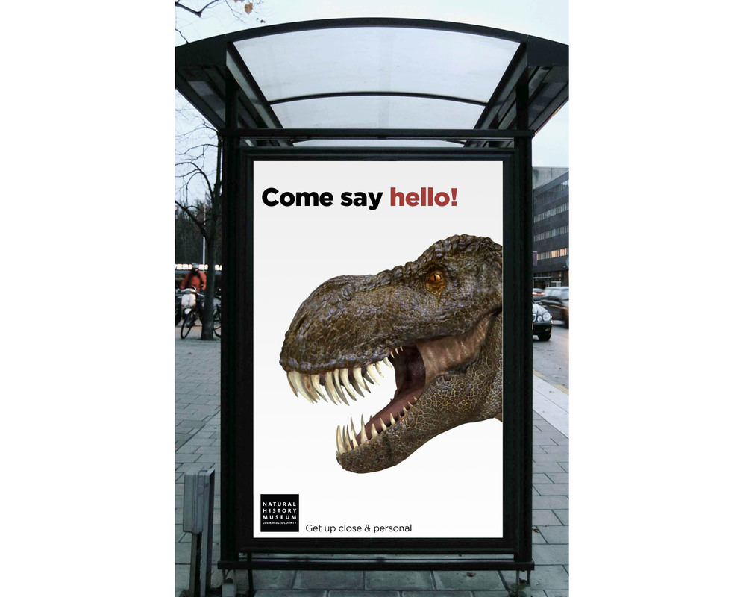
Types of Marketing
Organisation Marketing: Organisation often carry out activities to “sell” the organisation itself. Both profit and not-for-profit organisation practice organisation marketing. Business firms sponsor public relations or corporate image marketing campaigns to market themselves and polish their images. (charities, museums, colleges, universities)
People Marketing : People can also be thought of as products. People ranging from presidents, entertainers, and sports figures to professionals such as doctors, lawyers, and architects use person marketing to build their reputations. Businesses, charities, and other organizations use well-known personalities to help sell their products or causes.

Slide 15
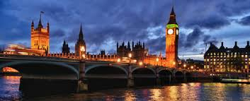
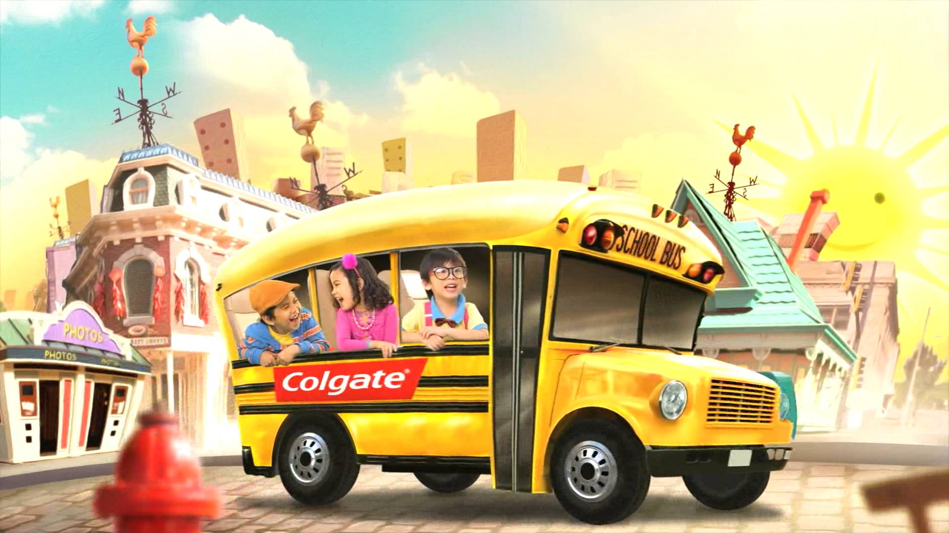
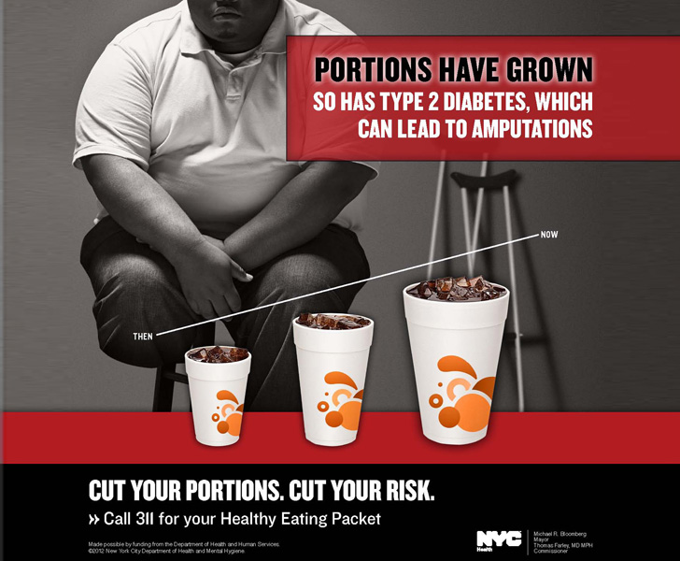
Types of Marketing
Place marketing:
Cities, states, regions, and even entire nations compete to attract tourists, new residents, conventions, and company offices and factories.
Ideas & social marketing:
Ideas can also be marketed. In one sense, all marketing is the marketing of an idea,
Social ideas. This area has been called social marketing such as
public health campaign for reducing smoking, drug abuse, obesity, family planning, human rights, racial equality.

Slide 16
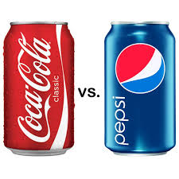
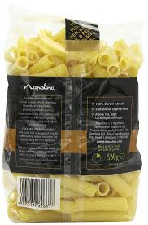
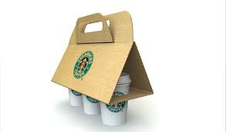
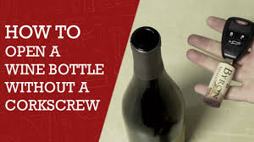
Branding
Branding : Brand is the name, term, sign, or design or a combination of these, that identifies the products/services of one seller and differentiates them from their competitors. .
Packaging : involves designing and producing the container or wrapper for product.
Labels identify the product or brand, describe attributes, and provide promotion. Labelling can enhance a brand’s positioning
Product Support Services: Customer service is another element of product strategy. A company’s offer usually includes some product support services, which can be a minor part or a major part of the total offering. (building lasting relationship)

Slide 17
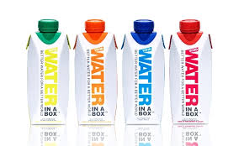
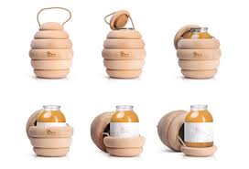
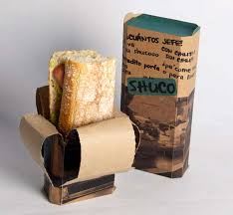
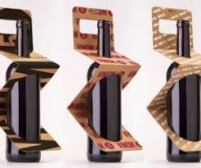
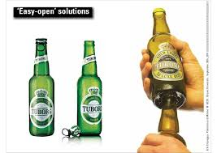
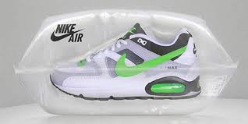
Distinctive packaging

Slide 18
Branding Strategy: Building Strong Brands

Slide 19
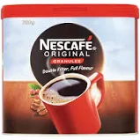
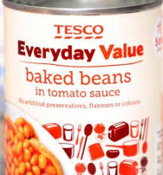
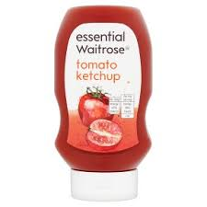
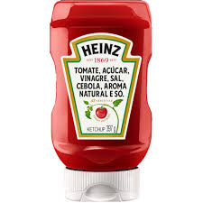
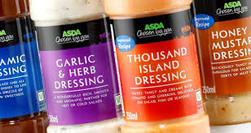
Brand Sponsorship
A manufacturer has four brand sponsorship options. The product may be launched as a national brand or a private brand (also called a store brand or distributor brand). Other alternatives include a licensed brand and co-branding.
Manufacturers’ brands (national brand) —A brand created and owned by the producer of a product or service.
Private brand (middleman, distributor or store brand)— A brand created and owned by a reseller of a product or service.

Slide 20
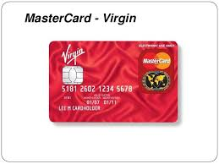
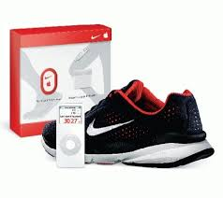
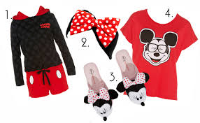
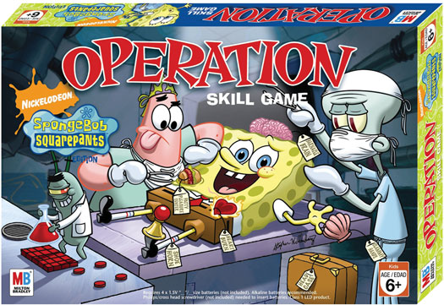
Brand sponsorship
Licensing: Some companies license names or symbols previously created by other manufacturers, names of well-known celebrities, or characters from popular movies and books. For a fee, any of these can provide an instant and proven brand name.
Co-brand: The practice of using the established brand names of two different companies on the same product (Nike& Apple sport kit)

Slide 21
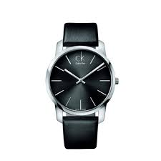
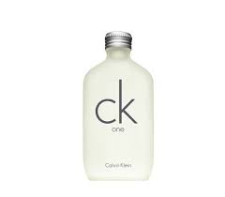
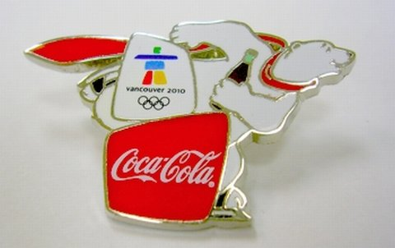
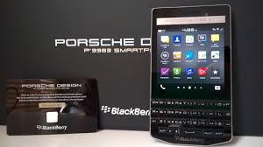
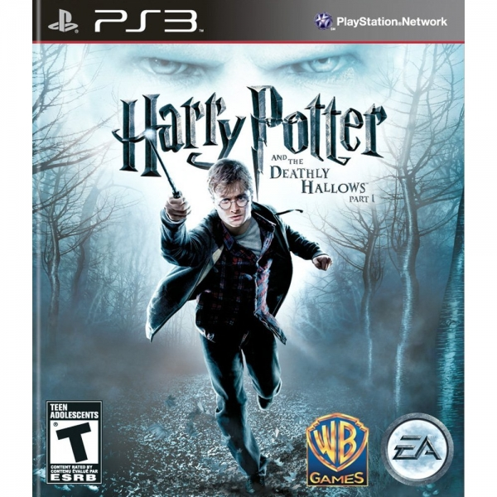
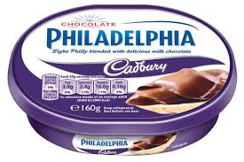
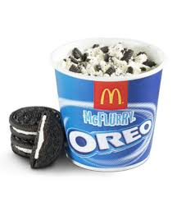

Slide 22
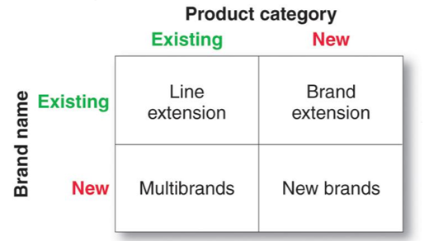
Brand Development Strategies

Slide 23
Brand Development
Line Extension
Brand Extension
Multi-brand
New Brand

Slide 24
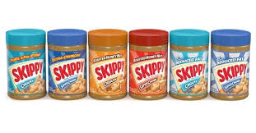
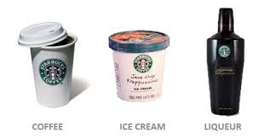
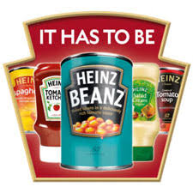
Brand development
Line extension: Extending an existing brand name to new forms, colours, sizes, ingredients, or flavours of an existing product category.
Danone has added several new ﬂavours to its yoghurt line, as well as fat-free and large, family/economy-size varieties
Brand extension: Extending an existing brand name to new product categories

Slide 25
Brand development
Multibrand strategy— A brand strategy under which a seller develops two or more brands in the same product category
Multibranding offers a way to establish different features that appeal to different customer segments, lock up more reseller shelf space, and capture a larger market share.
(Seiko Lasalle)
lower-priced watches (Pulsar)

Slide 26
Brand development
New brands- Firms that favour a multibands approach are likely to create a new brand to differentiate a new product, whether it is introduced into an existing or a new-product category.

Slide 28
Services Marketing

Slide 29
Services Marketing characteristics
Service intangibility means that services cannot be seen, tasted, felt, heard, or smelled before they are bought
Service inseparability: Services are produced and consumed at the same time and cannot be separated from their providers.
Service variability means that the quality of services depends on who provides them as well as when, where, and how they are provided. ( not every one is cheerful)
Service perishability Services cannot be stored for later sale or use. (it’s mortal)

Slide 30
Marketing Strategies for Service Firms
Internal marketing: Orienting and motivating customer contact
employees and supporting service people to work as a team to provide customer satisfaction.
Interactive marketing means that service quality depends heavily on the quality of the buyer-seller interaction during the service encounter (Service profit chain)

Slide 32
Marketing Strategies for Service Firms
Service profit chain : The chain that links service firm profits
with employee and customer satisfaction.
Internal service quality: superior employee selection and training, a quality work environment, and strong support for those dealing with customers, which results in . . .
• Satisfied and productive service employees: more satisfied, loyal, and hardworking employees,
which results in . . .
• Greater service value: more effective and efficient customer value creation and service delivery,
which results in . . .
• Satisfied and loyal customers: satisfied customers who remain loyal, repeat purchase, and
refer other customers, which results in . . .
• Healthy service profits and growth: superior service firm performance

Slide 33
Summary
The core customer value consists of the core problem-solving benefits that consumers seek when they buy a product.
The actual product exists around the core and includes the quality level, features, design, brand name, and packaging.
The augmented product is the actual product plus the various services and benefits offered with it, such as a warranty, free delivery,
Consumer products : those bought by final consumers—are usually classified according to consumer shopping habits (convenience products, shopping products, specialty products, and unsought products).
Industrial products: purchased for further processing or for use in conducting a business—include materials and parts, capital items, and supplies and services.

Slide 34
Summary
Branding decisions include selecting a brand name and developing a brand strategy.
Services are characterized by four key characteristics: they are
intangible, inseparable, variable, and perishable
In building brands, companies need to make decisions about
brand positioning, brand name selection, brand sponsorship, and
brand development. The most powerful brand positioning builds
around strong consumer beliefs and values

Slide 35
Summary
A manufacturer has four brand sponsorship options:
it can launch a national brand (or manufacturer’s brand), sell to resellers who use a private brand, market licensed brands, or join forces with another company to co-brand a product
A company also has four choices when it comes to developing brands. It can introduce
line extensions, brand extensions, multibrands, or new brands.

Slide 36
Plans to Create Las Vegas of the UK

Slide 37
Plans to Create Las Vegas of the UK
The idea to turn Blackpool into a UK Las Vegas came about in 2001, just as the seaside resort was welcoming its very first casino gambling property, Grosvenor Casino Blackpool. Local officials were looking for a way to reignite the tourist industry, resulting in what became a 7-year political controversy.
House of Lords rejected the idea of a gambling mecca in Great Britain in early 2008.
If ever the opportunity does arise again, though, casino developers will surely be at the ready with monumental proposals, like the one delivered by millionaire Trevor Hemmings back in 2001 that could have seen a 1,000-bed hotel and 100k-sqft gaming floor teeming with 2,500 pokies on the Promenade, or a similar plan introduced by tycoon Marc Etches around that same time.

Slide 38
Plans to Create Las Vegas of the UK
Create a marketing plan based on the UK culture and subculture to convince the government to turn Blackpool Into a British version of Las Vegas
1.Provide changes in the branding strategy for Blackpool
to attract more customers ? Who is the target market ?
2. What is Blackpool selling? What are visitors really buying?
Discuss these questions in terms of the core benefit, actual
product, and augmented product levels.
3. What Types of Marketing can grow and flourish in Blackpool?
4. What recommendations would you make for Blackpool’ future?

