Slide 1
Welcome to OXFORD BUSINESS COLLEGE in partnership with The University of West London
BA(Hons) Business Studies - Induction
Date: September 2022

Slide 2
What will be covered today 1. Talk about Oxford Business College and University of West London 2. Introduce you to our support services, resources and key policies 3. Programme Structure and classification 4. Prevent duties 5. Questions and Answers 6. Campus Tour 7. Complete your enrolment and documentation

Slide 3
PART 1 – OXFORD BUSINESS COLLEGE Welcome and brief overview of Oxford Business College followed by Campus-specific health and safety briefing - fire exits, fire assembly points, smoking areas, suggestion boxes etc. Welcome video by Dr. Gupta, Managing Director of Oxford Business College

Slide 4
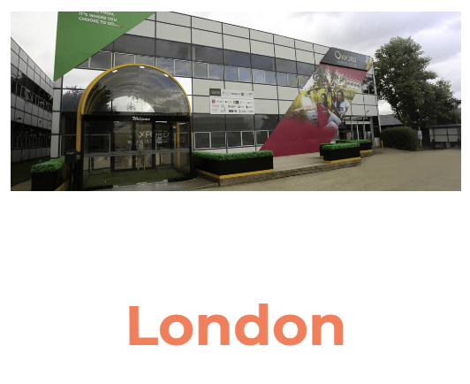
WE ARE IN FOUR UK CITIES

Slide 5
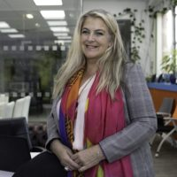
Student Support Services
Counselling and welfare
Disability Support
Learning difficulties
Administrative Support
Student Experience and Pastoral Support
Student Services Information Desk
Academic Liaison
Personal Tutoring
Diana Munoz – Head of Students’ Support Services
Email: diana.munoz@oxfordbusinesscollege.ac.uk

Slide 6
Learning Resources
Online Library – EBSCO
The Libraries of 158 institutions participating in SCONUL Access for the UK and Ireland are accessible
Oxford Business College’s own campus-based Physical Libraries
Computer Labs
Virtual Learning Environment (Blackboard)

Slide 7
Employment and careers
Assistance in looking for part-time jobs
Assistance in finding work experience and placements
Assistance with CV writing and drafting job applications
Assistance with preparation for interview.

Slide 8
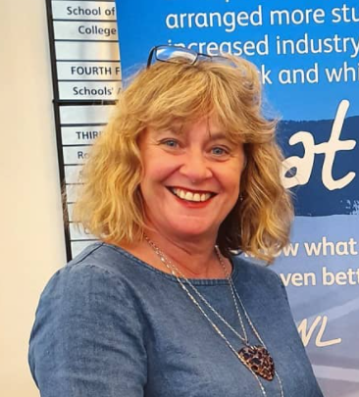
PART 2 – The University of West London (UWL) Welcome from the Senior Pro-Vice-Chancellor, Student Experience University of West London
Click here - video link to welcome talk

Slide 9
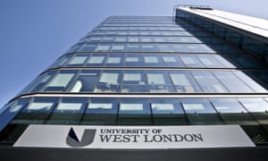
Who we are
We are the awarding body for your course
We are based in Ealing, Brentford (in London) and Reading
We work in partnership with over 40 education institutions across the world
You are part of a community of approximately 12,000 students
Find out more www.uwl.ac.uk
UWL achievements and the value of your degree

Slide 10
UWL’s Facts and achievements
We have been voted University of the Year for Student Experience in The Times and Sunday Times Good University Guide 2021, 2022 and 2023
University of the year for Teaching Quality - 2023.
In The Guardian University Guide 2022, we are one of the top 40 universities in the UK. UWL is now ranked 35th in the UK and the top modern* university in London.
Employability – Our career-focused courses will allow to immerse yourself in your chosen career before you even graduate.
Diversity - We have one of the most diverse student populations in the country.
UWL is described as ‘home to the nation’s most contented students’ (Times Good University Guide 2023. )
UWL’s achievements including REF 2021 and NSS are on the next slide.

Slide 11
Ranked no. 23 out of 121 Universities nationwide in the latest
2023 rankings

Slide 12
Your Degree with Oxford Business College- How it works
UWL approves and monitors your course
UWL awards your degree and issues your certificate
UWL works in partnership with Oxford Business College
Oxford Business College teaches your course and supports you in your studies
UWL provides you with access to Blackboard, virtual learning environment and e-Library

Slide 13
What this means for you
Your Education Institution will provide your details to UWL – your personal and contact details must be accurate
You must enrol online on the University’s enrolment website MyRegistry: http://onlineregistry.uwl.ac.uk/myRegistry/common/login.aspx (You will receive enrolment link from UWL)
After enrolment, you will be able to access UWL’s Blackboard and online Library (E-Library)
Your online enrolment will allow you to access any applicable and confirmed student finance payments (our admissions Officers will be able to help you after this induction)

Slide 14
TERMS AND CONDITIONS
You must read the UWL ‘Student Partnership Terms and Conditions 2022/2023 AY (for students studying on sub-contracted courses with UWL Partners) This document explains everything you need to know about your relationship with UWL and is available on Oxford
Business College’s website (direct link below) :
https://oxfordbusinesscollege.ac.uk/wp-content/uploads/2022/09/5-995.1 UWL_student_partnership_terms_and_conditions_2022_2023-Aug22-1.pdf

Slide 15
Our expectations of you
Attend your classes – face to face
Engage with the course content
Adhere to the UWL Regulations, including the Academic Regulations: https://www.uwl.ac.uk/about-us/policies-and-regulations
Adhere to all regulations, policies and procedures
Make sure we have your accurate and up to date personal contact details

Slide 16
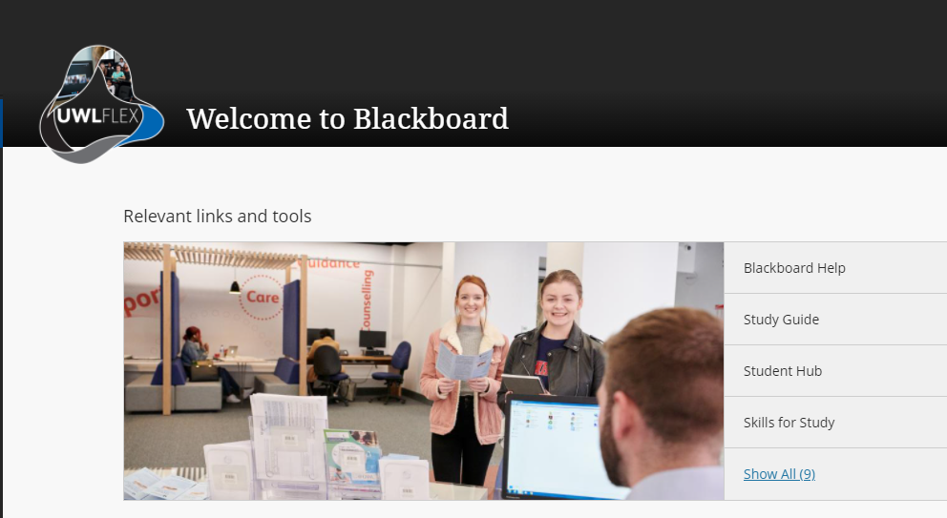
Your first week
Complete ONLINE Enrolment (A link will be sent to all students in the coming days)
Induction (today)
Complete any outstanding documentation (today see our admissions Team after the induction)
Lectures start next week - Make sure you come in for the attendance days you have chosen
You will be given your timetables when you come in next week
Lectures - over two days – 10am-5pm each day with lunch break from 1pm-2pm.
If you fail to attend lectures or engage, you could be withdrawn from the programme.

Slide 17
UWL Blackboard
Blackboard is a virtual learning environment where you will find each module that you are registered on and in each module you will find:
Learn to learn online module
Module study guides
Learning materials
Announcements
Grades and feedback from your tutors
Assignment submission areas (including Turnitin)
Online discussions and other learning activities
General Help: https://www.uwl.ac.uk/blackboard-help-students/
Click to watch video on How to use Blackboard http://bit.ly/UWLBB (Play Video)

Slide 18
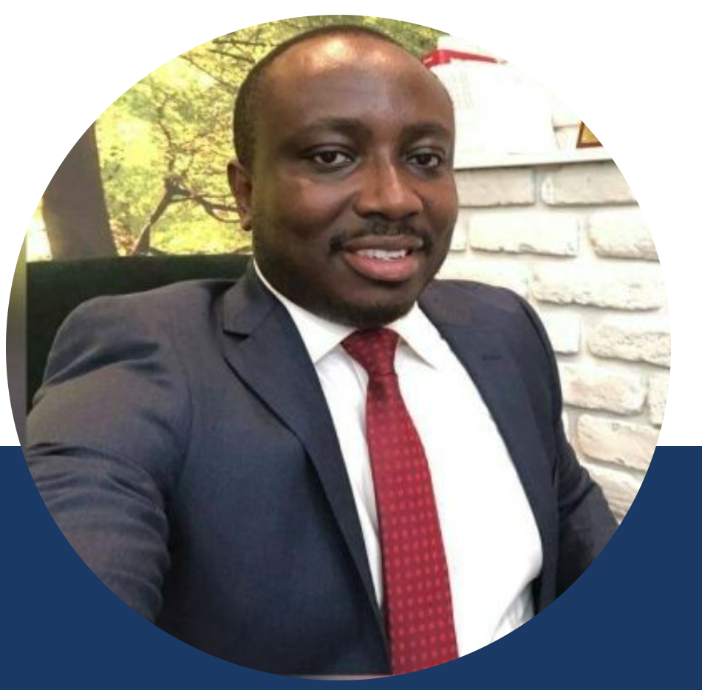
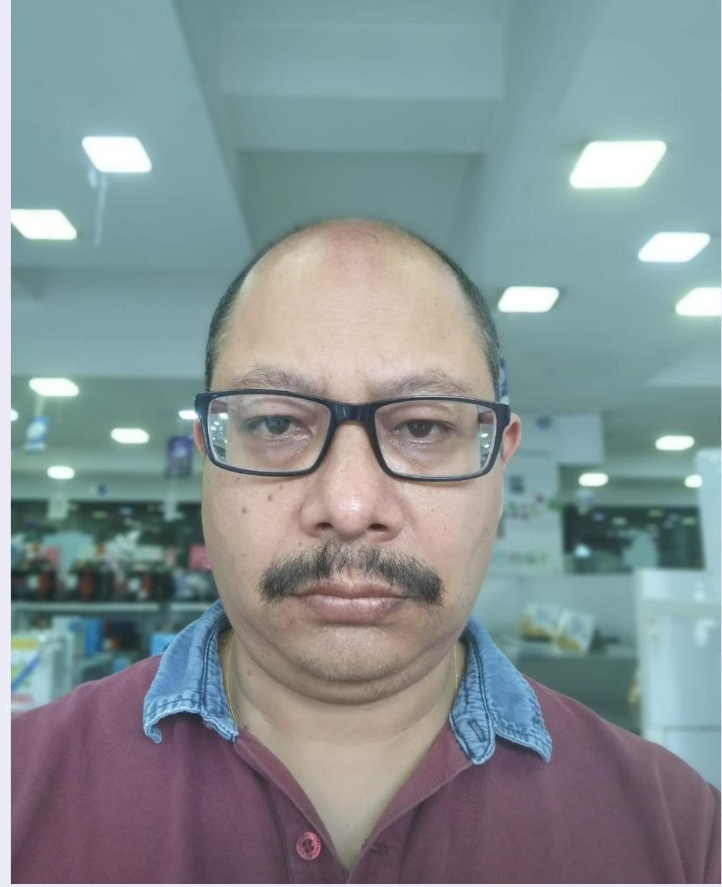
KEY ACADEMIC TEAM MEMBERS FOR YOUR PROGRAMME AT OBC
Samuel Asante-Nnuro – Head of Programme
Salvena Hussain – Programme Coordinator – Oxford Campus
Adu Adom Boateng – Programme Coordinator – London Campus
Amit Gupta– Programme Coordinator – Slough Campus
Manish Shrestha – Programme Coordinator – Nottingham Campus

Slide 19
PROGRAMME STRUCTURE
 | Semester 1 |  |  | Semester 2
 | Core | Core | Core | Core | Core | Core
Level 3 120 credits | Personalised Learning (20 credits) | Introduction to Business (20 credits) | Recording Business Transactions (20 credits) | Managing People and Systems (20 credits) | Data Handling and Using ICT (20 credits) | Academic Performance (20 credits)
Level 4 120 credits | Professional Skills for Business (20 credits) | Researching Business Data (20 credits) | Introduction to HRM (20 credits) | Principles of Marketing (20 credits) | Information Communications Technology (20 credits) | Business Accounting (20 credits)
Level 5 120 credits | Enterprise and Business Development (20 credits) | Managing Business Operations (20 credits) | Business Economics (20 credits) | Business ethics (20 credits) | Organisational behaviour (20 credits) | Research Methods (20 credits)
Level 6 120 credits | Strategic Management (20 credits) | International Trade, Finance and Investment (20 credits) | Business Research report (semester 1and 2) (40 credits) | International Business (20 credits) | Managing Small and medium enterprise (20 credits)

Slide 20
PROGRAMME ASSESSMENT
Percentage of final marks assessed by: | Level 3 | Level 4 | Level 5 | Level 6
Exam | 0% | 0% | 0% | 0%
Coursework | 100% | 100% | 100% | 100%
Please note: Although there are no exams, there may be some in-class or online tests for some of the modules

Slide 21
Possible exit awards – if you cannot continue your studies
Exit Awards (under exceptional circumstances) | Level and Credits completed | Total Cumulative Credits completed
Certificate of Higher Education in Business Studies | Level 4: 120 Credits | 120 credits
Diploma of Higher Education in Business Studies | Level 4:120 Credits & Level 5: 120 Credits | 240 credits
Ordinary Pass degree in Business Studies | Level 4:120 Credits, Level 5: 120 Credits & Level 6: 60 credits | 300 credits

Slide 22
Degree Classification
Mark Classification
70% - 100% First Class Honours
60% - 69% Second Class Honours, Upper Division
50% - 59% Second Class Honours, Lower Division
40% - 49% Third Class Honours
0% – 39% Fail

Slide 23
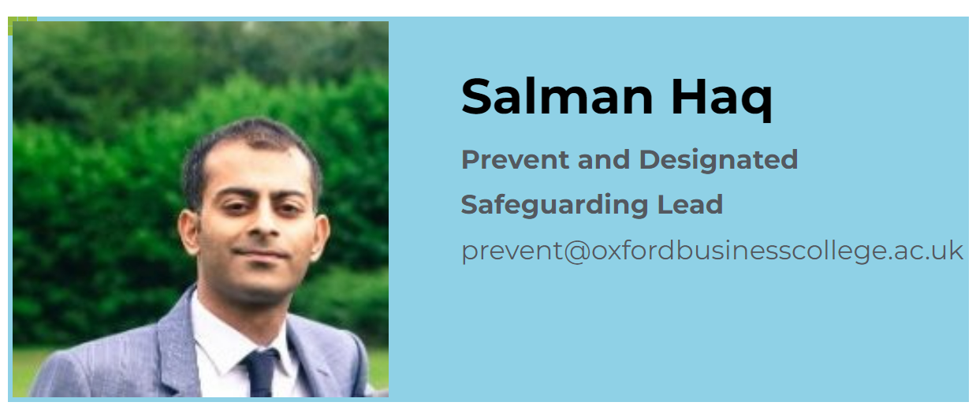
Prevent Duty
Prevent Lead: Salman Haq
prevent@oxfordbusinesscollege.ac.uk

Slide 24
What is Prevent Duty?
The Counter-Terrorism and Security Act 2015 (CTSA) imposes a statutory duty on Higher Education Institutions to 'have due regard to the need to prevent people from being drawn into terrorism’ (DFE, 2015).
The Office for Students (OFS) monitors Higher Education Institutions to ensure they have measures in place to prevent people from being drawn into terrorism

Slide 25
What is the purpose of the Prevent Duty?
The government describes the purpose of Prevent as “to reduce the threat to the UK from terrorism by stopping people becoming terrorists or supporting terrorism.” (Home Office, 2015)
Prevent is about safeguarding and supporting those vulnerable to radicalisation.

Slide 26
What does Prevent do?
1
Responds to the ideological challenge we face from terrorism and aspects of extremism, and the threat we face from those who promote these views.
2
Provides practical help to prevent people from being drawn into terrorism and ensure they are given appropriate advice and support.
3
Works with a wide range of sectors (including education, criminal justice, faith, charities, online and health) where there are risks of radicalisation that we need to deal with.

Slide 27
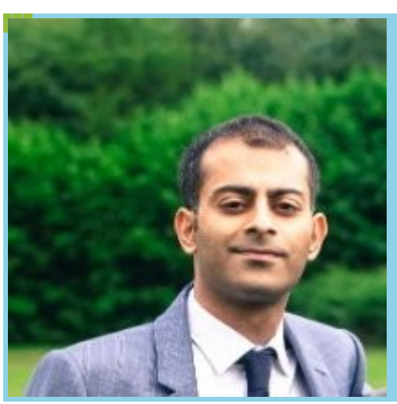
Talk to us
Counsellor
Students
Tutor
Academic Staff
Administrative Staff
Prevent Lead
prevent@oxfordbusinesscollege.ac.uk
Welfare Staff

Slide 28
QUESTIONS?
Next :
Scan the QR code at the bottom of the agenda and fill in the feedback form (only takes 2 minutes)
Campus Tour
Assistance with online enrolment for those who have received the link
Meeting with Admissions/Registry to check accuracy of personal details and complete outstanding documentation

Slide 29
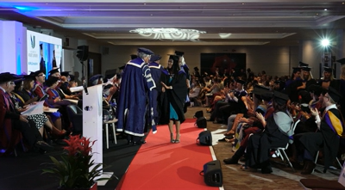
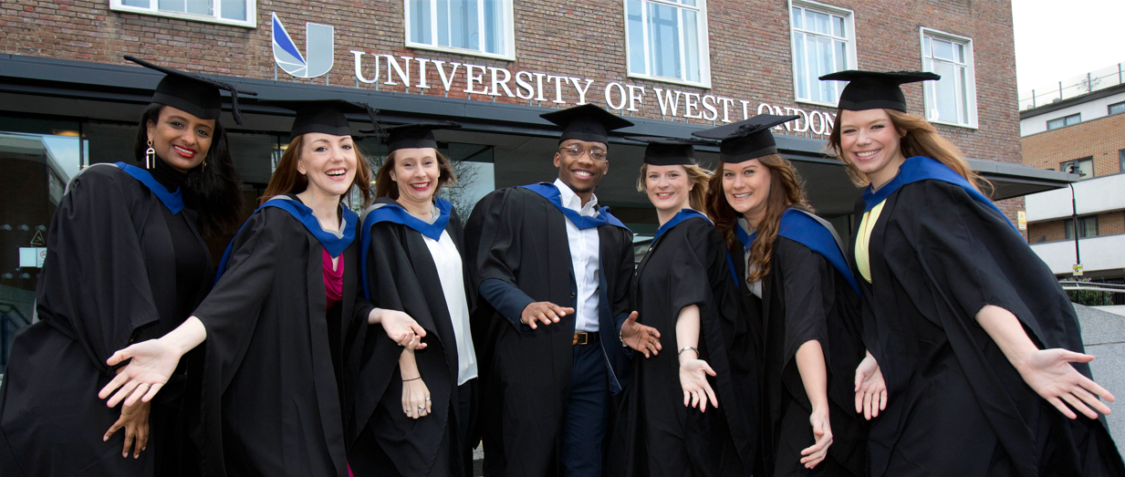
Good luck with your studies!

