Slide 1
Stage 2 Research Project – 2020
This template is to be used as a guide.
While the contents of your project should remain the same, you may adapt the layout or add additional annotations, etc. to meet the needs of your project.
RPA |  | RPB
School Assessment Cover Sheet for
Assessment Type 1: Folio
SACE Registration No:
Research Question:_______________________________________ _______________________________________________________
Planning | Development
P1 | D1
P2 | D2
 | D3
 | D4
10 single-sided A4 pages Evidence reduced in size (e.g. A3 pages or two A4 pages reduced in size to A4) is not acceptable. or 20 minutes of digitally recorded evidence or a combination of these

Slide 2
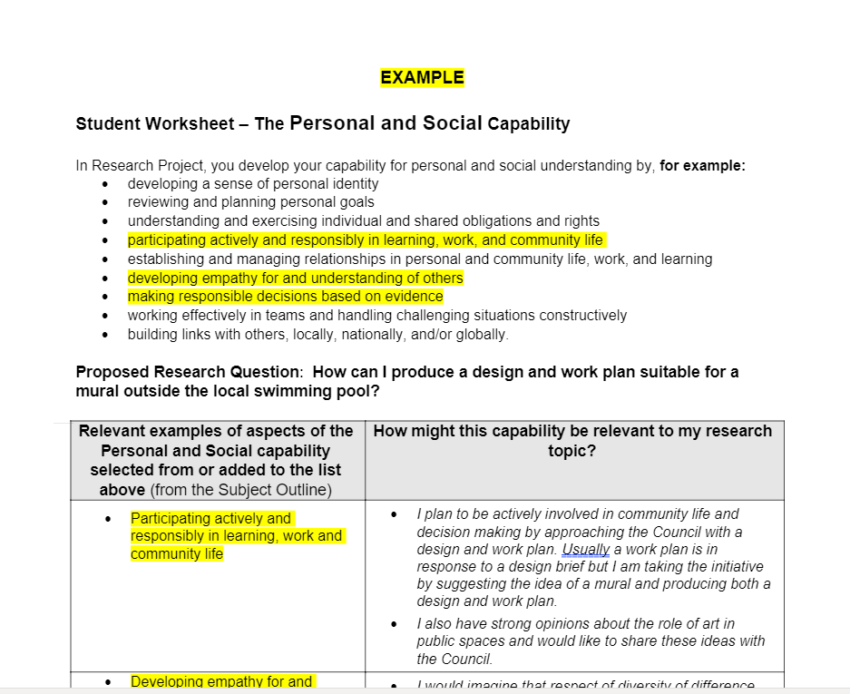
Proposal
P1
This worksheet should inform your first page.
Make sure that your responses are written in full sentences as the prompts in blue will not appear in your final product.
Question Refinement
Max went and got properly diagnosed and put onto a medication called Ritalin. Ritalin stimulates the mind and body in adults and can calm children down. Where I developed my question How have gender differences impacted the diagnosis and treatment of ADHD in female adolescents? is when I started to notice my own ADHD symptoms without knowing they were directly correlated to ADHD. I started to wonder whether my symptoms being different to maxes lead to a different treatment.
Ethics
I will need to consider a few things when I conduct my research, such as how long it will take my interview subjects to respond to me; this will depend on who and where they are. Additionally, the interviewees would have the choice to remain anonymous if they so desired. The responses to my surveys would be more thorough and authentic if I kept them anonymous. which would also be ethical.
Capabilities
Throughout my case study I plan on developing my personal and social capabilities as well as my critical and creative thinking I feel I could link these to be research when analysing different sources and articles about my topic.
Your responses from this documents should go here. Make sure you have used the language that SACE have given you and you are specific in your responses.
Research Processes
I plan to use a variety of sources, including both quantitative and qualitative research, to acquire information for my folio. In order to assist me construct an outcome, I'll use both primary and secondary materials in my folio. I'll analyse the qualitative data to better understand how people with ADHD struggle and succeed. This will be made clear in my surveys and interviews. While I collect numerical statistics comparing academic achievement while taking medication vs. when not taking medication, the quantitative data will be helpful.
My whole family knew my brother Max was ADHD before he was even diagnosed, he was everything you think of when you think ADHD, hyperactivity, inability to sit still, impulsive. Within the first term of every school year his teacher would sit down with mum and tell her everything she already knew. This wasn’t a problem for max until high school when all of a sudden sport wasn’t the only thing that mattered to him. He couldn’t focus in class and couldn’t listen to long explanations of tasks and this would frustrate and overwhelm him, causing him to act out.
Outcome
My outcome will take place in written form and will include thorough understanding of ADHD diagnosis and treatment. My intended audience is more than less aimed at young undiagnosed females. But it would be beneficial to combine and compare data.

Slide 3
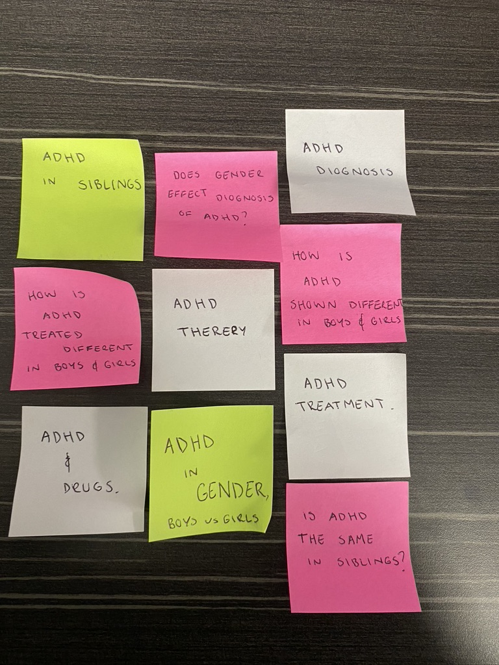
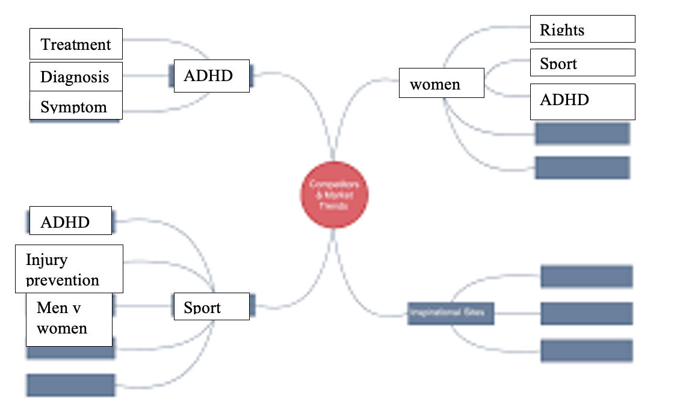
Lotus Diagram
P1
Lotus diagrams can be screenshot and pasted in.
Blank boxes are ok, but you can make use of this space by including annotations based on your preliminary research or other planning processes.
You might also consider enlarging specific sections, colour coding sections to match your question refinement.
Journal Entry 1
I began by brainstorming things on a mind map that I could be interested in researching and noticed that I could link ADHD to a lot of other areas, sport, gender... I then began coming up with questions and concepts on sticky notes that were directly correlated to ADHD.
I then came up with a broad, rough question: how does ADHD appear differently in girls and boys and how does it affect their diagnosis?
I Then build on it and made it more concise to have as my final question:
How have gender differences impacted the diagnosis and treatment of ADHD in female adolescents?
You can copy your journal entries straight in here, or you might use them to inform the annotations around your lotus diagram.
Make sure any references in your entries are specific and related.
Discuss why you have chosen your final question. What connection do you have to the topic? How can researching this topic benefit you/ society/ economy/ politics/ environment/ etc.? How does this question allow you to explore what it is you want to focus on?
Question Refinement
(Journal Entry 3)
Final Question
Evidence of Planning
This can include screen shots of you brainstorming your question, including questions you rejected.
You might also annotate screen shots of preliminary research or include mind-maps of your topic.

Slide 4
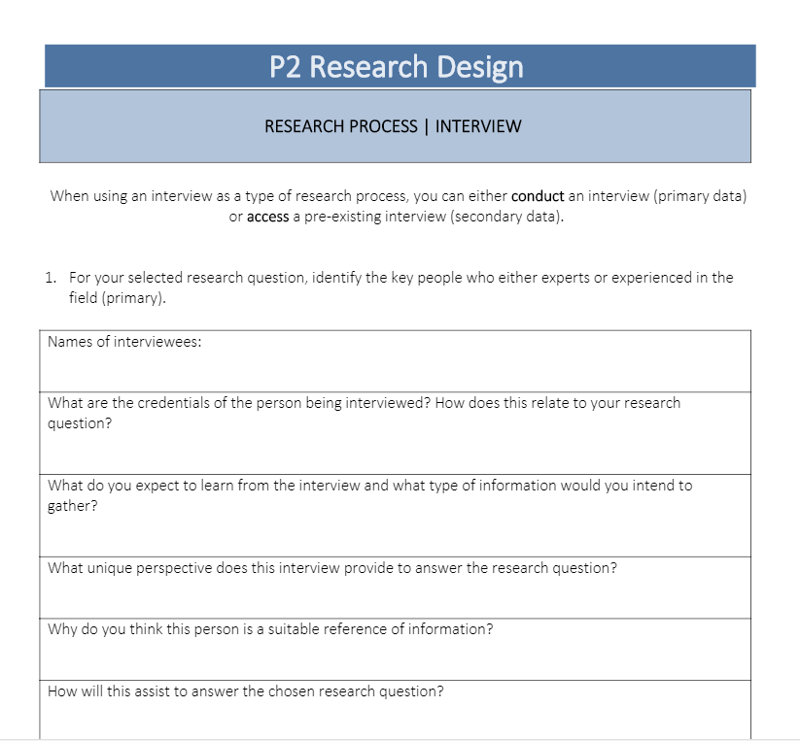
Sub Questions
P2
This documents can be screen shot and pasted here
Research Design and Processes
GANNT Chart
Your responses from this document can be copied here. Remember to put them into full sentences, as the prompts will not appear in your Folio.
This documents can be screen shot and pasted here

Slide 5
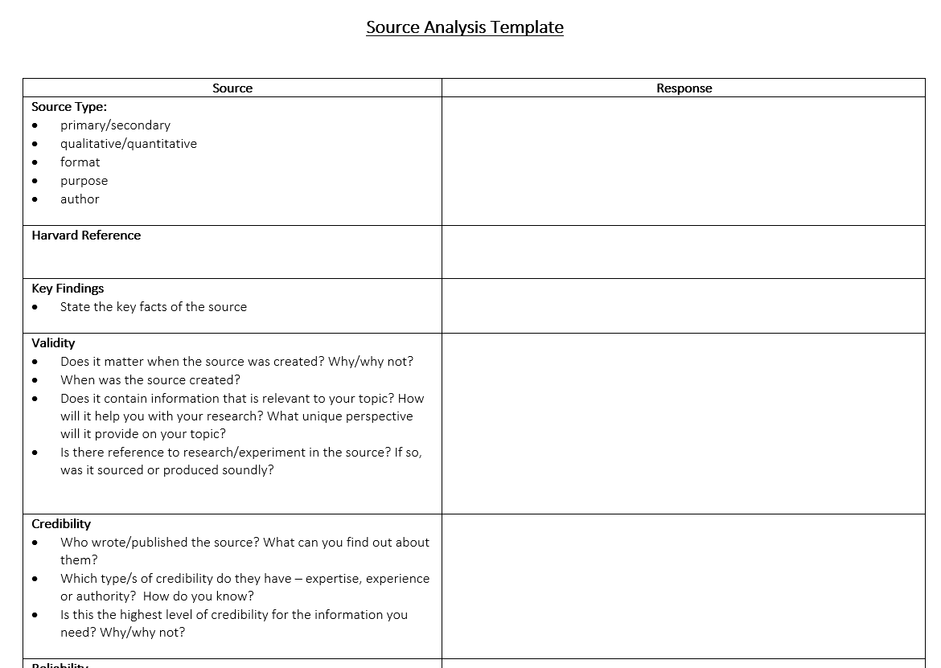
Source Information:
D1-4
Reliability:
Key Findings:
For Primary Sources such as interviews, or surveys, include your questions and the responses.
You should consider using diagrams, graphs, or charts to show your findings. You can also annotate these to highlight anomlies in your findings or other areas of interest.
​Ethical Considerations
Capabilities Developed:​
​
Validity: ​
​
Your responses from this document can be copied across, however remember to write in full sentence responses as prompts won't appear in your final copy.
Credibility:​​
Next:
New Terms (If appropriate):
This is where you can define any new terms that you have come across and (hopefully) added to your glossaries.

Slide 6
Source Information:
D1-4
Reliability:
Key Findings:
​
Ethical Considerations (If appropriate):
Capabilities Developed:​
​
Validity: ​
​
Credibility:​​
Next:
New Terms (If appropriate):

Slide 7
Source Information:
Source Information:
D1-4
Key Findings:
Key Findings:
You should be able to fit roughly two source analyses on each page. This enables you to include 10 sources In your Folio.
Validity: ​
Validity: ​
Credibility:​​
Credibility:​​
Reliability:
Reliability:
Capabilities Developed:​
Capabilities Developed:​
You may not need this space for every source.
You could use this space to add new terms, or you may need it to develop one of your other responses.
​Ethical Considerations:
​Ethical Considerations:
Next:
Next:

Slide 8
Source Information:
Source Information:
D1-4
Key Findings:
Key Findings:
Validity: ​
Validity: ​
Credibility:​​
Credibility:​​
Reliability:
Reliability:
Capabilities Developed:​
Capabilities Developed:​
​Ethical Considerations:
​Ethical Considerations:
Next:
Next:

Slide 9
Source Information:
Source Information:
D1-4
Key Findings:
Key Findings:
Validity: ​
Validity: ​
Credibility:​​
Credibility:​​
Reliability:
Reliability:
Capabilities Developed:​
Capabilities Developed:​
​Ethical Considerations:
​Ethical Considerations:
Next:
Next:

Slide 10
Source Information:
Key Findings:
D1-4
Source Information:
Key Findings:
Comparing Sources Table
Evidence
This documents can be screen shot and pasted here
Discussion of Comparison:
Look at similarities and differences between sources, and why these might be. Which of these sources is better and why?

Slide 11
D1-4
Reflection
You can copy your responses from this document here. Make sure your responses are in full sentences, as the prompts should not be included.
You may rephrase the questions so they appear as subheading.
You might also include annotations, screenshots or any other evidence which relate to your reflections.
Bibliography
Full Harvard references.
All sources should be listed alphabetically.

