Slide 1
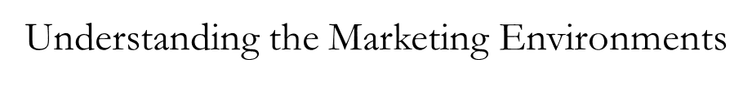

Week 2 Seminar
Maryam.Feyzi-Zad@uwl.ac.uk

Slide 2
Recap
What is marketing ? Marketing is defined as “the process by which companies create value for customers and build strong relationships to capture value from customers in return.” Kotler, Principles of Marketing, p.5
What are customer needs , wants & demand?
CRM? The overall process of building and maintaining profitable customer relationships by delivering superior customer value and satisfaction. What is customer lifetime value ? Customer Equity ?
Customer classification (stranger, Barnacle, butterfly, true friends)
2

Slide 3

The marketing environment consists of the factors and forces that affect a company’s capability to operate effectively in providing products and services to its customers. We can identify three levels in the environment around the organization:
Internal environment - This comprises internal factors that exist within an organization.
The micro environment - This comprises those factors external to a business that directly affect the running of the business and over which it can exert some control.
The macro environment - This comprises a complex set of uncontrollable variables which collectively form a framework within which organizations conduct business.
The Marketing Environment

Slide 4

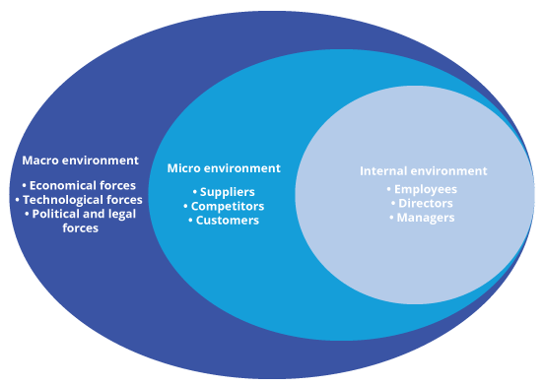
The Marketing Environment
The Three Levels in the Environment :
Internal Environment -
The Micro Environment -
The Macro Environment

Slide 5
Analysing Marketing Environment
Marketing environment: The actors and forces outside marketing that affect marketing management’s ability to build and maintain successful relationships with target customers.
Microenvironment
Macroenvironment
5
Notes:
5

Slide 6

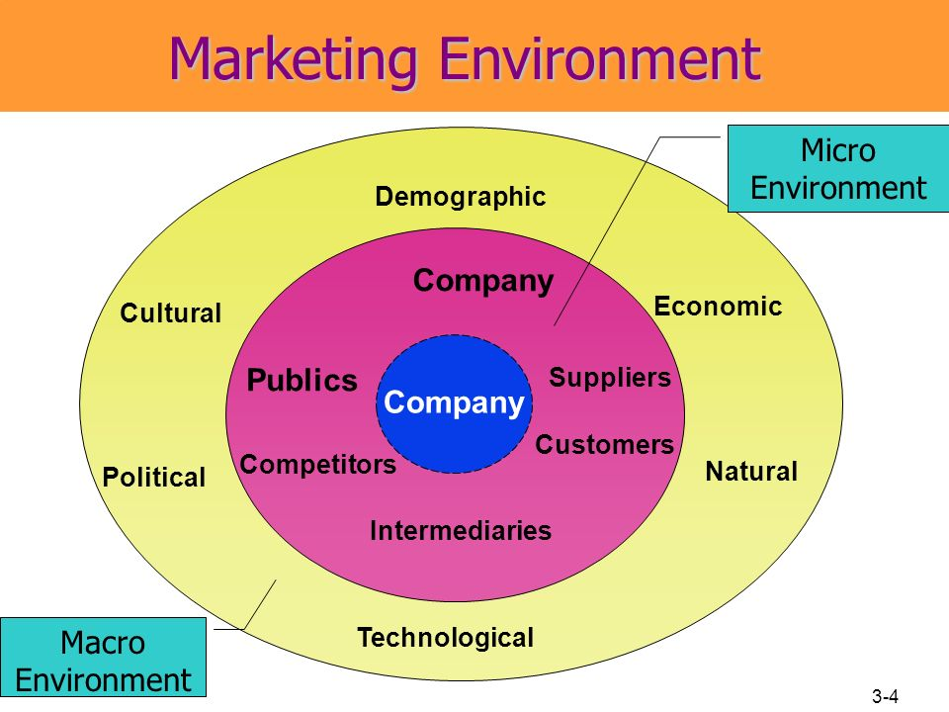

Slide 7
Forces in the company’s Macroenvironment
The Demographic Environment: The study of human populations in terms of size, density, location, age, gender, race, occupation, and other statistics
The Economic Environment: consumer purchasing power
The Natural Environment: Natural resources that are needed as inputs by marketers or that are affected by marketing activities
The Technological Environment: Forces that create new technologies, creating new product and market opportunities
Political environment: Laws, government agencies, and pressure groups that influence and limit various organizations and individuals in a given society.

Slide 8
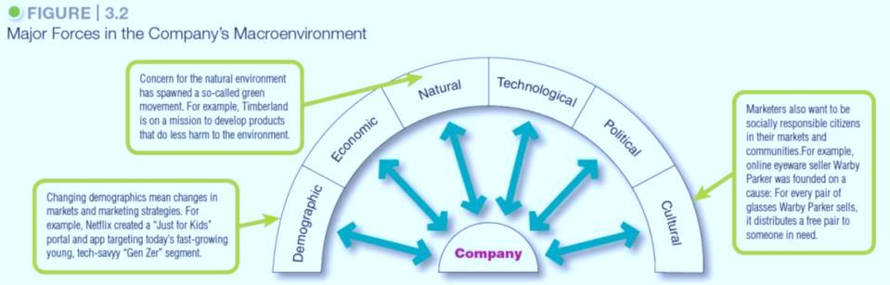
Macro-environment
Notes:
As shown in Figure 3.2, the company and all of the other actors operate in a larger macroenvironment of forces that shape opportunities and pose threats to the company.
Even the most dominant companies can be vulnerable to the often turbulent and changing forces in the marketing environment. Some of these forces are unforeseeable and uncontrollable. Others can be predicted and handled through skillful management.
Companies that understand and adapt well to their environments can thrive. Those that don’t can face difficult times.

Slide 9
Macro-environment: Demographic environment
Changing family structures
Geographic shifts in population
Changes in the workforce
Changes in how people work (telecommuting)
Notes:
Changing American family
Changes in the American family have included:
More couples and Divorcing or separating
More people choosing not to marry or marrying later
More people marrying without intending to have children
Increasing number of working women
Increasing number of stay-at-home dads
Changes in the workforce have included:
More educated workers
More white collar workers
Discussion Questions
Why do you think these geographic shifts in population are happening?
Where will you choose to live when you finish your education? Why?
Such population shifts interest marketers because people in different regions buy differently. For example, people in the Midwest buy more winter clothing than people in the Southeast.
The shift in where people live has also caused a shift in where they work. There has been a rapid increase in the number of people who “telecommute”—work at home or in a remote office and conduct their business by phone or the Internet.

Slide 10
Macro-environment: Demographic environment
Demography is the study of human populations-- size, density, location, age, gender, race, occupation, and other statistics.
Demographic environment involves people, and people make up markets.
Demographic trends include changing age and family structures, geographic population shifts, educational characteristics, and population diversity.

Slide 11
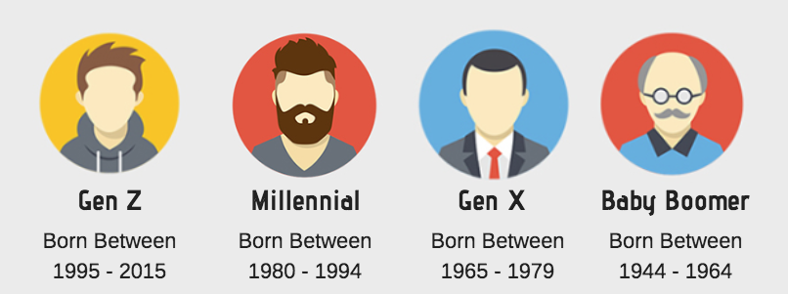
Macro-environment: Demographic Environment
  Generational marketing is important in segmenting people by lifestyle or life stage instead of age.
Baby boomers: people who were born between 1946 and 1964
Generation X: people born between 1965 and 1976
Millennials (or Generation Y): Born between 1977 and 2000
Notes:
The Baby Boomers. Over the years, the baby boomers have been one of the most powerful forces shaping the marketing environment through every stage of life through which they migrate. The youngest boomers are now in their fifties; the oldest are in their late sixties and well into retirement. Boomers are spending more carefully and planning to work longer. They are the wealthiest generation in U.S. history
Generation X. Considerably smaller than the boomer generation that precedes them and the Millennials who follow, the Generation Xers are a sometimes overlooked consumer group. From a marketing standpoint, the Gen Xers are a more skeptical bunch who tend to research products before they consider a purchase and prefer quality to quantity. They are less receptive to overt marketing pitches and more likely to be receptive to irreverent ad pitches that make fun of convention and tradition.
Millennials. The Millennials were the first generation to grow up in a world filled with computers, mobile phones, satellite TV, iPods and iPads, and online social networks. As a result, they engage with brands in an entirely new way, such as with mobile or social media. In the post-recession era, the Millennials are the most financially strapped generation. Still, because of their numbers, the Millennials make up a huge and attractive market, both now and in the future.
Generation Z. The GenZers make up important kids, tweens, and teens markets who spend an estimated $43 billion annually of their own money and influence a total of almost $200 billion of their own and parents’ spending. These young consumers also represent tomorrow’s markets—they are now forming brand relationships that will affect their buying well into the future.
Discussion Question
Do marketers need to create separate products and marketing programs for each generation?
Some experts warn that marketers need to be careful about turning off one generation each time they craft a product or message that appeals effectively to another. Others caution that each generation spans decades of time and many socioeconomic levels.
Thus, marketers need to form more precise age-specific segments within each group. More importantly, defining people by their birth date may be less effective than segmenting them by their lifestyle, life stage, or the common values they seek in the products they buy.
Changing American family
Changes in the American family have included:
More couples and Divorcing or separating
More people choosing not to marry or marrying later
More people marrying without intending to have children
Increasing number of working women
Increasing number of stay-at-home dads
Changes in the workforce have included:
More educated workers
More white collar workers
Countries vary in their ethnic and racial makeup. At one extreme is Japan, where almost everyone is Japanese. At the other extreme is the United States, with people from virtually all national origins. Marketers now face increasingly diverse markets, both at home and abroad, as their operations become more international in scope.
More than 40 million people living in the United States—about 13 percent of the population—were born in another country. The nation’s ethnic populations are expected to explode in coming decades.
Diversity goes beyond ethnic heritage. For example, many major companies explicitly target gay and lesbian consumers

Slide 12
Macro-environment: Economic Environment
The economic environment consists of factors that affect consumer purchasing power and spending patterns.
  Industrial economies are richer markets.
  Developing economies also offer outstanding marketing opportunities.
  The economic environment can offer both opportunities and threats
Notes:
The economic environment can offer both opportunities and threats. Nations vary greatly in their levels and distribution of income. Some countries have industrial economies, and at the other extreme are subsistence economies.
In between are developing economies that can offer outstanding marketing opportunities for the right kinds of products.

Slide 13

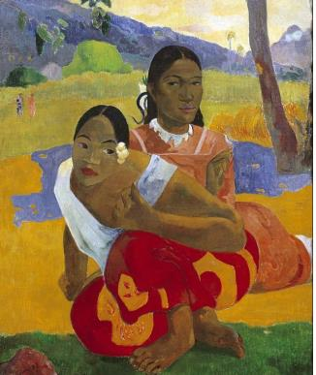
Macro-environment: Income distribution
Over the past several decades, the rich have grown richer, the middle class has shrunk, and the poor have remained poor.
  £ 200 million painting

Slide 14
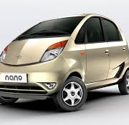
Macro-environment: Changes in consumer spending
Value marketing involves offering financially cautious buyers greater value—the right combination of quality and service at a fair price.
Make luxury affordable, “Now you can.”

Slide 15
Macro-environment: Natural environment
Trends
  Growing shortages of raw materials
  Increased pollution
  Increased government intervention
  Developing strategies that support environmental sustainability

Slide 16

Macro-environment: Natural environment
The physical environment and the natural resources that are needed as inputs by marketers or that are affected by marketing activities.

Slide 17

Environmental Sustainability
Environmental sustainability involves developing strategies and practices that create a world economy that the planet can support indefinitely.

Slide 18
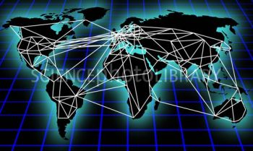
Macro-environment: Technological Environment
Most dramatic force in changing the marketplace
New products, opportunities
Concern for the safety of new products
Online Marketing

Slide 19
Macro-environment: Political & Social Environment
Legislation regulating business is intended to protect
  companies from each other
  consumers from unfair business practices
  the interests of society against unrestrained business behavior

Slide 20
Political & Social Environment
  Increased emphasis on ethics
  Socially responsible behavior

Slide 21
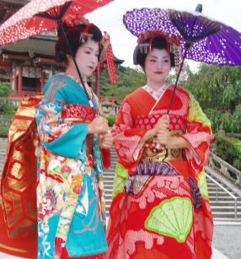
Macro-environment: Cultural environment
The cultural environment consists of institutions and other forces that affect a society’s basic values, perceptions, and behaviors.

Slide 22
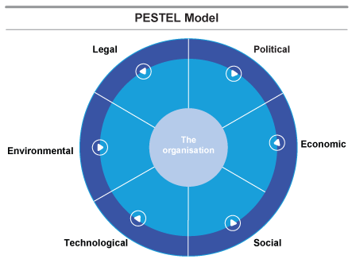
Identify Key Factors In The Macro-environment
The PESTEL model is used to analyze the external environment in which the company operates

Slide 23
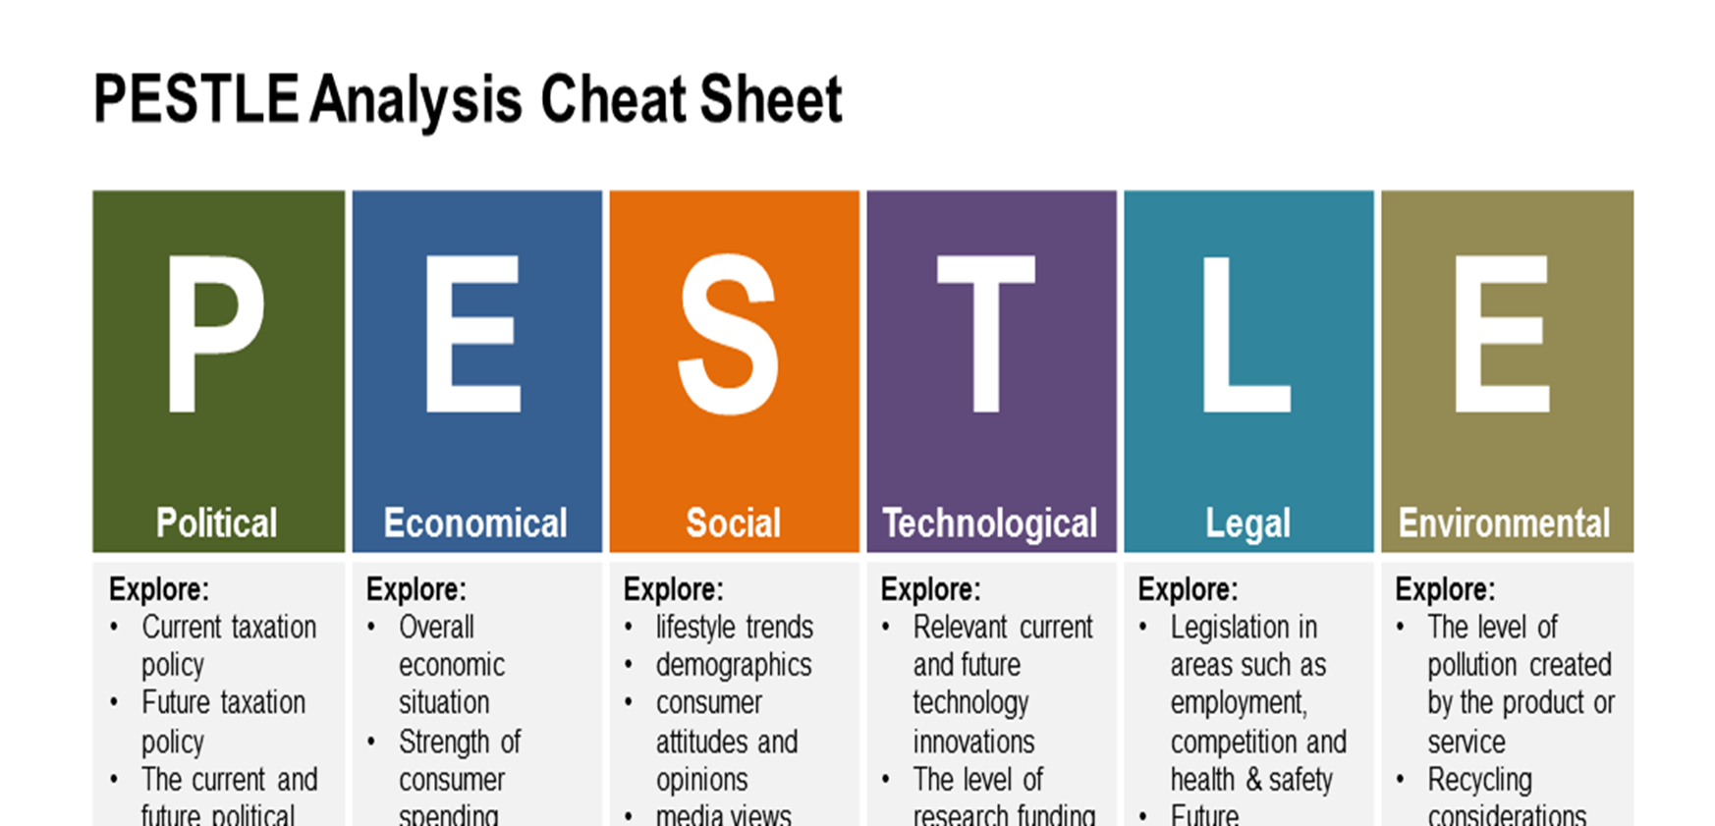
Macroenvironment
Macroenvironment: The larger societal forces that affect the microenvironment—demographic, economic, natural, technological, political, and cultural forces.
23

Slide 24
Micro - environment
Microenvironment consists of the actors close to the company that affect its ability to serve its customers—the company, suppliers, marketing intermediaries, customer markets, competitors, and public(s).

Slide 25
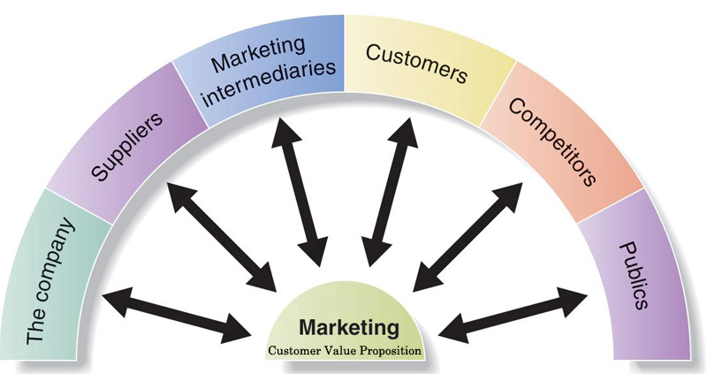
Microenvironment
Microenvironment : The actors close to the company that affect its ability to serve its customers.
25

Slide 26
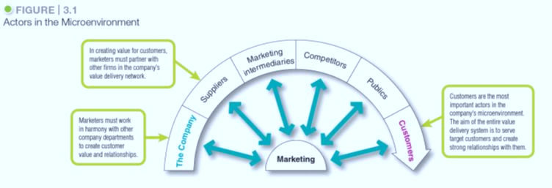
The Factors in the micro-environment

Slide 27
Actors in the Microenvironment
The company ; top management (finance, R&D, purchasing, accounting) sets the company’s mission, objectives, broad strategies,. Marketing managers should work closely with them ,
Suppliers: marketing managers should watch supply availability and costs, good relationships
Marketing Intermediaries: Firms that help the company to promote, sell, and distribute its goods to final buyers
Competitors: provide grater customer satisfaction than your competitors
Public: Any group that has an interest in or impact on an organisation’s
ability to achieve its objectives. (banks, media, citizen groups, internal or external people)
Customers : individual market, international , government
27

Slide 28
The Microenvironment
Suppliers - Provide the resources to produce goods and services, companies should treat as partners to provide customer value.
Intermediaries - Firms that help the company to promote, sell, and distribute its goods to final buyers. These include resellers, physical distribution firms, marketing services agencies, financial intermediaries.
Competitors - Firms must gain strategic advantage by positioning their offerings strongly against competitors’ offerings in the minds of consumers.
Public(s) - Any group that has an actual or potential interest in or impact on an organization’s ability to achieve its objectives:
    Financial institutions
    Customers
    Employees
    Shareholders
    Media
    Government organizations,
    Local authorities

Slide 29
Micro-environment : Company
In designing marketing plans, marketing management takes other company groups into account.
  Top management
  Finance
  Purchasing
  Operations
  Accounting

Slide 30
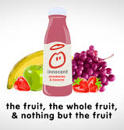
Micro-environment: Suppliers
Provide the resources to produce goods and services
Treat as partners to provide customer value

Slide 31
Micro-environment: Marketing Intermediaries
Firms that help the company to promote, sell, and distribute its goods to final buyers.
Resellers
Physical distribution firms
Marketing services agencies
Financial intermediaries

Slide 32



Micro-environment: Competitors
Firms must gain strategic advantage by positioning their offerings strongly against competitors’ offerings in the minds of consumers.

Slide 33
Micro-environment: Public(s)
Any group that has an actual or potential interest in or impact on an organization’s ability to achieve its objectives:
    Financial institutions
    Customers
    Employees
    Shareholders
    Media
    Government organizations
    Local authorities
Notes:
Financial. This group influences the company’s ability to obtain funds.
Media. This group carries news, features, and editorial opinion.
Government. Management must take government developments into account.
NGO’s. A company’s marketing decisions may be questioned by consumer organizations, environmental groups, minority groups, and others.
Local public. This group includes neighborhood residents and community organizations.
General public. A company needs to be concerned about the general public’s attitude toward its products and activities.
Internal public. This group includes workers, managers, volunteers, and the board of directors.
Consumer markets consist of individuals.
Business markets buy goods and services for further processing or use in their production processes.
Reseller markets buy goods and services to resell at a profit.
Government markets consist of government agencies that buy goods and services to produce public services or transfer the goods and services to others who need them.
International markets consist of various buyers in other countries, including consumers, producers, resellers, and governments.
Each market type has special characteristics that call for careful study by the seller.

Slide 34
Marketing Analysis (SWOT)
Managing the marketing function begins with a complete analysis of the company’s situation.
The marketer should conduct a SWOT analysis
SWOT analysis : An overall evaluation of the company’s
Strengths (S), Weaknesses (W),
Opportunities (O), Threats (T).
34

Slide 35
SWOT Analysis
Strengths: internal capabilities, resources, and positive situational factors that may help the company serve its customers and achieve its objectives.
Weaknesses: internal limitations and negative situational factors that may interfere with the company’s performance.
Opportunities are favorable factors or trends in the external environment that the company may be able to exploit to its advantage.
Threats are unfavorable external factors or trends that may present challenges to performance

Slide 36
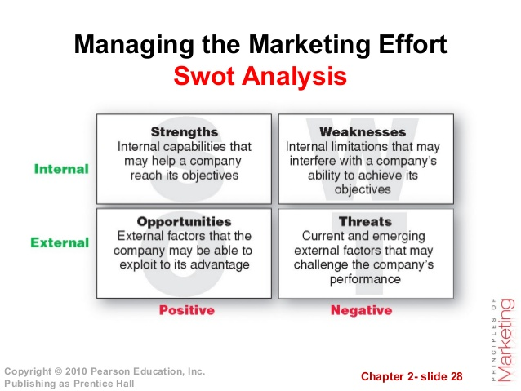
36

Slide 37

Seminar Activity
Choose a company from any of the three industries: Food retail, Automotive and Hospitality and undertake the following activities;
Identify the company's mission and vision
Carry out a micro & macro environmental analysis of the company
As future marketing executives, what does this analysis tell you about the company's situation?. Identify 3 most important factors.

