Slide 1
Week 2 Seminar and Marketing Strategies
Chapters 2 & 3 (Kotler )

Slide 2
Recap
What is marketing ? What are customer needs , wants & demand?
CRM? The overall process of building and maintaining profitable customer relationships by delivering superior customer value and satisfaction. What is customer life time value ? Customer Equity ?
Customer classification (stranger, Barnacle, butterfly, true friends)
Marketing management concept (production concept, product concept, selling concept, marketing concept, societal concept)
2

Slide 3
Analysing Marketing environment
Marketing environment: The actors and forces outside marketing that affect marketing management’s ability to build and maintain successful relationships with target customers.
Microenvironment
Macroenvironment
3
Notes:
3

Slide 4
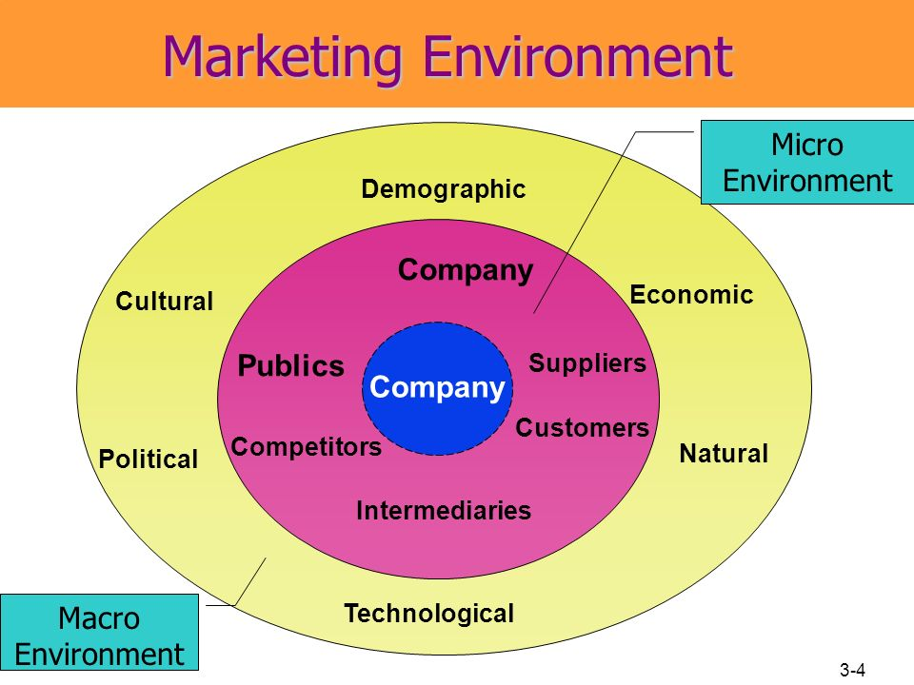

Slide 5
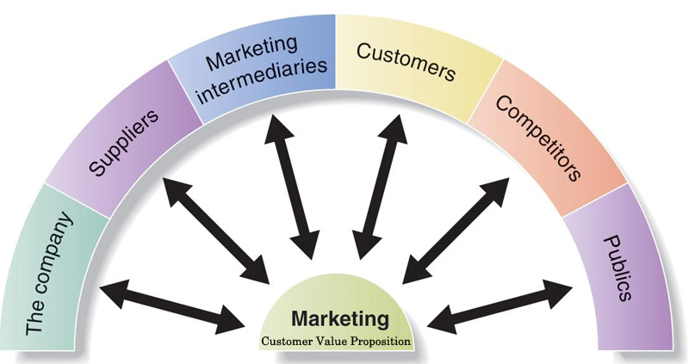
Microenvironment
Microenvironment : The actors close to the company that affect its ability to serve its customers.
5

Slide 6
Actors in the Microenvironment
The company ; top management (finance, R&D, purchasing, accounting) sets the company’s mission, objectives, broad strategies,. Marketing managers should work closely with them ,
Suppliers: marketing managers should watch supply availability and costs, good relationships
Marketing Intermediaries: Firms that help the company to promote, sell, and distribute its goods to final buyers
Competitors: provide grater customer satisfaction than your competitors
Public: Any group that has an interest in or impact on an organisation’s
ability to achieve its objectives. (banks, media, citizen groups, internal or external people)
Customers : individual market, international , government
6

Slide 7
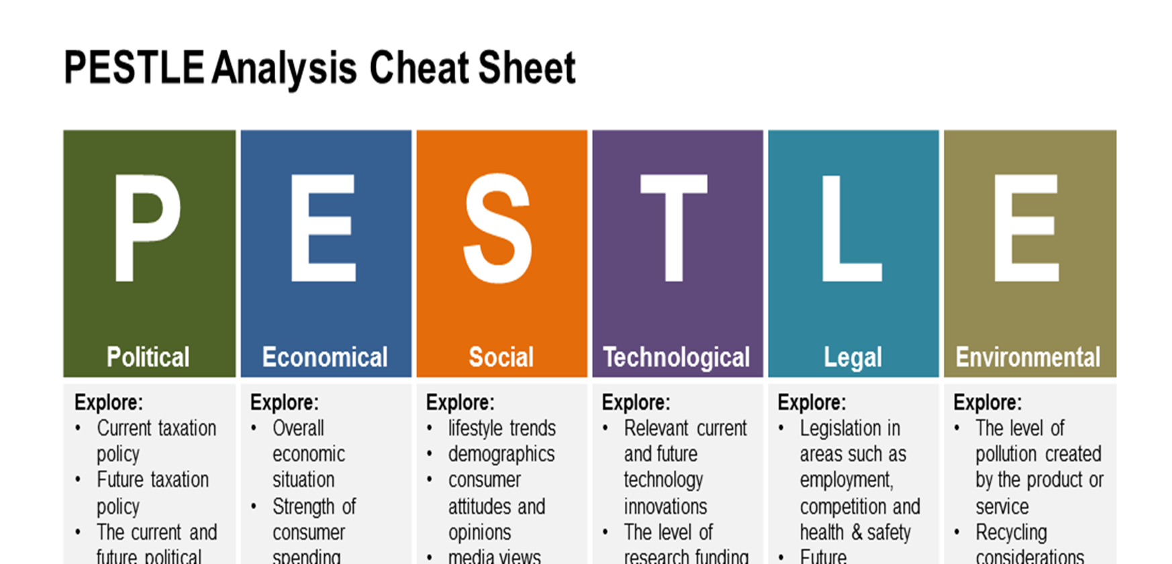
Macroenvironment
Macroenvironment: The larger societal forces that affect the microenvironment—demographic, economic, natural, technological, political, and cultural forces.
7

Slide 8
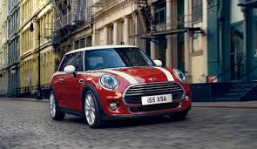
Seminar Activity
Choose a company from any of the three industries: Food retail, Automotive and Hospitality and undertake the following activities;
Identify the company's mission and vision
Carry out a micro & macro environmental analysis of the company
As future marketing executives, what does this analysis tell you about the company's situation?. Identify 3 most important factors.

Slide 9
SWOT analysis
Strengths: internal capabilities, resources, and positive situational factors that may help the company serve its customers and achieve its objectives.
Weaknesses: internal limitations and negative situational factors that may interfere with the company’s performance.
Opportunities are favourable factors or trends in the external environment that the company may be able to exploit to its advantage.
Threats are unfavourable external factors or trends that may present challenges to performance

Slide 10
Forces in the company’s Macroenvironment
The Demographic Environment: The study of human populations in terms of size, density, location, age, gender, race, occupation, and other statistics
The Economic Environment: consumer purchasing power
The Natural Environment: Natural resources that are needed as inputs by marketers or that are affected by marketing activities
The Technological Environment: Forces that create new technologies, creating new product and market opportunities
Political environment: Laws, government agencies, and pressure groups that influence and limit various organizations and individuals in a given society.
10

Slide 11
Discussing the Concepts
What is the impact of the following generations on the market ?
Baby boomers: people who were born between 1946 and 1964
Generation X: people born between 1965 and 1976
Millennials (or Generation Y): Born between 1977 and 2000,

