Slide 2
7BUS2040-0105-2022 (Jan 2023) Strategic Marketing & Entrepreneurship - Assignment Briefing

Slide 3
LINK TO ASSESSMENTs
https://herts.instructure.com/courses/102848/assignments

Slide 4
Assignment 1- Group Market Research, Ideation Presentation (Live), Promotional teaser
Submission Date
Time | 12.00 pm
Module Eligible for extension | No
Weightage | 40%
Submission Type | PowerPoint submission on Canvas

Slide 5
WORKING IN GROUPS
Groups are based on lectorial slots, have already been determined and can not be changed.
You will be expected to work as a group, and for all group members to have read and agreed to the group report before submission.
It is, therefore, advisable to review and give feedback on your group member’s contributions as you develop your group report.
You should provide a table showing the contribution that each group member has made to the report. Please use the table shown:
Student Number | Work done | Signature
Please note that it is a requirement that groups make notes of their meetings (You may be asked for these at a later stage).
You must also keep a note of individual contributions to the report so that you are able to complete the table above. Failure to include this table may result in a mark penalty for all team members.
Please refer to the group work principles on the CASE website.

Slide 6
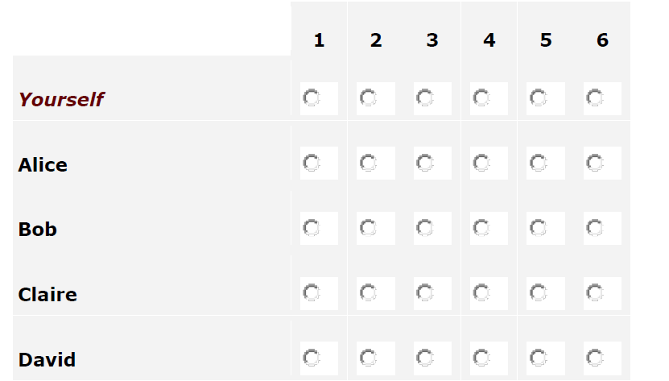
Peer Review via WebPA – 10%
WebPA Form
Taking This Assessment
Please complete the assessment below. For each question you must give a mark to each group member, including yourself.
Marking Your Team
For each criterion you must rate your teammates using the scale provided. High Score(s) indicate better performance in the criteria.
Introduction
Assessment Criteria
1. Attended tutorials and outside meetings, and was constructive about the arrangement of meetings.
The student attended all tutorials. The student attended the meetings they agreed they would be able to attend when they were initially planned. They were constructive and supportive in the process of organising meetings to ensure the team could meet with appropriate frequency.
Score 1 : Unreliable, often absent or late without explanation; was not constructive in arranging meeting; didn't attend the tutorials
Score 6 : Reliable, always present when required by the team; constructively engaged in the arrangement of meetings
2. Came prepared to meetings and tutorials
The student had done the work agreed at previous meetings and had it ready to present to/discuss with the group. They turned up to tutorials with an understanding of the theory from the topic and data to analyse, discuss and write up.
Score 1 : Was not prepared and had not demonstrated completion of agreed work. Weak familiarity with the theory and unprepared to complete assignment tasks.
Students will use the WebPA to peer review each other.

Slide 7
ASSIGNMENT TITLE: MARKET REPORT
Chosen Company: University of Hertfordshire (UH)
Assignment Title: Group Live PowerPoint Presentation
What you will produce:
You work for a marketing agency as a team. Your manager (represented by the tutors on the module) has asked your team to help a client, the University of Hertfordshire (UH), to develop a suitable NEW product or service aligning with UH’s SDG (Sustainable Development Goal).
https://www.un.org/en/actnow/facts-and-figures
Your team also needs to create a promotional teaser via social media message on any two social media platforms of your choice (LinkedIn, Instagram, TikTok etc.,).

Slide 8
Assignment Task
Task 1 Market Research
Use of analysis tools
Task 2 Ideation process
You will need to think about your client organization:
What are its values?
What are its Sustainable Development Goals (SDG)?
What makes the brand unique?
What is its competitive advantage, or how can it be created?
What innovation is possible based on the micro and macro environment?
You will be expected to justify the ideation summary by referring to your market research.

Slide 10
Assignment Task
Task 3 – Create a Promotional Teaser via Social Media
After completing your Marketing Research and Ideation summary:
Choose any TW0 (2) social media platforms (Facebook, LinkedIn, Instagram, TikTok etc.) to promote your message
Choose ONE (1) of the Themes below:
#1 HBS services/activities relating to SDG (inclusivity/equality/building awareness/environmental)- Corporate-driven
#2 HBS student activities link to SDG (volunteer/Enactus) – student-led
Follow the UH Brand Guidelines, which can be found here:
https://brand.herts.ac.uk/

Slide 11
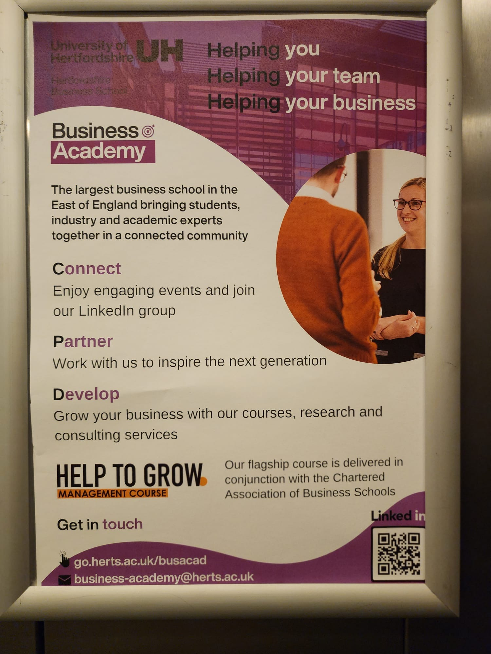
HBS
PROFESSOR HAFIZ ALAKA
Lead Researcher Applied Contemporary Technologies
Hafiz is a leading researcher in the area of contemporary applied technologies, including big data, artificial intelligence and loT. He studied short courses on Machine Learning and Analytics Edge at Stanford University and Massachusetts Institute of Technology, respectively. He regularly collaborates with industry partners to help solve their challenges.
Hafiz is the founding Director of the Big Data Technologies and Innovation laboratory, which currently hosts over 16 members of staff, including postdoctoral research fellows, machine learning scientists, data warehouse/analyst experts, civil engineers, lecturers, and senior lecturers. The lab has various equipment and services required for project delivery, including a deep learning local server machine, VR ready endlessly expandable machine capable of rapid prototyping, numerous Apple Macbook Pros and Airs, Google Play and App Store developer's accounts, Android and Apple phones and tablets, Vuzix Augmented reality equipment, loT pollution monitoring sensors, large interactive visualisation screen, AWS EC2 Big Data Infrastructure account, among others.
He also leads the Prediction of Climate and its Impacts' group in the Centre for Climate Change Research.

Slide 12
Task 3 cont…
For your social media, you can use an Image+Message or Short Video+Message (or a combination of both) approach(es). The content must be based on ONE of the theme’s messages above. You must use the UH Brand Guidelines to create your post.
You can create your content using Behance and creating yourself a PRIVATE profile (https://www.behance.net/portfolio/editor/?tracking_source=forYouChecklist ) by logging in with your student email that ends in @herts.ac.uk
The social media post you design in the private Behance will be viewed and graded by the UH and HBS Social Marketing Team, tutors. – Top 3 highest ‘Liked’ and that meet the assignment criteria will have an awarded. The Marketing Department may use the winners’ social content for commercialisation.
IMPORTANT Note: Please be advised NOT to publish/share the social media content/message on your or other social media site, as it is strictly prohibited, especially without the university’s approval. By publishing and sharing with the public WITHOUT consent, you may face a heavy penalty or legal action taken against you.

Slide 13
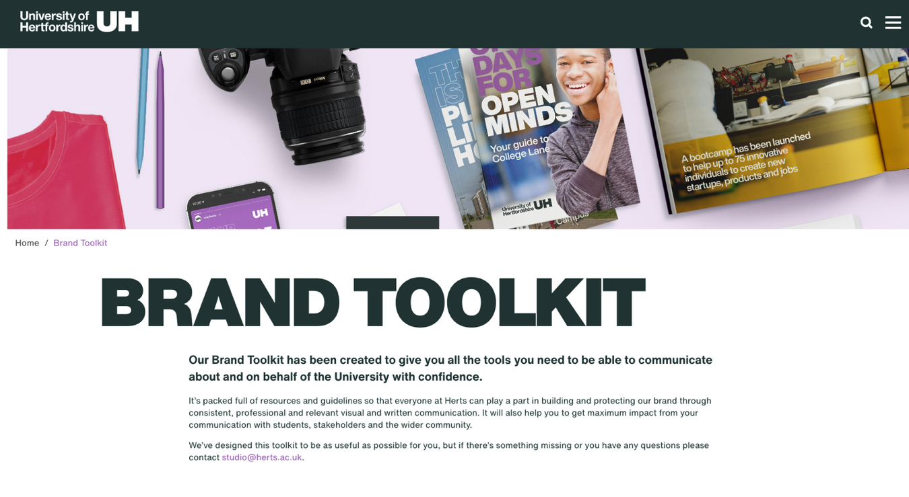
HELLO
BRILLIANT
STUDENT
Welcome to Hertfordshire Business School
Follow the Business School on Social Media
Semester B

Slide 14
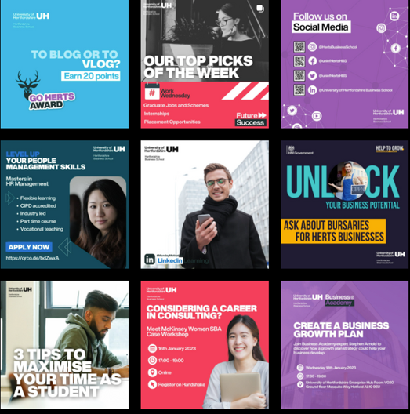
HELLO
BRILLIANT
STUDENT
Welcome to Hertfordshire Business School
BRAND GUIDELINES - COLOUR PALETTE
Colour is a key feature of our brand identity and should be used to complement photography and typography.
Whilst there is scope for wide variation in colour, we encourage creatives to exercise restraint when varying colour within campaigns, so we have defined palettes per audience.
Colours we use most often on HBS Channels
Bright Green (L4 Students, Sustainability)
Bright Violet (L5 Students, Businesses)
Bright Pink (All Students, Employability)
Bright Blue (L6 Students, CASE, GoHerts Awards)
Dark Purple (Alumni)
Dark Teal (Research, Part-time courses)
Follow the Business School on Social Media
Semester B

Slide 15
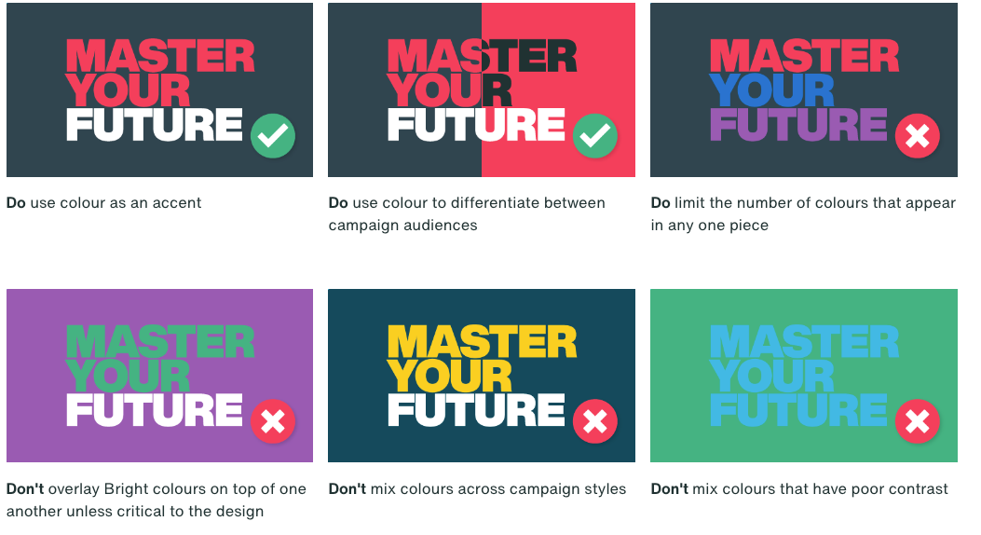
HELLO
BRILLIANT
STUDENT
Welcome to Hertfordshire Business School
BRAND GUIDELINES - COLOUR PALETTE
Always think about accessibility! Make sure that the words are easily read.
Not sure? Check the brand guidelines.
Follow the Business School on Social Media
Semester B

Slide 16
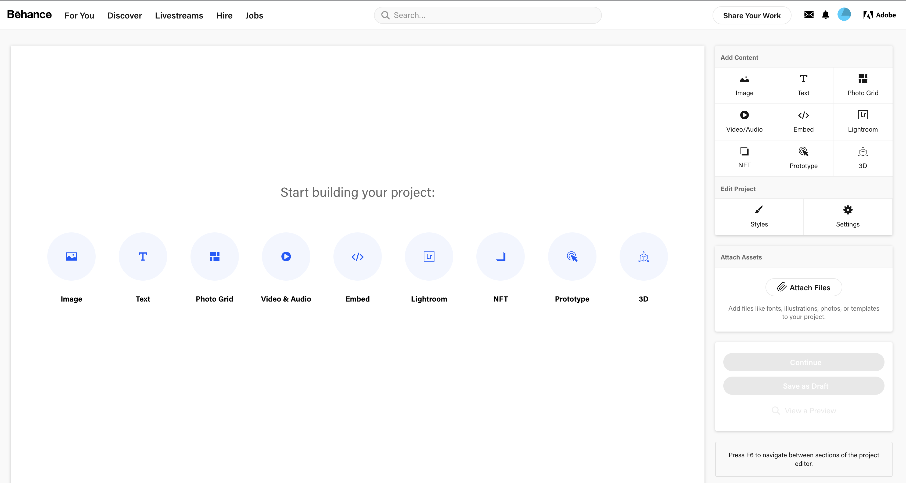
More on this will be/ has been explained at The Social Media Briefing 21st February, Tuesday, 12 pm (the session is/will be recorded)

Slide 17
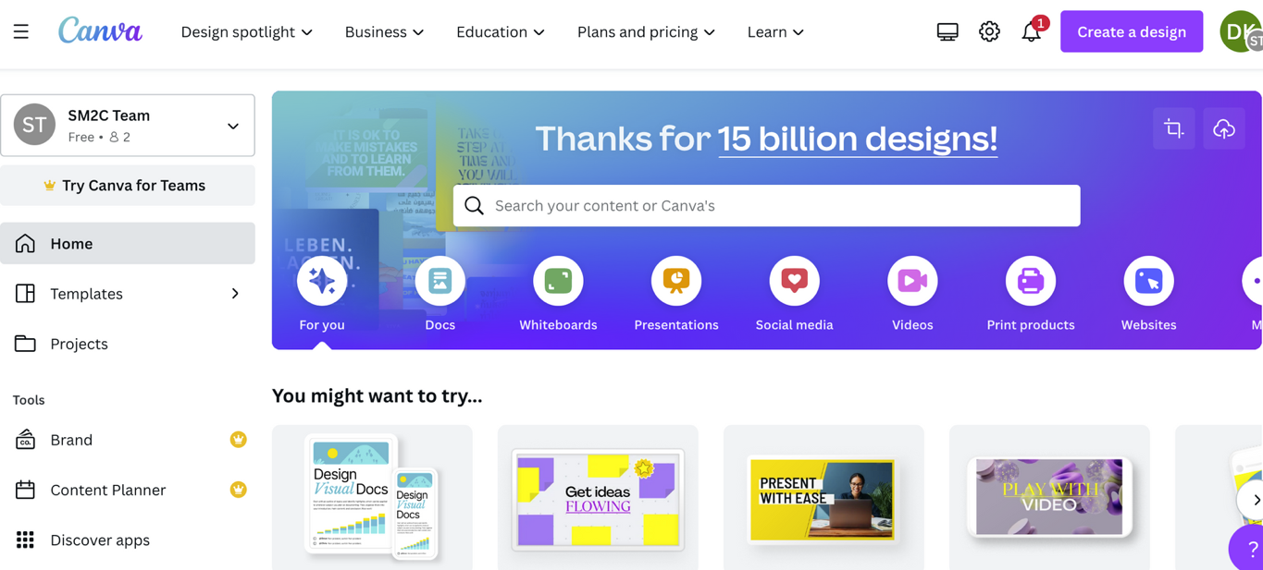
Create your designs using Canva - canva.com

Slide 18
Submission requirement: PowerPoint presentation with Notes
Submission requirement: Live PowerPoint presentation.
Summarise your critical evaluative marketing audit, ideation process and social media promotion into a PowerPoint presentation for the client company’s directors.
Your presentation must cover the following areas:
A title slide that must include a heading and a list of your group members by Student ID number
Market trends, competition, supply, and distribution
The proposed segmentation of the customers available to target and the key opportunities available to include met/unmet needs of the preferred market segment
The external factors (opportunities and threats) affecting the organisation (PESTEL) (no more than 8)
The businesses capabilities (based on strengths and weaknesses)
Identify the university’s sustainable development goals and the ideas that must be aligned towards these goals.
Create a social media message - Promoting the university’s sustainable development goals (SDG) as a positive message (this message should aim to support your new product/service idea) through any two social media platforms.
Summarise three (3) NEW innovative products/services (Income generating) from your ideation process that you want to present to the company.

Slide 19
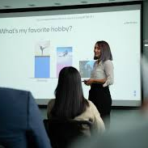
Live Presentation
Date: Various: Mon 20 – Fri 31 March 2023
Method: Live on-campus presentation
Delivery: Live, on-Campus, during your allocated tutorial & Lecture sessions (Groups book time slot on canvas).
Time per group: 10 minutes – maximum. Be sure to arrive on time and you may be recorded
Presentation Duration:
Each member of the group must present an equal share of content. There will be a Q&A after the presentation.
The tutor will stop the presentation sharp at 10 mins. Therefore, it would be good to rehearse your presentation to ensure you and your members keep strictly to the 10 minutes, or you may miss the chance to present your ideas.
All members must be present during the live presentation (The presenter who is not present at the time of the presentation will be marked as 0).

Slide 20
Live Presentation..cont
Number of slides:
The presentation should not exceed 10 slides, with a professional standard of visual presentation. The Title page, references and credit log slides are not part of the 10 slides limit.
Style of Slides:
We would like a visual presentation using slides with (ideally) the necessary images/graphs/figures etc., and only a few words. Include only necessary information and limit the information to essentials.
Submission of work to Canvas:
One (1) student from the group should submit the presentation slides (PPTX) to the Canvas Assessment site by the date stated at the top of this document. All the members of the group can view the submitted file.
Dress code: Professional.

Slide 21
Tips
Use relevant theory and frameworks (PESTEL, 5 Forces, BCG, ANSOFF, Mckinsey 7S, to help structure your report.
You may use any relevant marketing planning models.
Concentrate on the critical quality and depth of your report, not the quantity of points.
Give evidence to support your analysis and recommendations (e.g. market data).
Interpret rather than just present numbers

Slide 22
Data / information
Mintel
IBIS World
Business Source Complete
WARC
Statista
Mckinsey
Audit company – KPMG, Deloitte…
Links to all of these can be found on your Canvas module page under “Reading”
https://herts.instructure.com/courses/94199/modules/items/1867985

Slide 23
Sections of the assignment breakdown | Weighting
Delivery = 30pts
Presentation and Structure Quality of voice, appropriacy of body language and dress style, clarity of delivery, and quality of slides content 10 slides with Notes pages excluding title slides and reference list Plus Professional cover page listing group members by ID only Reference list (may be more than one slide) List of credits by student ID - who contributed and how | 15 pts
Intellectual Curiosity Follows Harvard referencing style for in-text citation & Reference list. Uses marketing databases Includes a range of relevant information from quality sources e.g., Business Toolkit, business pages of broadsheets Includes appropriate academic referencing (minimum 5 + secondary source 5) | 10 pts
Teamwork Evidence of cohesive preparation, team building, communications, team cooperation, contribution and participation during the presentation | 10 pts

Slide 24
Sections of the assignment breakdown | Weighting
Content = 70 pts
Content and Findings Content included – Provided task required on the assignment brief and use of concept taught on the module. Undertakes comprehensive market research by applying appropriate models to complete a marketing audit. Must cover: 1. Market trends, competition, supply and distribution 2. The segmentation of customers available to target 3. The significant factors affecting the organisation 4. The business capabilities 5. The key opportunities 6. Any relevant ethical or CSR factors | 25 pts
Business Application Demonstrates a detailed ideation process that is evidenced and supported by market research. Indicates the process of innovation and business model development to create new ventures, products and services in response to growth opportunities. Summarises three ideas. | 20 pts
Discussion and Analysis Demonstrate logical Line of argument and critical analysis Provides insights from market research. Evaluates appropriate opportunities for new product/service/venture development based on market research. Evaluates and demonstrate understanding of the client company/context in terms of strategic marketing. | 20 pts
TOTAL | 100pts

Slide 25
A REMINDER ABOUT Academic Integrity
Taken from the CASE (2021) online resources:
Academic integrity is the ‘moral code’ of academic life, based on accepted conventions of good academic practice.
The fundamental concept of academic integrity is honesty - being honest in how you conduct research and in what you do and/or submit as written, oral and creative work.
It means being ethical and fair, with all students judged on their own ability. Students are not allowed to:
i. Unfairly create an advantage over others (e.g. by cheating, plagiarism or any other type of fraud, including buying essays from essay mills)
ii. Affect the integrity of the assessment process
iii. Diminish the quality, validity or reliability of UH degrees.

Slide 28
A REMINDER ABOUT ACADEMIC INTEGRITY CONT… Plagiarism
Examples of Intentional Plagiarism
Examples of Unintentional Plagiarism
Omitting in-text citations
Omitting sources in reference list
Taking material written by someone else & submitting as your own
Collusion or co-writing an assignment & submitting it as your own
Cheating in exams
Purchasing an assignment & submitting it as your own
Contract cheating (having your assignment written by someone else, even without payment)
Attempting to gain credit for same work twice by re-submitting all/part of it
Inaccurate/incomplete in-text citations
Inaccurate/ incomplete reference list
Poor quoting
Poor paraphrasing
Poor summarising

Slide 29
ACADEMIC INTEGRITY & HARVARD REFERENCING
https://herts.instructure.com/courses/61421/pages/referencing-style-guidelines-for-your-school-slash-subject-area
https://www.studynet1.herts.ac.uk/ptl/common/LIS.nsf/lis/busharvard

