Slide 1

Dr. Cameron Spence
Enterprise Application Architect / Modelling Lead
Thames Digital

Slide 2
Introduction
Dr. Cameron Spence - Enterprise Architect
  Background in software engineering, solution and enterprise architecture
  Visiting Fellow at Reading University
  Worked for Capgemini 2008-2016 (IT consulting)
  Completed this BTC course in 2014
  Completed PhD in 2020
  Research area – EA modelling and modelling tools
  I’ll talk about:
  EA as a practitioner
  EA as an academic
  Second lecture covers research on EA modelling as well as consulting careers

Slide 3




What I do for fun (I get bored easily)

Slide 4

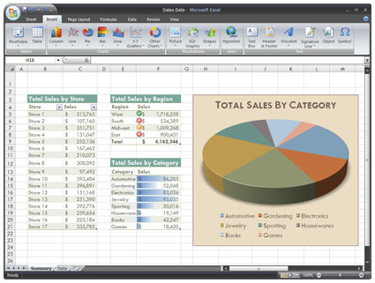
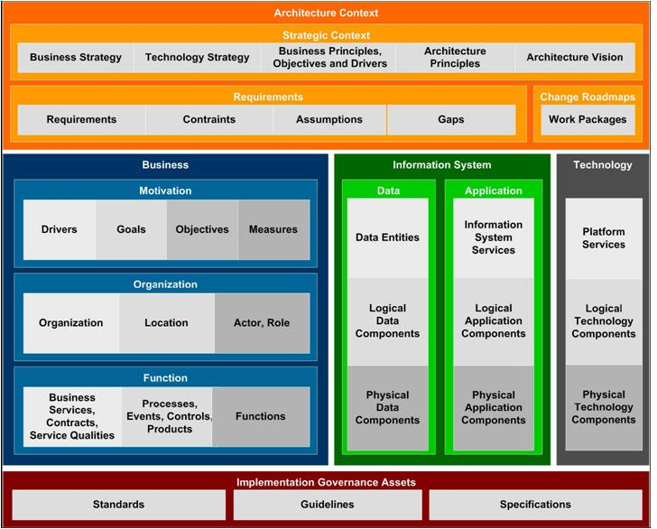
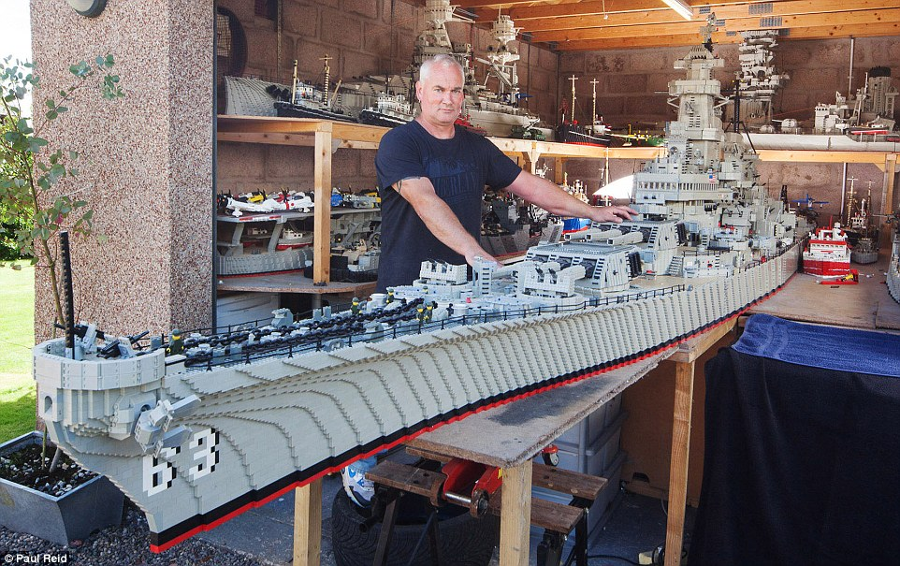
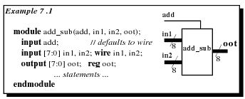
What is a Model?

Slide 5
What is a Model?
Some useful ideas from the literature:
Explicit representations of some portions of reality as perceived by some actor
Krogstie, J. and H. Jørgensen (2003). Quality of Interactive Models. Advanced Conceptual Modeling Techniques. A. Olivé, M. Yoshikawa and E. K. Yu, Springer Berlin Heidelberg. 2784: 351-363.
Represent something else
Mapping: Models are always models of something, i.e. mappings from, representations of natural or artificial originals, that can be models themselves.
Reduction: Models in general capture not all attributes of the original represented by them, but rather only those seeming relevant to their model creators and/ or model users.
Pragmatism: Models are not uniquely assigned to their originals per se. They fulfill their replacement function a) for particular – cognitive and/ or acting, model using subjects, b) within particular time intervals and c) restricted to particular mental or actual operations.
Stachowiak, H. (1973). Allgemeine Modelltheorie. Wien, Springer-Verlag, translated by modelpractice. (2012). "General Model Theory by Stachowiak." Retrieved 7th December, 2015, from https://modelpractice.wordpress.com/2012/07/04/model-stachowiak/.
Partial representation
Have a purpose

Slide 6

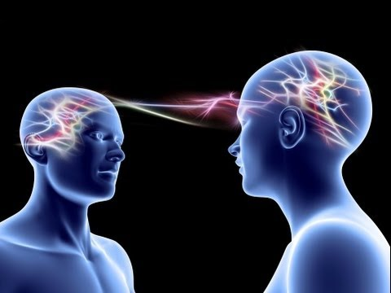


Why are Models Useful?

Slide 7
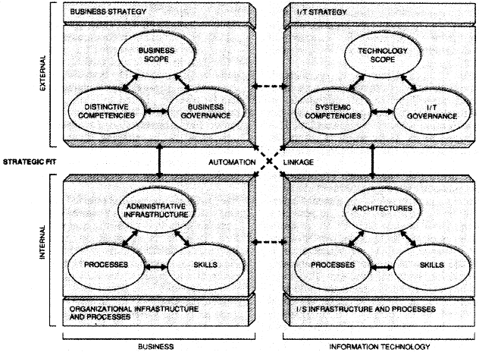
What is a Enterprise (Business)?
Consists of people, information and technologies
Performs business functions
Has a defined organizational structure that is commonly distributed in multiple locations
Responds to internal and external events
Has a purpose for its activities
Provides specific services and products to its customers
Rood, M. A. (1994). Enterprise architecture: definition, content, and utility. Third Workshop on Enabling Technologies: Infrastructure for Collaborative Enterprises, 1994.
an organization, especially a business, or a difficult and important plan, especially one that will earn money
Cambridge University Press, Definition of “Enterprise”, in Cambridge Advanced Learner’s Dictionary and Thesaurus. 2016, Cambridge University Press.
any collection of organisations that has a common set of goals
The Open Group, The Open Group Architectural Framework (TOGAF) 9.1. 2011.
Henderson, J. C. and N. Venkatraman (1993). "Strategic alignment: leveraging information technology for transforming organizations." IBM Syst. J. 32(1): 4-16.

Slide 8
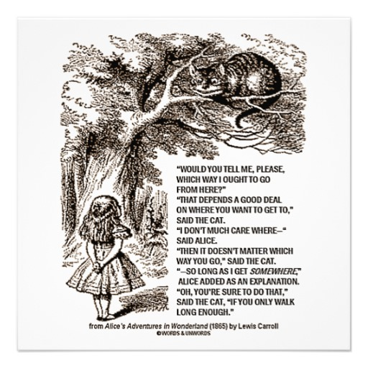

Strategic layer provides direction
where are we going?
idealised state of the enterprise
Infrastructure layer describes reality
where are we now?
How do things actually work?
Projects, changing infrastructure,
provide movement
- the next step along the way
8

Slide 9
What is Enterprise Architecture?
[The] fundamental concepts or properties of a system in its environment embodied in its elements, relationships, and in the principles of its design and evolution
ISO/IEC/IEEE (2011). ISO/IEC/IEEE 42010:2011, Systems and software engineering — Architecture description.
Business Strategy
IT Strategy
Business Infrastructure
IT
Infrastructure
… applied to the Enterprise as a whole
(treat the whole Enterprise as a system)
What are the kind of elements we’d find in business and IT infrastructures?

Slide 10
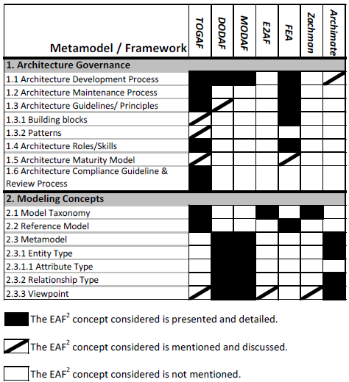
What is an Enterprise Architecture Framework?
EA frameworks provide some or all of these
More recent frameworks exist, e.g. NATO Architecture Framework
EAF² paper published before TOGAF 9 which addressed this gap
Franke, U., D. Hook, J. Konig, R. Lagerstrom, P. Narman, J. Ullberg, P. Gustafsson and M. Ekstedt (2009). EAF2- A Framework for Categorizing Enterprise Architecture Frameworks. Software Engineering, Artificial Intelligences, Networking and Parallel/Distributed Computing, 2009. SNPD '09. 10th ACIS International Conference on.

Slide 11
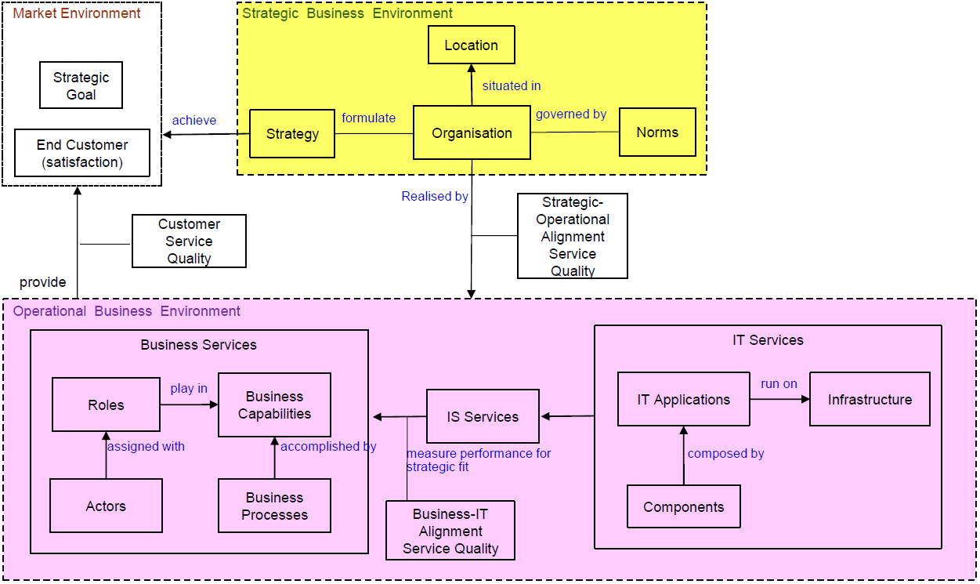
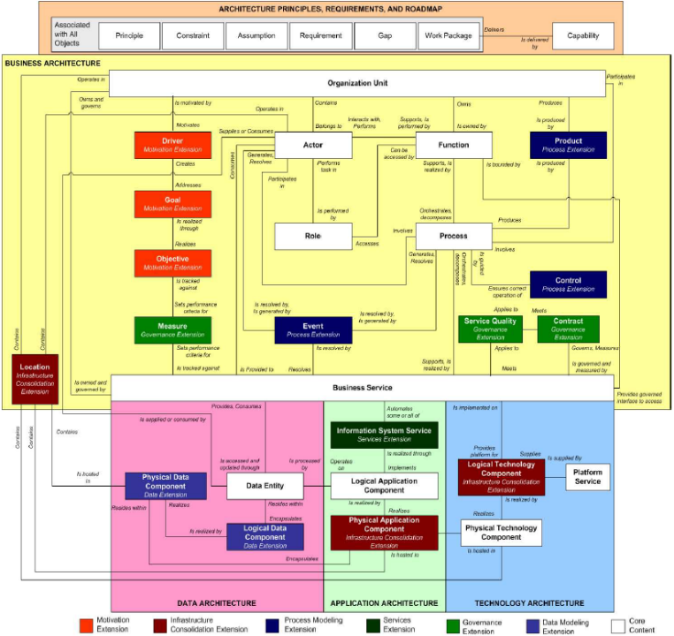
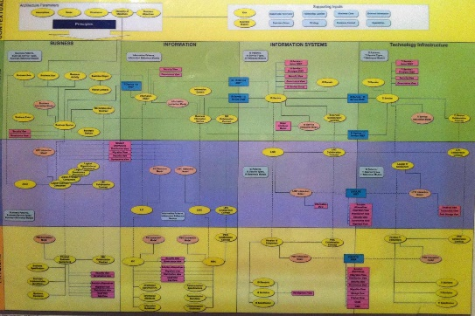
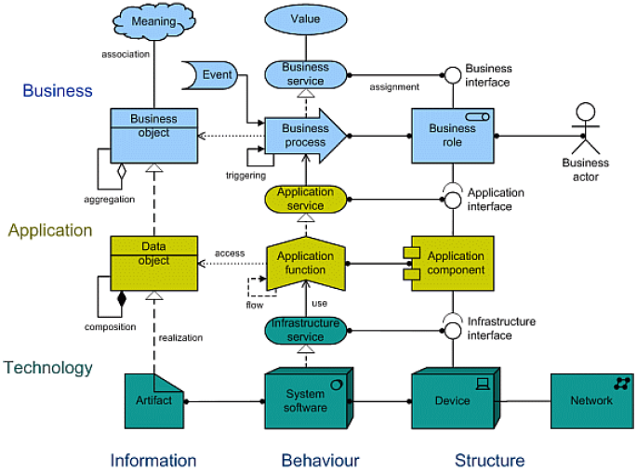
Entities – Standard Language for our elements
Interpretation – affected by norms
BTC
Sign
Referent
IAF
Archimate
TOGAF

Slide 12
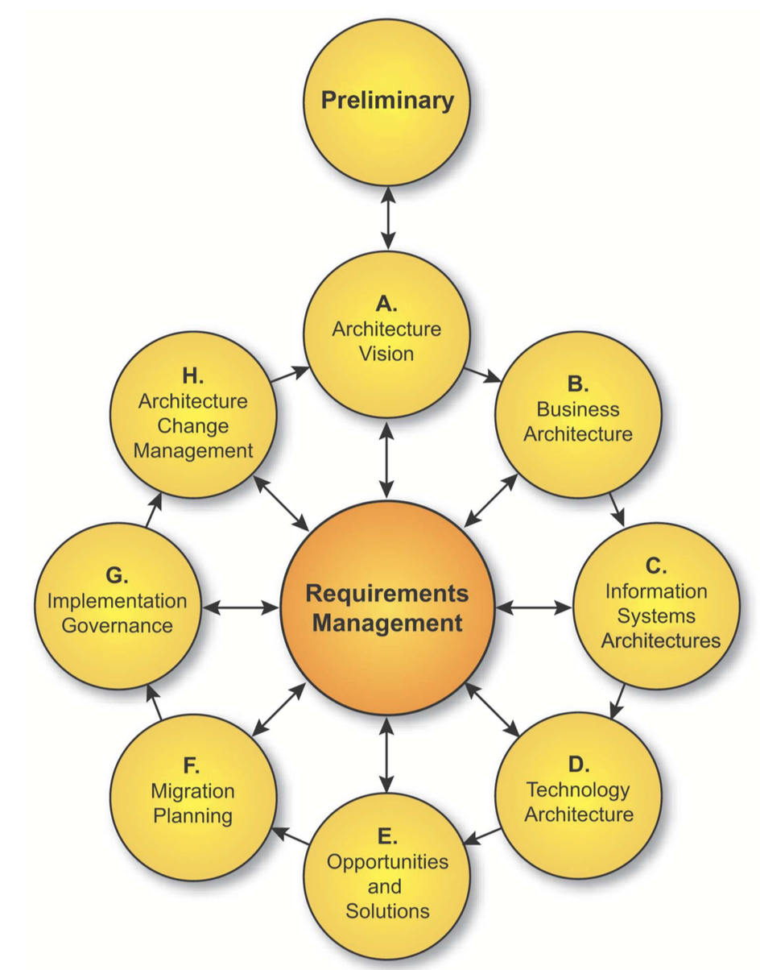


Relationship to Architecture Processes
Represent something else
Partial representation
Have a purpose
Where might they help us?
The Open Group, The Open Group Architectural Framework (TOGAF) 9.1. 2011.

Slide 13
Picking Metamodels
Class discussion
Why do we need to choose at all?
What factors might influence our choice?
Do we need to use all of it?
How do we adapt it for our particular situation?
What questions are we trying to answer?
What data is needed to answer the questions?
What attributes are needed?
What are we trying to communicate, to whom?
Entities, attributes and relationships all needed

Slide 14
Architecture Analysis – Terminology (1)
Entities - the things (or classes) that categorise what we would expect to see in our description of our enterprise architecture.
Artefacts - representations of a number of entities that shows the relationships between them. Examples include lists (catalogues), matrices and diagrams.
View – a set of artefacts selected to describe a specific architecture
Viewpoint – addresses the concerns of specific stakeholders by prescribing a particular set of views, independent of any specific architecture. A viewpoint is a recipe or template for a view.
Terms based upon:
The Open Group, The Open Group Architectural Framework (TOGAF) 9.1. 2011.

Slide 15
Architecture Analysis – Terminology (2)
Relationship – a connection with some meaning between two or more entities
Attributes - the properties of a particular instance of an entity
Stakeholder – someone who has a particular interest in or concern for some area affected by the architecture work
Stakeholders could be:
Social actors – reviewing our work but not understanding the language
Technical actors – using our models as a basis for their own work
Terms based upon:
The Open Group, The Open Group Architectural Framework (TOGAF) 9.1. 2011.

Slide 16
A simple use case for architecture analysis
Hypothesis: “we have no duplicate applications” *
  Collect information on applications
  Collect information on what they do
  See if any applications do the same thing
  If they do, then the hypothesis is disproven
Need to agree on definition of “application” and “what they do”
  This is where a meta-model will help
The contents of the meta-model are determined by the questions or hypotheses you wish to address, now or in the future
* Actual statement made by a UK police force to Capgemini during a consulting study in 2011

Slide 17
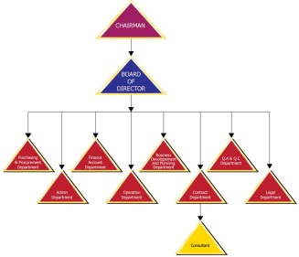




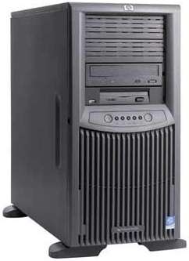



A bespoke metamodel (used with many clients)
Organisation
Products
Product Aliases
Business Services
Applications
Application Components
Infrastructure
Information
IS Services
Location

Slide 18

Looking for Application Duplication
Organisation
Products
Product Aliases
Business Services
Applications
Application Components
Infrastructure
Information
Location
Application Services

Slide 19
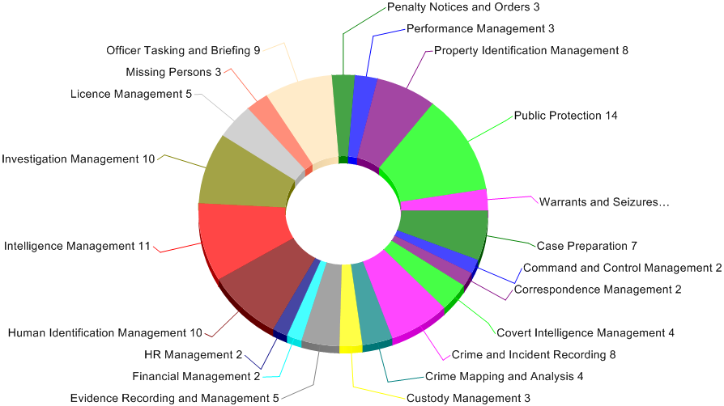
Visualising the Extent of Application Duplication
Application Services
Benefit to client: reduce application cost

Slide 20
Looking for Information Duplication
Organisation
Products
Product Aliases
Business Services
Applications
Application Components
Infrastructure
Information
IS Services
Location

Slide 21
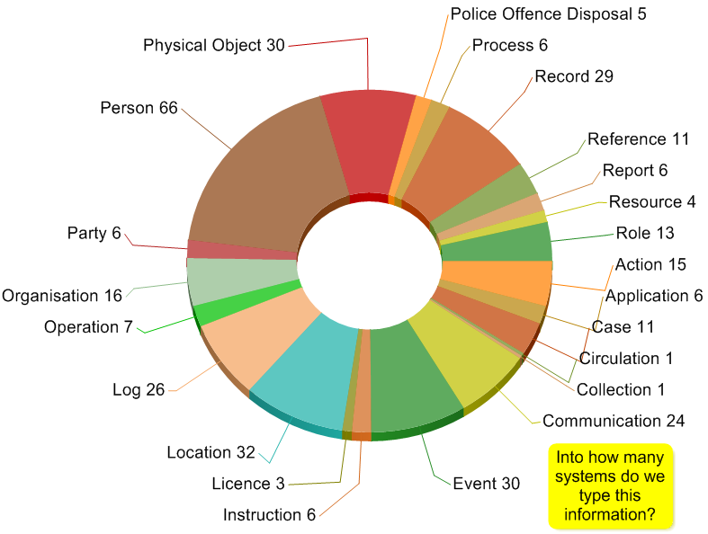
Visualising the Extent of Information Duplication (1)
Information
Benefit to client: reduce rekeying, increase quality

Slide 22
A bespoke metamodel (used with many clients)
Organisation
Products
Product Aliases
Business Services
Applications
Application Components
Infrastructure
Information
IS Services
Location

Slide 23
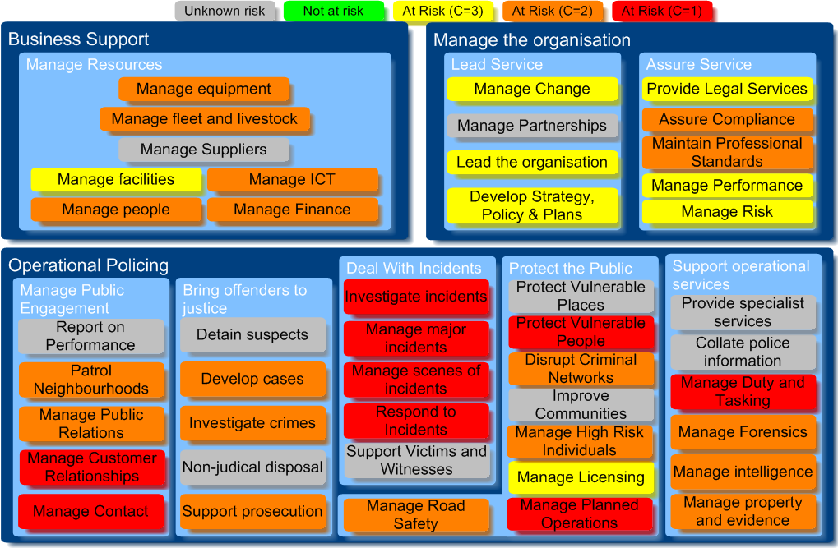
Visualising Business Risk from Obsolete Technology
Business Services
C. Spence and V. Michell: Assessing the Business Risk of Technology Obsolescence through Enterprise Modelling, Symposium on Business Modeling and Software Design, SciTePress (2011).

Slide 24
One-off vs. Sustainable EA modelling
EA can be used as a targeted offer to develop consulting business
To use long-term requires embedding in change processes

Slide 25
In closing
This week
  Mixture of practical and theoretical aspects of EA modelling
Next week:
  Academic research into EA modelling
  Focus in particular on ArchiMate
  Consulting careers

Slide 26
For more information
Cameron.spence@reading.ac.uk
Cameron.spence@thameswater.co.uk

Slide 27
Spare Slides

Slide 28
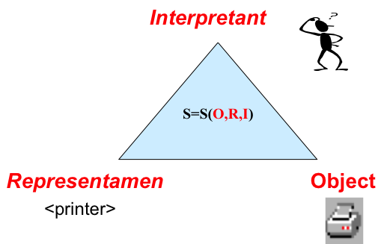
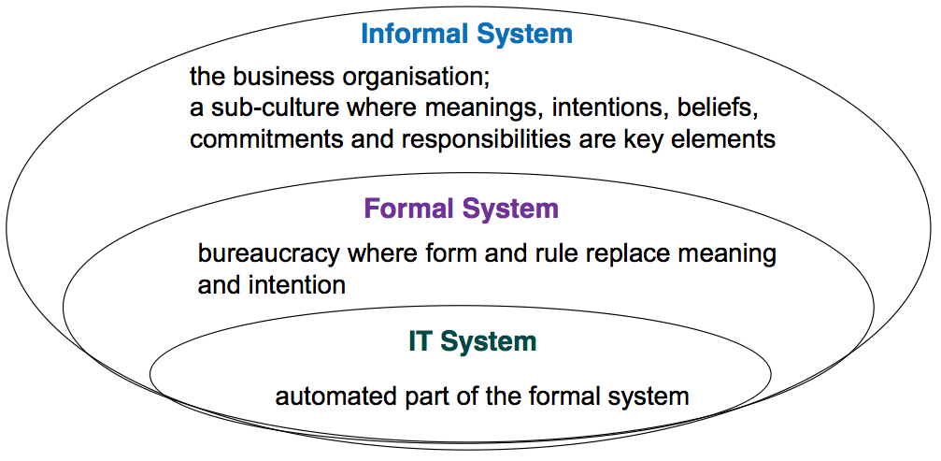
Architecture Analysis – Entity Metamodels
Metamodel – a model describing what goes in models
Entity metamodel – a model showing the different types of entities that are available for use in artefacts (lists, matrices, diagrams)
Every framework will have an entity metamodel that describes what it calls “stuff”

Slide 29
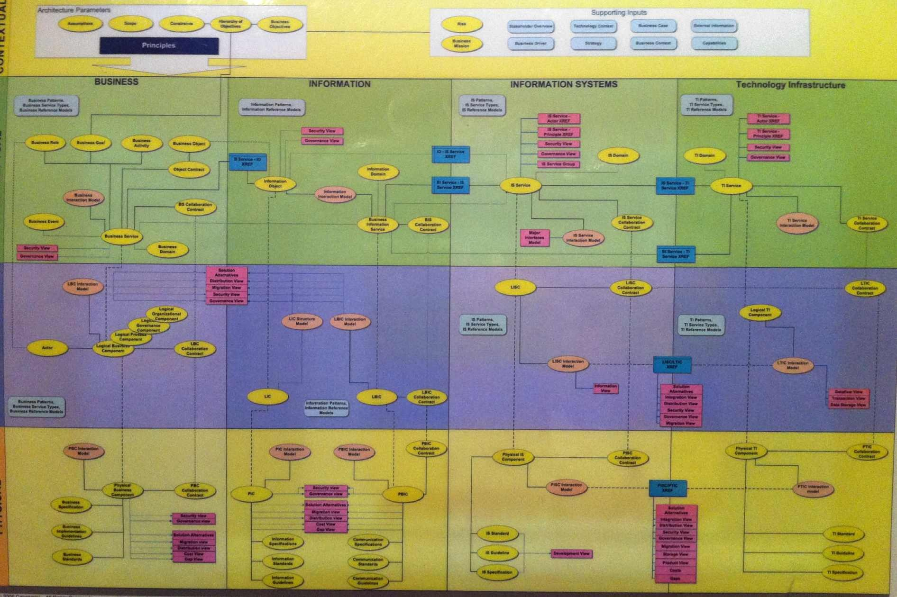
Entity (Content) Metamodel - IAF

Slide 30
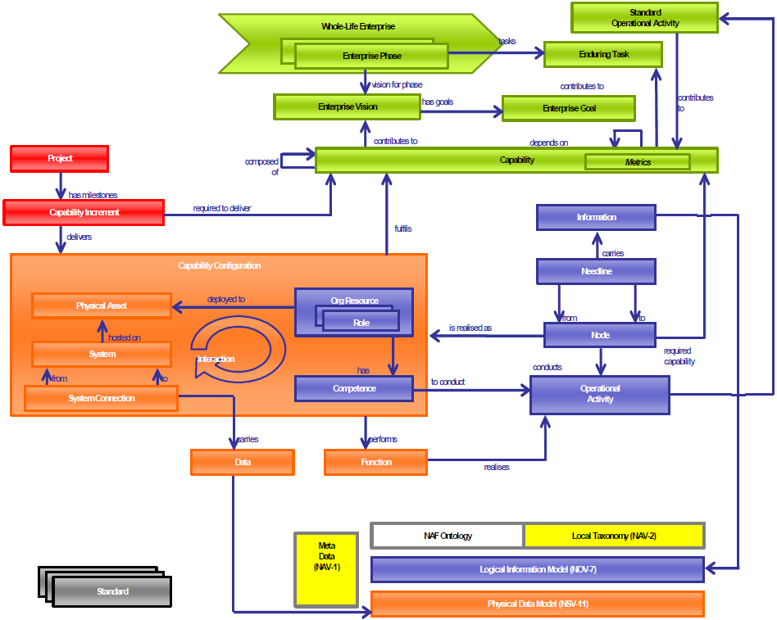
Entity (Content) Metamodel - NAF

Slide 31
Entity (Content) Metamodel - Archimate

Slide 32
Entity (Content) Metamodel - BTC

Slide 33

Entity (Content) Metamodel - TOGAF

Slide 34
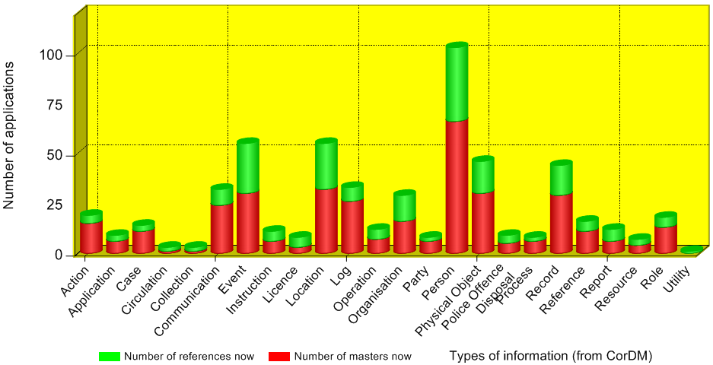
Visualising the Extent of Information Duplication (2)
Information

Slide 35
Why do the modelling?
Portfolio Management
… of Applications
… of Technologies
Risk Management
… Impact of Obsolescence
… Impact of SPOF
Cost Management
… Opportunities for consolidation
… Opportunities for reuse
Proactive not Reactive
… Professional Duty of Care?
… “They should know this stuff” …

Slide 36
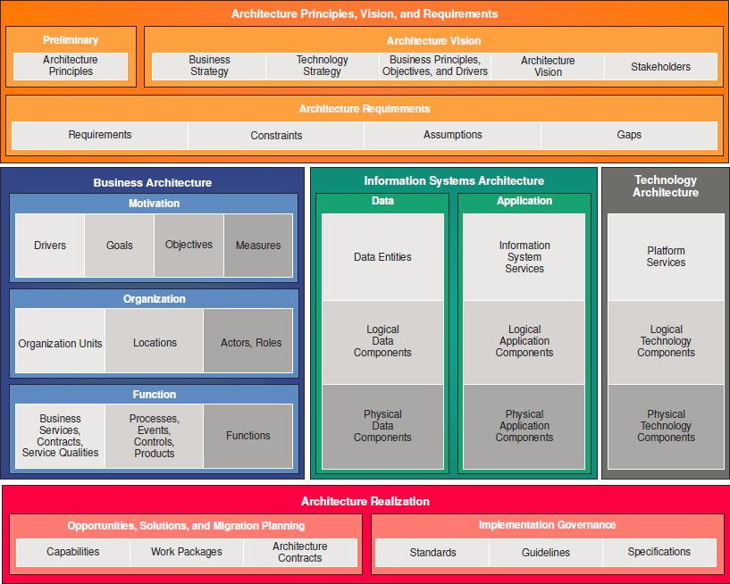
… with Office Tools…
Architecture Principles
Business Strategy
IT Strategy
Business Requirements
Stakeholder Concerns and Views
Business Motivation Models
Information Architecture
Building Blocks
Organisation Charts
Application Architecture
Business Process Models
Technology Architecture
Business Capability Models
Disconnected, duplicate, inconsistent silos of information
IT Standards

Slide 37
… with Enterprise Modelling …
Architecture Principles
Business Strategy
IT Strategy
Stakeholder Concerns and Views
Business Requirements
Business Motivation
Information Architecture
Building Blocks
Organisation Units
Application Architecture
Business Processes
Technology Architecture
Business Capabilities
IT Standards
Joined-up, consistent information
Collaboration across teams

