Slide 1
Amazon Inc.
Marketing Strategies

Slide 2
History

Slide 3
Growth and Development
Notes:
50% of Amazon revenues lie outside the U.S.
Half of all Amazon book sales are digital , creating growth where most competitors have stagnated and declined
Amazon developed game-changing technology and capabilities allowing it to do what customers wanted. Some examples are:
Kindle
Drone Delivery Service
Online films and media, etc.

Slide 4
Pillars of Amazon Marketing
Having one of the widest range of products and services
Providing user-friendly and easy to use interface
Scalability
Affiliate services and resources
Notes:
1. Offering the widest range of products. The largest internet retailer in the world by revenue offers hundreds of millions of products. The wide range of product it offers has earned the online retailer the moniker The Everything Store.
2. Using customer-friendly interface. The tech giant has an advanced interface that integrates personalized recommendations and recent browsing history, among others. Ever-improving user interface is the result of the company’s focus to become Earth’s most customer-centric company.
3. Scaling easily from small to large. The e-commerce and cloud computing company has experience and competence in scaling from small to large. This factor plays in instrumental role exploring new business segments. Scaling from small to large has allowed the online retail behemoth do disrupt increasing ranges of industries such as retail, transportation, entertainment and now industrial distribution.
4. Exploiting affiliate products and resources. Up to date, the tech giant has taken a full advantage of affiliate programs, products and resources to contribute to the bottom line of the business.

Slide 5
RACE Marketing Strategy Framework – Analyzing Amazon
Notes:
We can also learn from their digital marketing strategy, since they use digital marketing efficiently across all customer communications touchpoints in our RACE Framework:
Reach: Amazon's initial business growth based on a detailed approach to SEO and AdWords targeting millions of keywords.
Act: Creating clear and simple experiences through testing and learning.
Convert: Using personalization to make relevant recommendations and a clear checkout process that many now imitate.
Engage: Amazon's customer-centric culture delights customers and keeps them coming back for more.

Slide 6
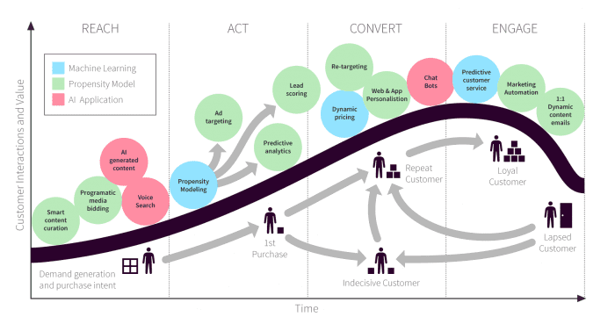
Notes:
Amazon defines what it refers to as three consumer sets customers, seller customers and developer customers.
There are over 76 million customer accounts, but just 1.3 million active seller customers in it’s marketplaces and Amazon is seeking to increase this. Amazon is unusual for a retailer in that it identifies “developer customers” who use its Amazon Web Services, which provides access to technology infrastructure such as hosting that developers can use to develop their own web services.
Members are also encouraged to join a loyalty program, Amazon Prime, a fee-based membership program in which members receive free or discounted express shipping, in the United States, the United Kingdom, Germany, and Japan.

Slide 7
Amazon Marketing Channels
Notes:
Amazon marketing channels can be grouped into two types:
Internal marketing
External marketing
The internal marketing comprises:
Amazon SEO
Amazon PPC
The external marketing comprises:
PPC advertising on Google, Facebook, YouTube, Instagram, Twitter, etc.
Forums and blogs

Slide 8
Amazon PPC Marketing
Notes:
Amazon PPC also plays a key role in organic rankings. Though Amazon keeps the functionality of the A9 algorithm a secret, we know that apart from the factors we have listed above, it also looks for these three things:
Sales velocity: Besides having a greatly optimized listing, it is also important that it generates maximum sales. The higher the sales count, the greater are the chances of ranking higher on Amazon.
Conversion rate & relevancy: If your item is receiving good sales per click, then it means that your item is relevant and Amazon does see this factor seriously. Just like other search engines, even Amazon offers the best experience to its customers. So, it ensures that it shows the right and relevant products after a keyword is typed in its search box.
Product Diversity or Variety: Amazon SERPs aren’t only about showing high-converting, relevant products but rather, offer multiple options too.

Slide 9
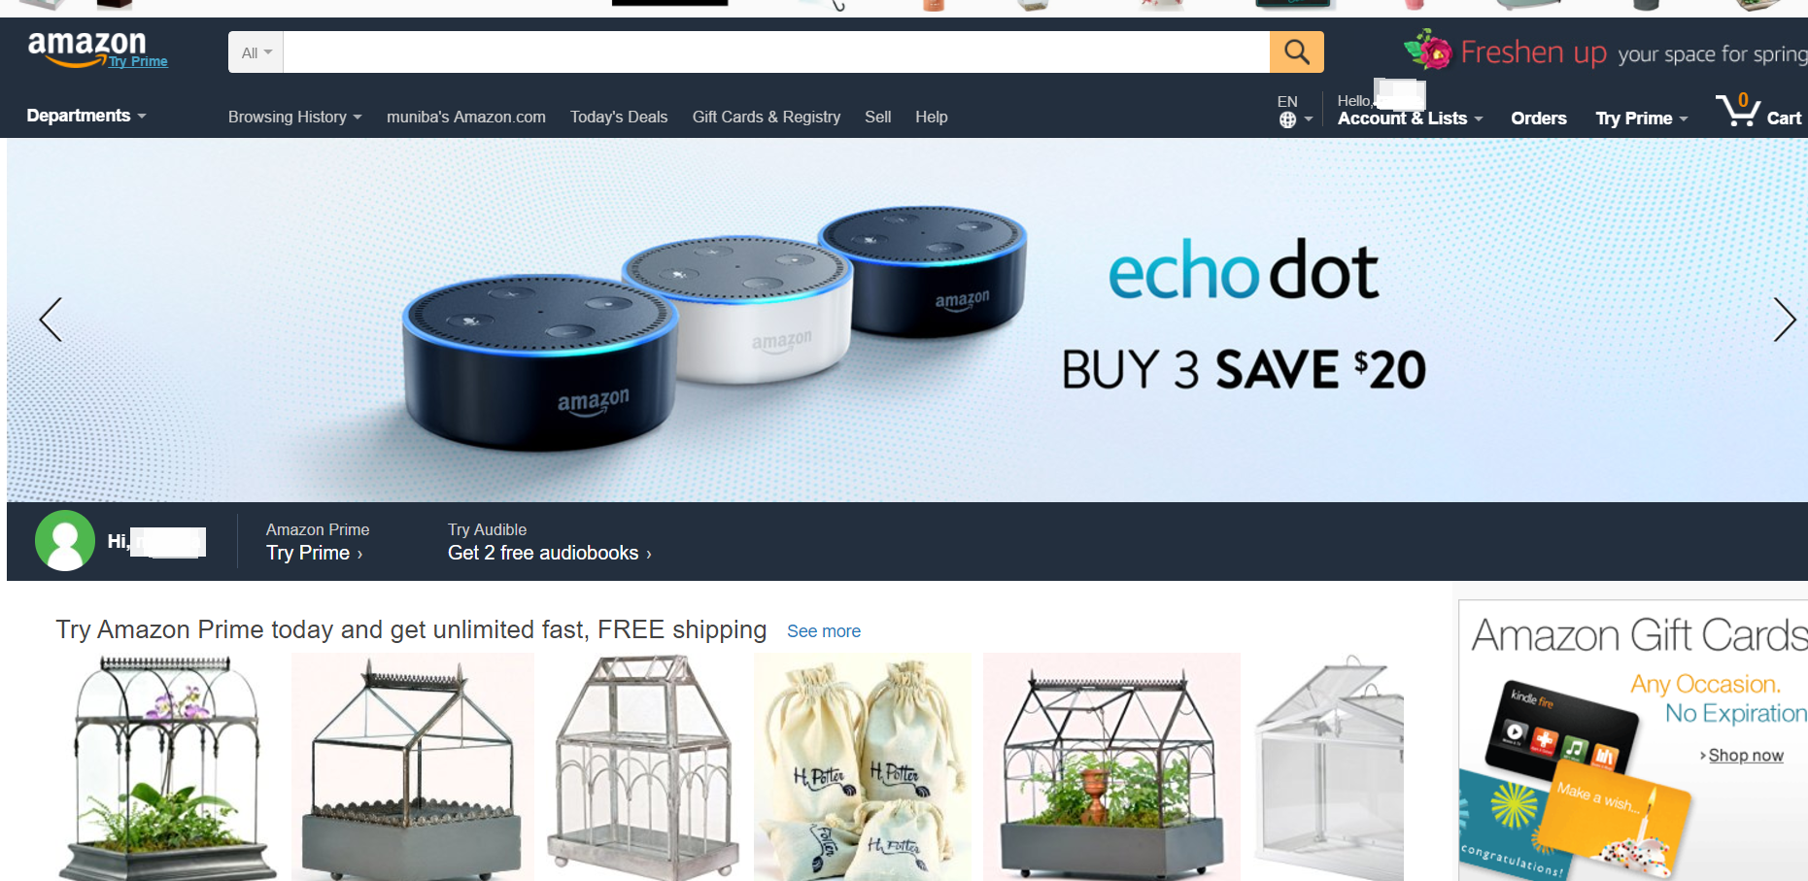
Customized User Experience
Mechanism
Use of cookies
data mining
AI based algorithms to track users patterns
Dynamic customization of the users experience based on their previous searches
Instantaneous changes
Notes:
When it comes to hyper-personalization, customer service, and customer experience, Amazon is one of the first brands that people think of. Amazon’s mission statement is “We aim to be Earth’s most customer-centric company. Our mission is to continually raise the bar of the customer experience by using the internet and technology to help consumers find, discover and buy anything, and empower businesses and content creators to maximize their success.”
Amazon has elevated customer service expectations in nearly every vertical, including apparently unrelated B2B niches, because it is in the faces (and on the doorsteps) of customers daily. From real-time inventory visibility to easy returns, the advancements it has pioneered (or at times lifted and then popularized) are incalculable.

Slide 10
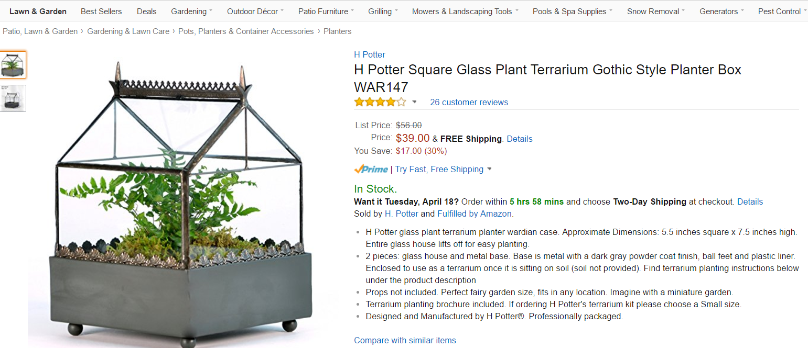
Feedback and Reviews
Large customer base
Active review community
Customer can views and analyse opinions.
Access both positive and negative reviews
Notes:
After you order from a third-party, you can leave comments, feedback, and ratings. This lets other customers know about your experience. You have 90 days from the date of your order to do this.
Your comments should focus on your buying experience and answer some of the following questions:
Were you happy with how the seller packaged and shipped your order (for products)?
Was the seller professional and was their work of good quality?
If applicable, did you get good customer service and did the seller fix your issue quickly?
Would you buy from this seller again?
What would have improved your experience?
You can rate third-party sellers from one to five stars, with five stars being the best. The seller's average rating will appear beside their name on our site. Before you leave a critical rating, make sure that you've given the seller a chance to resolve any issues you had.

Slide 11
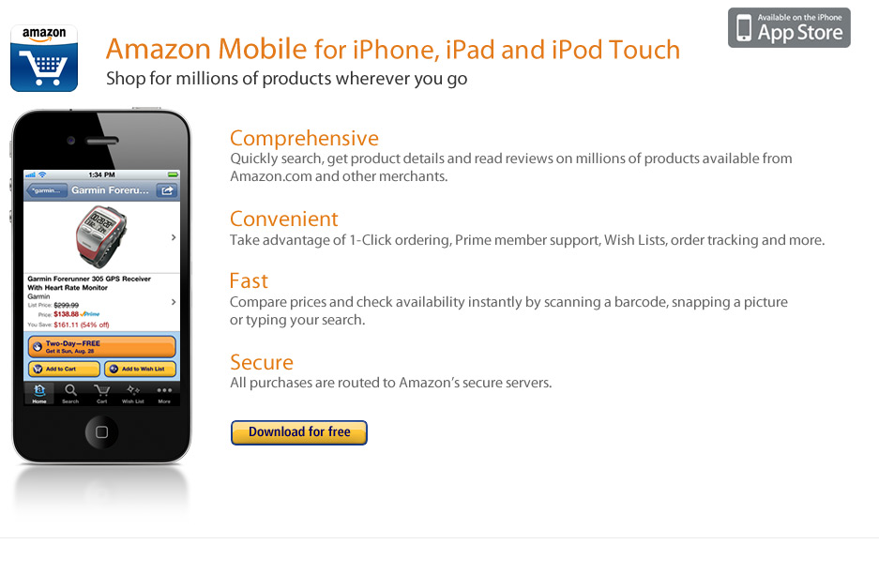
Mobile Compatibility
Apps for all smart phone operators and tablets
Fast and convenient good use of bar codes and pictures
Amazon Appstore for Android
Certain limitations and challenges have marred its efficiency.
Notes:
Amazon’s app isn’t terribly creative and for a very good reason: Alexa. While we didn’t study Alexa in-depth for the research that led to the Personalization Index, there’s no doubt that Alexa is a game-changer for Amazon. Alexa can already manage smart devices in your home, in addition to, of course, helping you shop, including in-app.
And Alexa doesn’t help you shop the way most retail mobile apps do. Alexa is becoming more of a personal shopper than a mainstream shopping app. In most shopping apps, including Amazon’s, a search for “batteries” brings up every battery that retailer sells. That is not how Alexa works. When Alexa is asked to find batteries, it will only find Amazon-brand batteries. It will only help you buy Amazon-brand batteries. We expect Amazon to launch a standalone Alexa app in the near future.

Slide 12
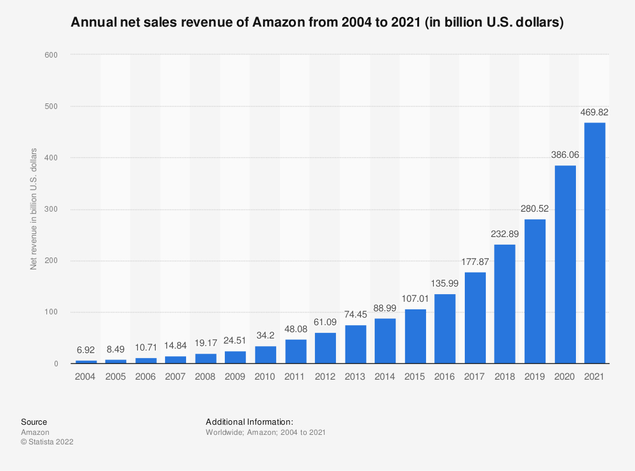
Financial Performance
Notes:
Covid-19 may have knocked the sales and profits of many businesses, but Amazon was a standout pandemic winner, notching up millions of new recruits who turned to online streaming and shopping while shielding at home.
With the pandemic shifting sales online and consumers flush with stimulus checks, Amazon on Thursday reported $108.5 billion in sales in the first three months of the year, up 44 percent from a year earlier. It also posted $8.1 billion in profit, an increase of 220 percent from the same period last year.
The first-quarter results surpassed Wall Street’s expectations. Shares were up as much as 5 percent in aftermarket trading.
The most profitable parts of Amazon’s retail business boomed. Revenue from merchants listing items on its website and using its warehouses was up 64 percent, to $23.7 billion. Its “other” business segment, which is largely its lucrative advertising business, increased 77 percent, to almost $7 billion.
Amazon previously disclosed that 200 million people pay for Prime memberships, and subscription revenue for that service and others reached almost $7.6 billion in the quarter. In addition to paying Amazon $119 a year or $12.99 a month for free shipping and other perks, households with Prime memberships typically spend $3,000 a year on Amazon, more than twice what households without the membership spend.

Slide 13
Other Benefits of Amazon
High class and quality promotion for the products
Extensive and global customer base
Focuses on User needs, requirements, trends and patterns
Brought digital book system
Notes:
Amazon has been one of the largest and most extensive online stores and retailers that have been ahead of all their competitors in introducing and efficiently implementing innovative and highly secure business solutions and services online. Amazon has been the very first online company that successfully implemented and integrated the cloud computing services and solutions within their online business infrastructure, giving a new dimension and enhancement to the field of e-commerce.
Amazon was further followed by Google, eBay and Netflix. These companies also introduced specific cloud services that revolutionized the e-commerce domain. However, it was amazon that was the trend setter in this domain and is still keenly introducing innovative and highly efficient services that have created new trends for e-commerce infrastructure and trends.
Amazon is an e-commerce company that has been serving its clients since 1995. Now it has followers, buyers and consumers all over the world. And their services are no more limited to selling products. Now they also offer business solutions and platforms for small and medium business through their revolutionary services i.e. AWS and EC2 that have been introduced recently. AWS is specifically focused on providing specific APIs that can be used for the provision of mechanical Turk services. It also offers Saleable DNS services through Amazon Route 53.

Slide 14
Conclusion
Global Approach
Greater customer base with diverse product inventory
Efficient logistic services
Affordable prices
Reliable and innovative
Notes:
Amazon is known as the pioneer in Online sales and marketing as well as in providing the virtual business platforms by harvesting the power of cloud computing. Amazon has carefully set its standards so high that they are referenced as market standards for other competitors in the same domain. Amazon is majorly compared to Craigslist and e-bay when it comes to e-commerce technology and strategies, other than that it is also being compared to internet giants such as Google, Microsoft Azure, etc.
Amazon has one of the most comprehensive and easy to understand layout for the website as compared to E-Bay and Craigslist. Amazon’s main page gives an exact idea to the visitor about the nature of services being offered, what can be expected out from the website and variety of services that can be used through Amazon’s platforms. Parts of main page are dedicated to different aspects of overall objectives of amazon. For instance, the first page shows a gadget for most favorite sales, new products, Amazon Kindle, and a suggestion gadget for your possible interested products. This is done by parsing our search histories over interne. Amazon has excelled in this technology along with Google. Amazon deploys a fully featured e-commerce business management system with inventory management, customer management, and information management tools. Other than that Amazon also offers a detailed and very intelligent bot to keep track of what consumer was looking and viewing on the website as well as on rest of the internet. The suggestions of products are immediately presented based on this data that helps in enhancing sale opportunities for the Amazon.

Slide 15
References
Lammenett, E. (2021). Amazon-Marketing. In Praxiswissen Online-Marketing (pp. 297-332). Springer Gabler, Wiesbaden.
Alolama, Y. (2020). Recommender Systems and Amazon Marketing Bias.
Ayci, A., & Tyagi, S. (2022). The Role of Big Data Analysis and Machine Learning in Marketing Communications: A Case Study of Amazon. In Machine Learning for Societal Improvement, Modernization, and Progress (pp. 225-247). IGI Global.
Ghosal, I. (2018). Consumer Buying Behavior on E-Marketing and its Operations: A case study on Amazon, India. International Journal on Recent Trends in Business and Tourism (IJRTBT), 2(3), 26-32.

